Slide 1
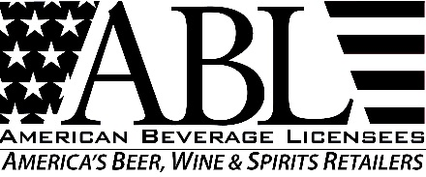
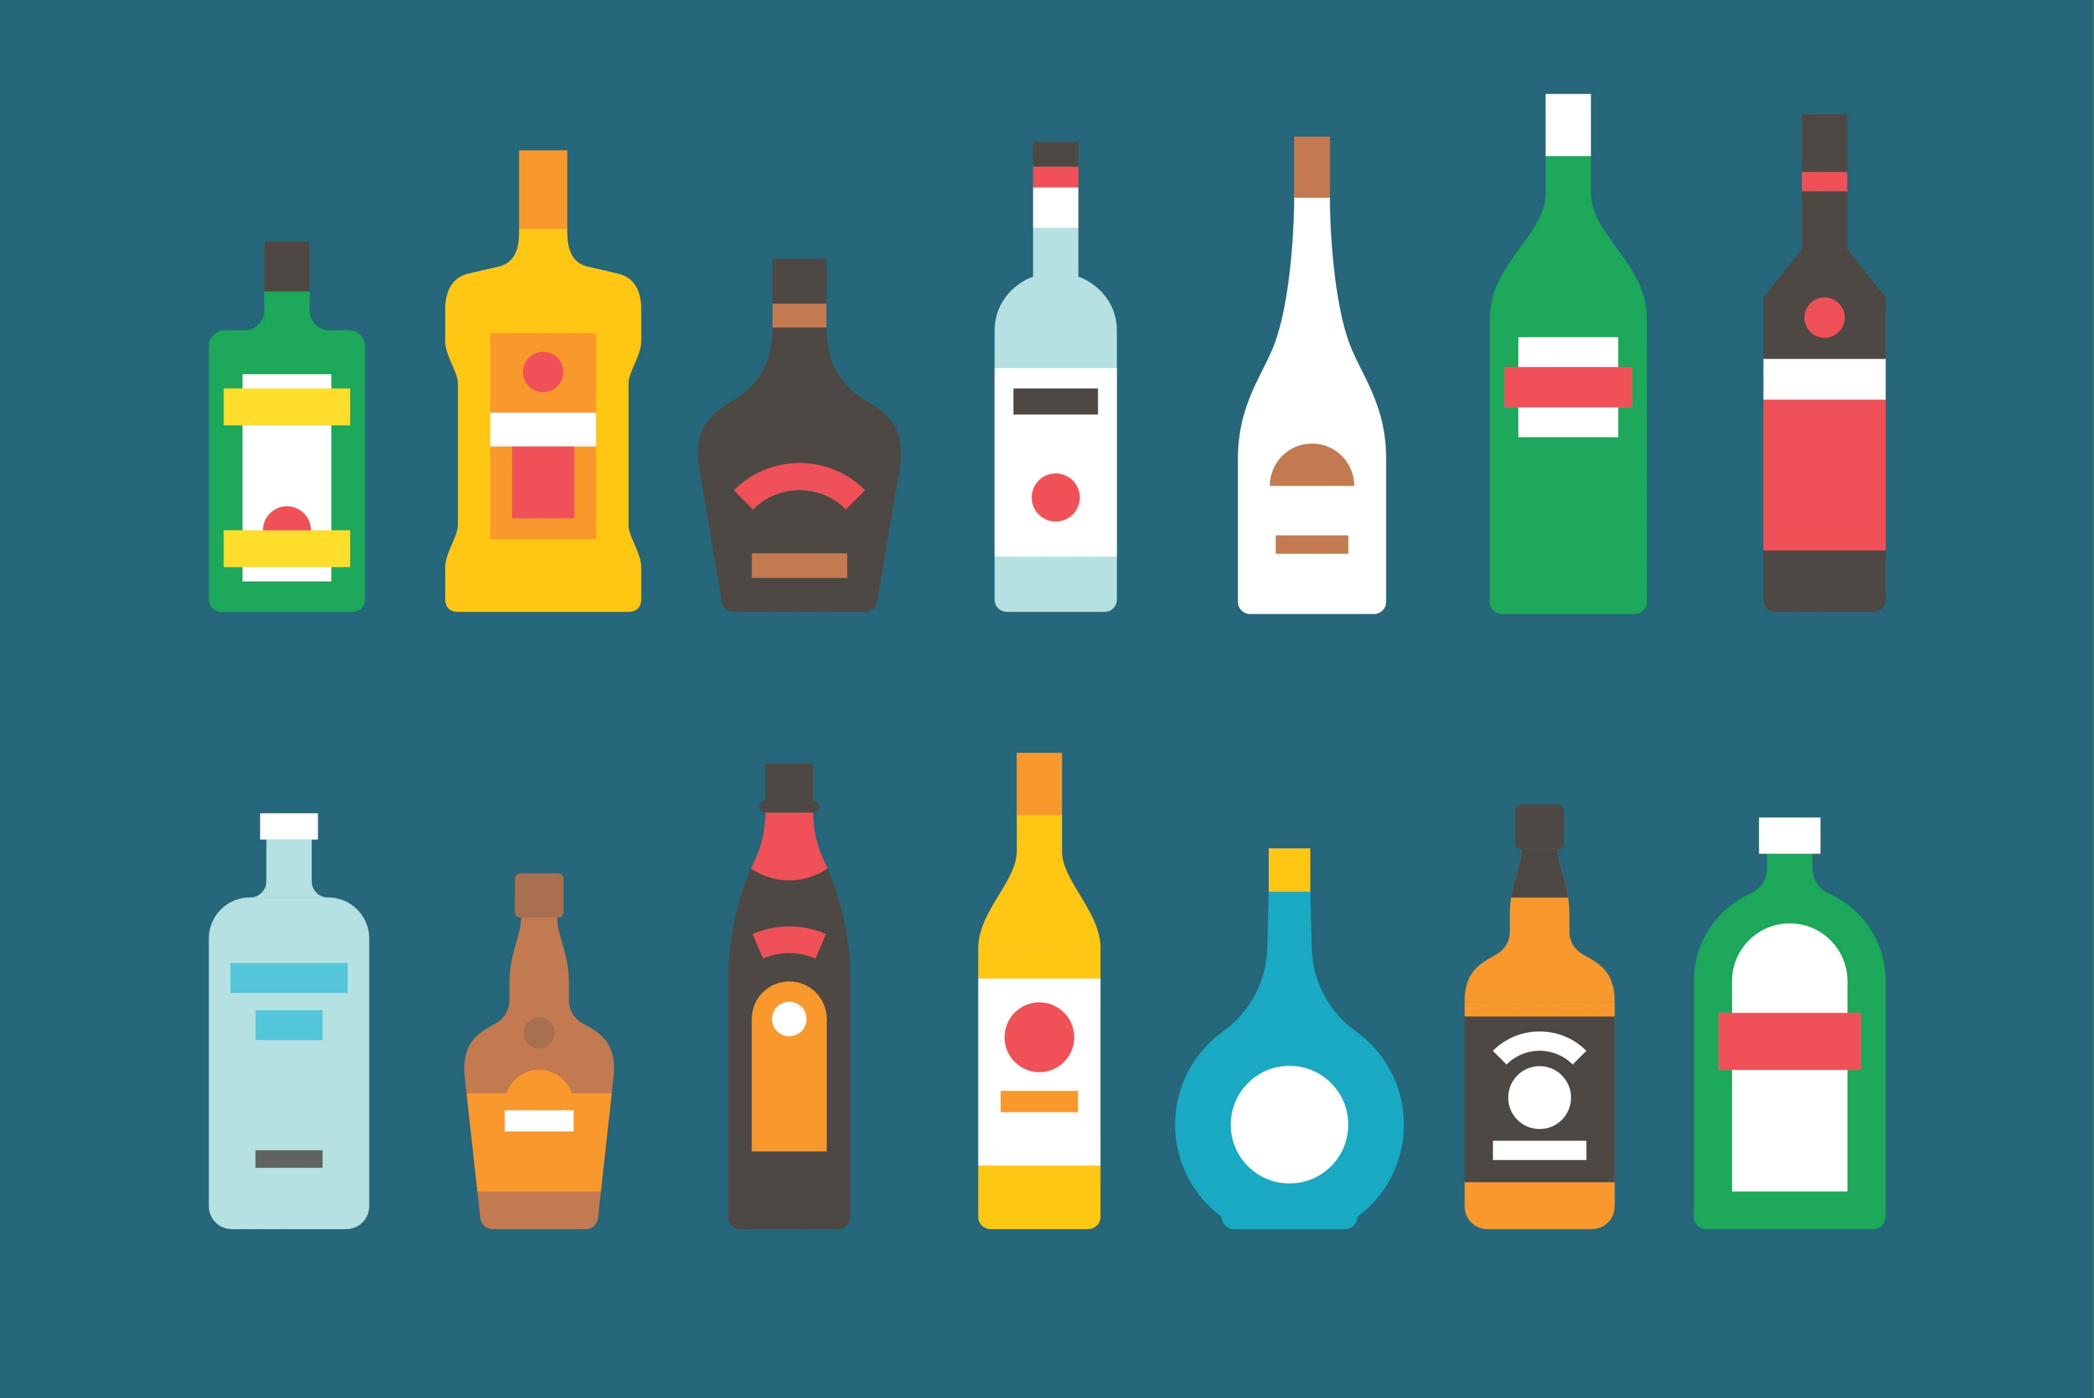
Regulation of
the Alcohol Marketplace
Wisconsin Legislative Council
Study Committee on Alcohol Beverages Enforcement
July 25, 2018 | Madison, WI

Slide 2
Regulation of the Alcohol Marketplace What We’ll Cover
Where I’m Coming From
Regulation: How Did We Get Here?
Regulation: What’s Normal?
Regulation: Getting Easier? Less Important?
Constructive Commentary
Honest Abe!

Slide 3
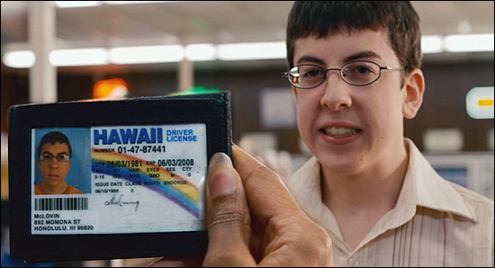
Independent Beverage Retailers Providing Choice, Service & Accountability
Independent business people; Often multi-generational and family-owned; active in communities
Beverage licensees check more IDs than most law enforcement officers; are also under scrutiny by state and local enforcement agencies
Some of the last stores on American “Main Streets”; provide unparalleled choice to consumers
As brick-and-mortar retailers, pay sales and property taxes; assume liabilities of physical presence
Independent beverage licensees help form the most diverse and innovative beverage alcohol marketplace in the world

Slide 4
Economic Impact of Beverage Retailers ~2/3 of U.S. Adults Enjoy Beverage Alcohol…
…which means that America’s independent and local bars, taverns and package stores play a large role in that enjoyment.
ECONOMIC IMPACT
In the United States, the direct retail sales of the beverage alcohol industry are responsible for $762 billion in total economic activity.
JOBS
Establishments that sell alcohol employ as many as 5.65 million people in the United States, and generate an additional 2.61 million jobs in supplier and ancillary industries.
WAGES
Businesses selling alcohol in the United States, along with their supplier and ancillary industries, pay $281 billion in wages and benefits each year. This amounts to an average of $34,000 in wages and benefits.
TAXES
In the United States, the industry and its employees pay over $43 billion in state taxes, and an additional $64 billion in federal taxes.
Source: John Dunham & Associates. 2016 Economic Impact Study of America’s Beer, Wine and Spirits Retailers. New York, July 2016

Slide 5
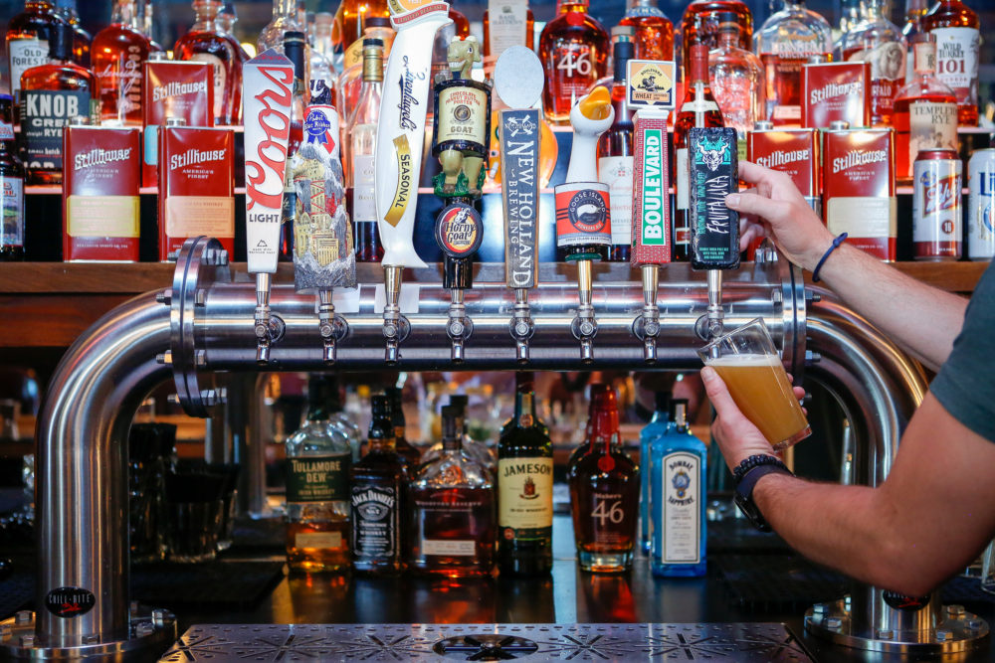
Economic Impact of Beverage Retailers …in WISCONSIN
ECONOMIC IMPACT
The direct retail sales of the beverage alcohol industry are responsible for $7.92 billion in total economic activity.
JOBS
Establishments that sell alcohol employ as many as
59,575 people, and generate an additional 14,815 jobs in supplier and ancillary industries.
WAGES
Businesses selling alcohol, along with their supplier and ancillary industries, pay $2.69 billion in wages and benefits each year.
TAXES
The industry and its employees pay over $446 million in state and local taxes, and an additional $593 million in federal taxes.
Source: John Dunham & Associates. 2016 Economic Impact Study of America’s Beer, Wine and Spirits Retailers. New York, July 2016

Slide 6
Public Opinion Are Americans Happy with the System & Variety of Options?
Availability
90% of adults agree that it is easy to find a wide variety of beer, wine and liquor in their community.
79% agree that there are more local and craft beers and liquor available in their community today than ever before.
Three-Tier System
89% of adults agree that it is very important to keep the American alcohol industry regulated.
81% of Americans are in support of the existing system for purchasing alcohol in their state and support the state’s ability to regulate alcohol.
Public Safety
Americans agree the following health and safety issues are the top priority: reducing drunk driving (77%), protecting health and safety (70%) and reducing underage drinking (62%), over economic issues such as allowing more businesses to sell alcohol (19%).
80% agree that getting rid of alcohol rules, regulations and safeguards could make the problem worse as parents, police officers and retailers already have a difficult challenge keeping alcohol out of the hands of minors.
Source: Public Opinion Strategies. Americans’ Views of Alcohol Regulations: Center for Alcohol Policy 2017 National Survey. July, 2017

Slide 7
Alcohol Regulation in America How Is Alcohol Regulated in the United States?
1933 – Prohibition Ends with 21st Amendment
21st Amendment does two things:
Section 1. The eighteenth article of amendment to the Constitution of the United States is hereby repealed.
Section 2. The transportation or importation into any State, Territory, or possession of the United States for delivery or use therein of intoxicating liquors, in violation of the laws thereof, is hereby prohibited.
States adopt three tier systems (supplier, wholesaler, retailer) to avoid problems (tied-house, etc.) that led to Prohibition
50 different state alcohol regulatory bodies in the United States, tailored to their populaces; can address issues with local understanding
Q. What has the Three Tier System created?
A. The most vibrant and diverse alcohol marketplace in world history.

Slide 8
Alcohol Regulation in America Open States & Control States
Washington
Washington
Montana
Vermont
Maine
North Dakota
Oregon
Minnesota
Idaho
New Hampshire
South Dakota
Wisconsin
New York
Massachusetts
Wyoming
Michigan
Rhode Island
Connecticut
Iowa
Pennsylvania
New Jersey
Nevada
Nebraska
Ohio
Utah
Illinois
Indiana
Delaware
Colorado
West
Maryland
California
Virginia
Virginia
Kansas
Missouri
Kentucky
North
Tennessee
Carolina
Arizona
New Mexico
Oklahoma
Arkansas
South
Carolina
Open States
MS
Alabama
Georgia
(Alaska; Hawaii)
Texas
Louisiana
Control States
Florida

Slide 9
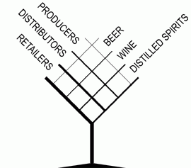
Three-Tier System What Is the Three-Tier System?
Regulatory framework involving a system for the sale of beverage alcohol products (beer, wine and spirits).
System is made up of three “tiers”: producers, wholesalers, and retailers – each of which is licensed at the state and/or federal level.
Each tier is typically required to be wholly separate and independent from the other tiers within the industry to prevent anti-consumer ills associated with pre-Prohibition “tied houses”.
All states abide by the same basic tenets of the three-tier system – though each state has adopted its own unique structure for regulating beverage alcohol commerce.

Slide 10
Three-Tier System Five Common Characteristics Among State Systems
Efficiently collecting taxes
State and local tax collection is straightforward and easy to track through a clear chain of custody
Preventing the sale of alcohol to minors
Sales are made to of-age consumers by licensed retailers under threat of loss of their license and their business for non-compliance
Fostering and overseeing responsible competition in a regulated environment and marketplace
Builds and expand brands through merchandising, product promotion, marketing plans that are available to all licensees
Ensuring product safety
Product accountability through tracking products from manufacturer to retailer provides a transparent and traceable chain of custody
Preventing the sale of tainted or counterfeit products
System participants use leading quality control mechanisms, significantly decreasing instances of tainted or counterfeit alcohol products appearing in the marketplace

Slide 11
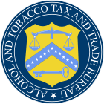
Federal Alcohol Regulation Is There a Dedicated Federal Alcohol Enforcement Agency?
YES.
The Alcohol and Tobacco Tax and Trade Bureau (TTB)
Created in 2003 with the split the Bureau of Alcohol, Tobacco and Firearms:
ATF - investigation and prevention of federal offenses involving the unlawful use, manufacture, and possession of firearms and explosives; acts of arson and bombings; and illegal trafficking of alcohol and tobacco products (Dept. of Justice)
TTB – tax collection, regulation of legitimate trade e.g. label and formula approval; trade practice investigations & enforcement (Dept. of Treasury)
TTB enforces the provisions of the Federal Alcohol Administration Act (FAA Act). Certain alcohol businesses must file an application with and receive approval from TTB before engaging in business.
The TTB does NOT issue a license to sell beverage alcohol products at retail. Interested parties must contact their State or local licensing authority to obtain a retail license.

Slide 12
State Alcohol Regulation Do Most States Have Dedicated Alcohol Laws Enforcement Agencies?
YES.
Almost all states have some type of dedicated alcohol agency that focuses on alcohol laws, licensing, tax collection and enforcement.
WHY? Public safety; revenue; orderly marketplace; fair competition; education
Different ≠ Dissimilar
States vary in many ways when it comes to how they regulate alcohol commerce, and they all have different alcohol laws and regulations, but there are common themes and threads that are worth examining.
EXAMPLE: State alcohol control agency structures
Illinois Licensing Legal Investigations Education
Michigan Licensing Exec. Services Enforcement Financial Mgt
Massachusetts Licensing Legal Investigation Administration

Slide 13
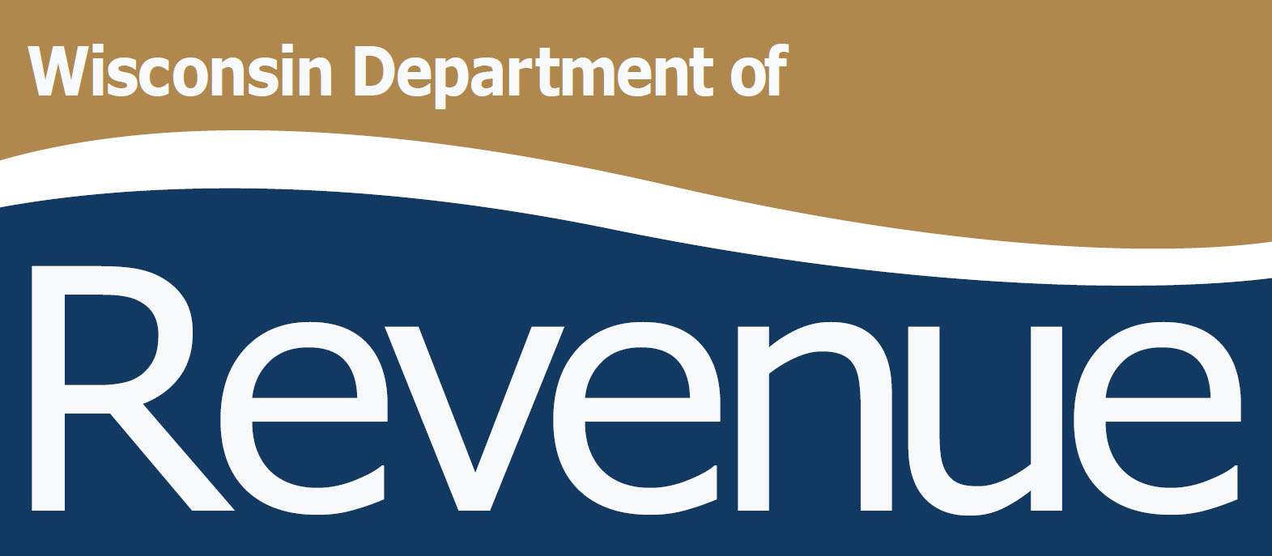
State Alcohol Regulation Which State Govt. Departments Are Alcohol Control Agencies?
Department-Level Examples from States
Department of Alcoholic Beverage Control
Department of Business Regulation
Department of Commerce
Department of Consumer Protection
Department of Finance & Administration
Department of Law & Public Safety
Department of Liquor Licenses & Control
Department of Public Safety
Department of Revenue
Department of State Regulation & Licensing
Department of Taxation
Office of the Treasurer; Office of the Comptroller
Directly appointed Commission; Authority

Slide 14
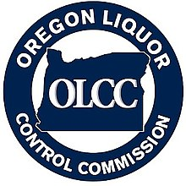
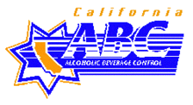
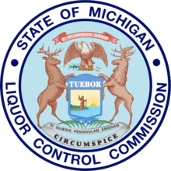
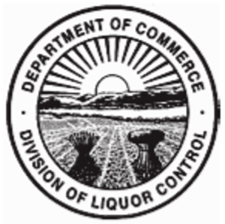
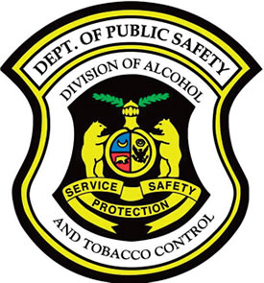
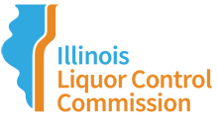
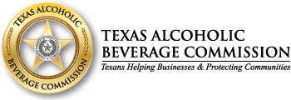
State Alcohol Regulation What Are Alcohol Control Agencies Called?
Division-Level Examples from States
Alcohol & Gaming Division
Alcohol & Gambling Enforcement
Alcohol & Marijuana Control Division (AK)
Alcohol & Tobacco Control Division
Alcohol Beverage Control Board
Alcohol Beverage Licensing Section
Alcoholic Beverage Commission
Alcoholic Beverages Control Commission
Division of Alcoholic Beverages & Tobacco
Division of Alcoholic Beverage Control
Division of Liquor Control
Liquor Control Administration
Liquor Control Commission
Office of Alcohol & Tobacco Control
State Liquor and Cannabis Board (WA)

Slide 15
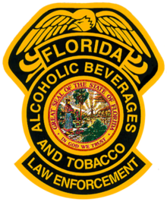
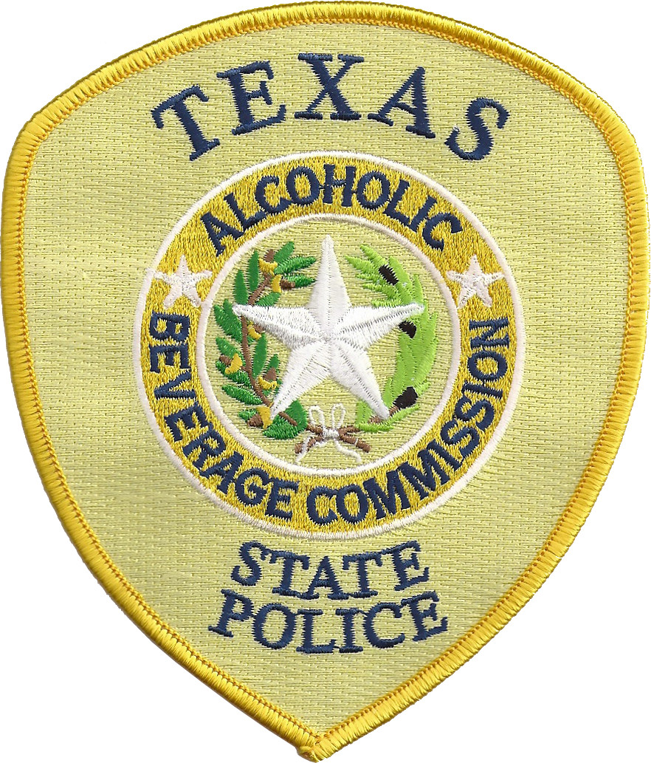
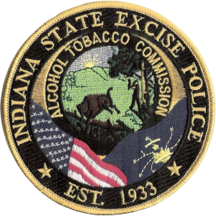
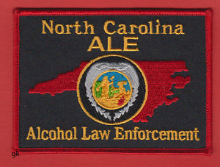
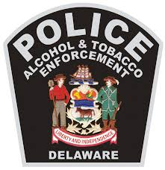
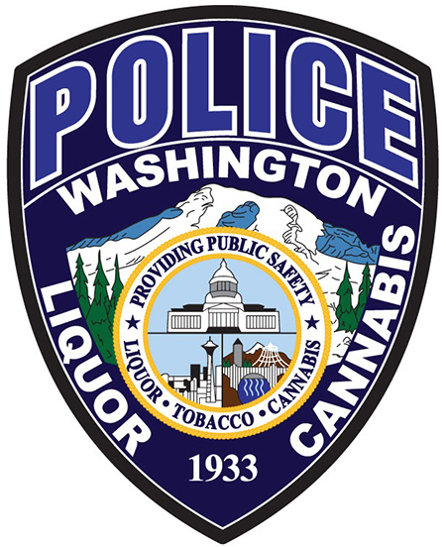
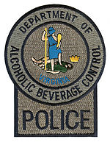
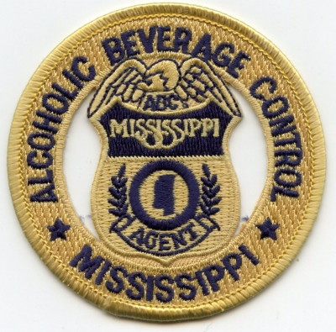
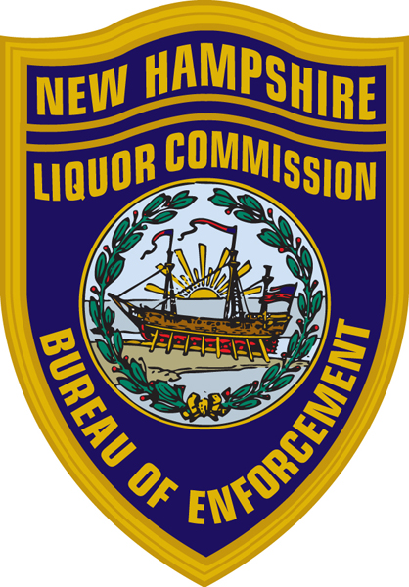
State Alcohol Regulation Examples of States with Dedicated Alcohol Law Enforcement
Law Enforcement Examples from States
Indiana State Excise Police – Law enforcement division of the Alcohol & Tobacco Commission (ATC). State excise police officers are empowered by statute to enforce the laws and rules of the ATC as well as the laws of the State of Indiana
North Carolina Alcohol Law Enforcement (ALE) - A branch under the State Bureau of Investigation. ALE is the lead enforcement agency for the state's alcoholic beverage control laws.
Virginia ABC Bureau of Law Enforcement – Agents enforce the alcoholic beverage laws and have full police powers with a diverse range of duties including investigating license applicants; conducting underage sale compliance checks; and enforcing ABC laws in nearly 19,000 licensed establishments.

Slide 16
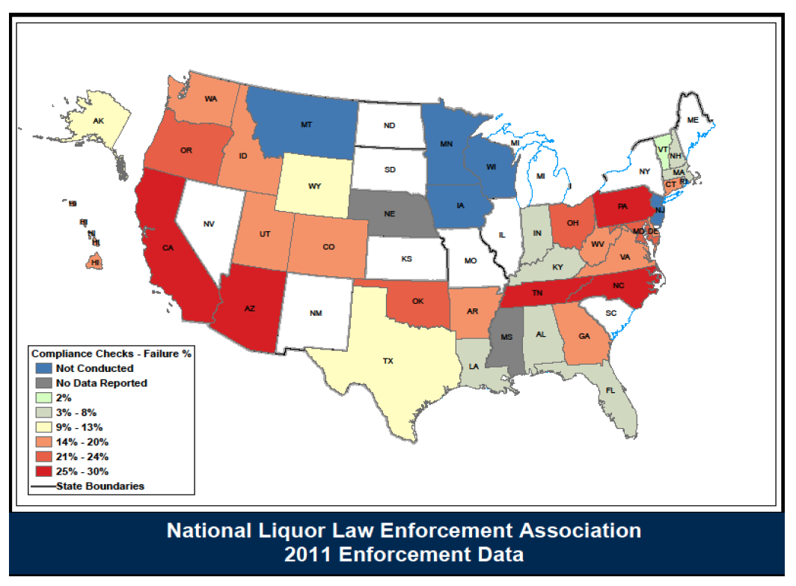
Snapshot on Enforcement Compliance Checks Enforced in the United States

Slide 17
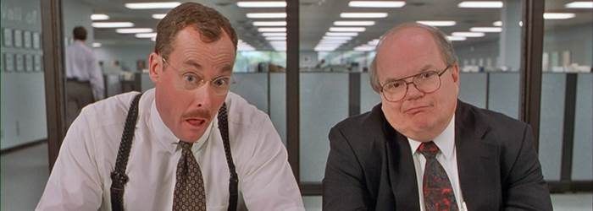
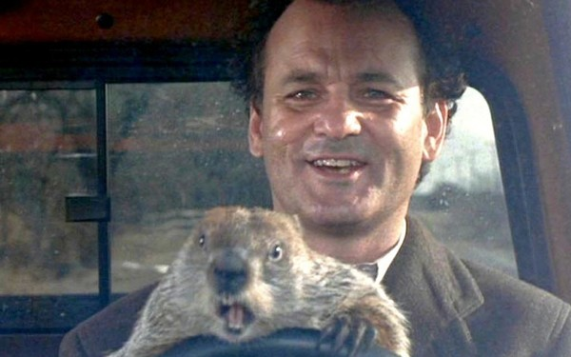
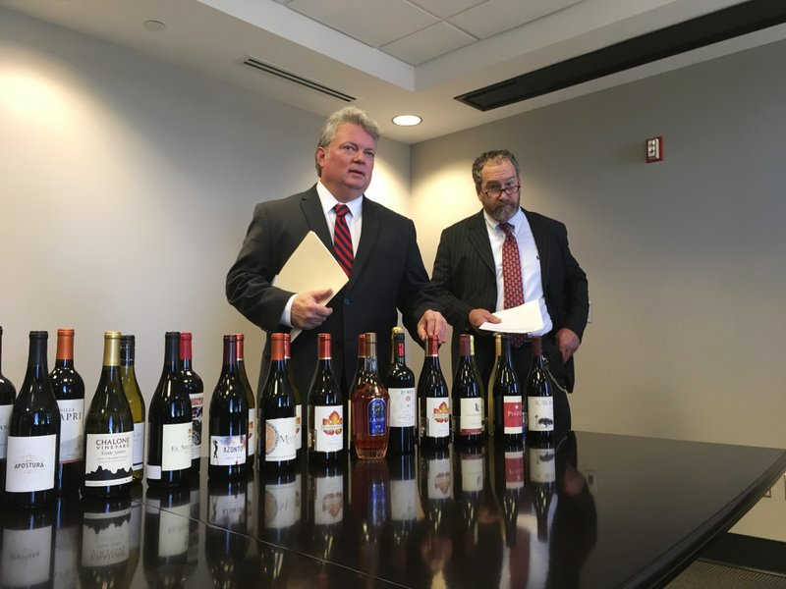
State Challenges & Opportunities… …But Mostly Challenges
Legislative Churn
2018: 6,066 of the nation’s 7,383 legislative seats are up for regularly scheduled elections (Source: NCSL)
“What would say…you do here?” Bob Slydell, Office Space
Groundhog Day
New year, same issues
(Costly) Lawsuits
Courtrooms – not legislature – now preferred venue to change laws
Enforcing the Law
Mississippi AG Jim Hood: “We’re losing millions of dollars a year (in tax revenue) because so many companies are shipping alcohol into the state.” (Revenue loss: ~$6 lost on every $25 bottle of wine.)
"The place to fix that law is to walk across the street over here at the legislature. It's our duty to enforce it.”
"I know it's been phrased as a 'crack down' or a taking away of privileges, but actually what it really is, is focusing on enforcing the statutes in the various states the way the regulators want them enforced." - Steve Gross, VP of State Relations, Wine Institute

Slide 18
Market Facts Pertinent Realities for Alcohol Marketplace Regulation
There are more ways for consumers to purchase alcohol than ever before.
The number of places that sell alcohol beverages in the U.S. grew by over 100,000 between 2007-2017. (Source: Nielsen)
There are more beverage alcohol products than ever before.
The Alcohol & Tobacco Tax &Trade Bureau (TTB) received over 170,000 label submissions in 2017.
By volume, overall beverage alcohol consumption was -0.2% in 2017.
Wine: +1%; Spirits: +2.2%; Beer: -1.1% (“Craft” Beer: +5.0%; Import Beer: +3.2%) (Source: IWSR)
The three tier system allows small, medium and large businesses to compete; grow.
12,734 wineries; 9,175 breweries; 3,094 distilleries (25k+ wholesalers; 12k+ importers; 600K+ retailers) (Source: TTB)
Alcohol is a secondary enhancement to new market entrants’ primary business interests.
Getting into alcohol retail: Dunkin’ Donuts; Dollar Stores; Taco Bell; Amazon; Walgreens; your local zoo
Some industry business models ultimately rely on changing regulatory/licensing systems.
About 97% of U.S. breweries produce <15,000 barrels a year; sell an ~31% of their beer onsite. (Source: Brewers Association)

Slide 19
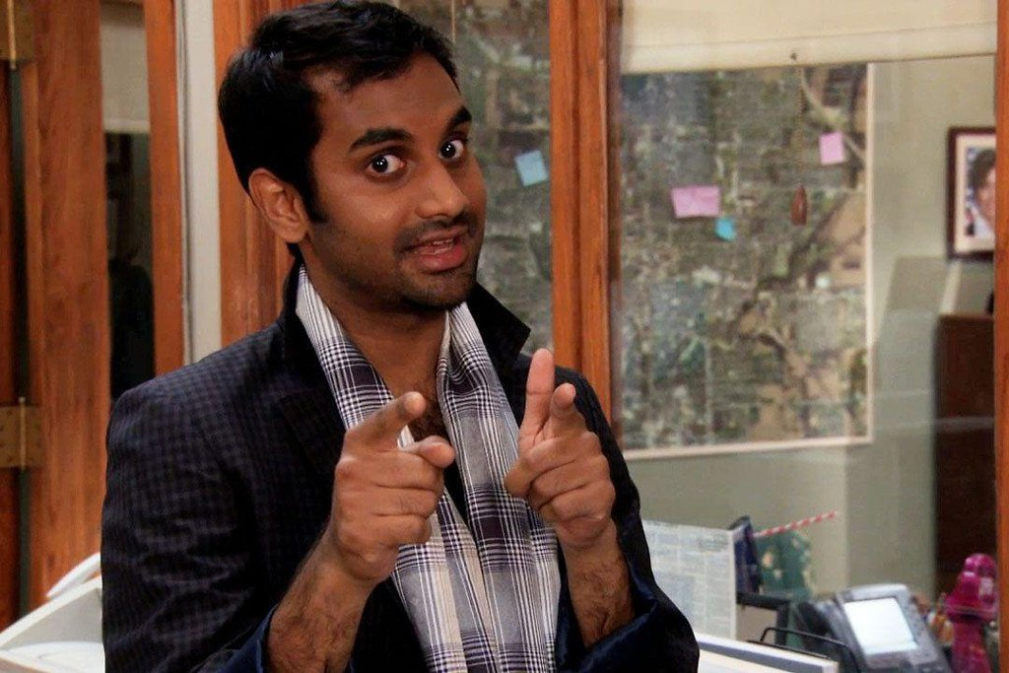
Disruption Doesn’t Discriminate Similar Forces Are Shaping ALL Retail
Disruption as cliché…ask Tom Haverford
eCommerce & Direct-to-Consumer sales
Non-Traditional Venues (Barns?)
Amazon v. Wal-Mart
Anti-regulatory/govt. sentiment
REMEMBER: All of this is happening while overall U.S. alcohol consumption remains relatively flat. (2.5 gal/65%)
“Yogurt Platinum” – gourmet alcoholic yogurt
“Snail Mail” – escargot delivery service
“Rent-a-Swag” – high-end clothing rental
“Saltweens” – Saltines for tweens
“Sparkle Suds” – laundry detergent with glitter

Slide 20
Regulation & Enforcement It’s Only Going to Get More Complicated
More licensees, No additional resources
States face decreasing budgets and decreasing workforces but greater demands to enforce trade practice issues and more complex entities and licensure.
Blurred Lines
The blurring of three-tier lines will make for more complex alcohol commerce and regulation; More suppliers seeking more control over wholesale and retail.
Growth of eCommerce
How will states apply Prohibition-era laws to Cyberspace? (Apps, Digital Storefronts, 3rd Party vendors)
Trade Practice Laws
Are trade practice laws adaptable/amendable to address today’s regulatory realities?
Market Participant Education
New (and existing) industry practitioners & regulators should know the laws…that’s not always the case.
Tied House & Category Management
Consolidation and mergers have created international suppliers and national distributors that prefer a CPG approach to alcohol and vertical integration.

Slide 21
Building a Bridge to Future Regulation Acknowledge Realities & Ask the Right Questions
The threshold for acceptable change continues to be lowered.
Are we willing to think the unthinkable AND still defend what works and why it works?
Effective and efficient institutions are worth defending.
How are we talking about effective, behind-the-scenes systems that make it all GO?
More than 7,000 U.S. brick-and-mortar stores closed in 2017 (2x as many as 2016).
How are business adapting to a rapidly shifting marketplace?
Despite advances in technology (or because of it?), regulation is HARDER.
What resources are being committed to calling balls and strikes?
90% of adults agree that it is easy to find a wide variety of beer, wine and liquor in their community. (Source: CAP 2017, National Survey)
How can we tap into that sentiment to benefit ALL constituencies?

Slide 22
Understand Constituencies Balance Is Important for Effective Regulation
Beverage retailers have four constituencies
Customers
Stakeholders
Employees
Communities
Hallmark of a successful business is a balanced profile, but…
Those interests naturally clash with each other, which makes balance hard
America tends to emphasize one category of interests as primary (customers) largely based on the rule of the majority (E.G. “The customer is always right.”)
Recognizing the importance of balance for beverage alcohol regulation
Customers: choice/value
Stakeholders: income/existence
Employees: jobs/benefits
Communities: public health/safety; revenue; growth

Slide 23
Retailer Relationships with Control Systems What Are Retailers Saying About Alcohol Regulators?
“We don’t agree on everything, but have learned to work it out to the benefit of all.”
“We often are up against the same forces that make the same arguments against us.”
“We have partnered on education and awareness programs, as well as working together on legislative and regulatory issues that help, as much as possible, to keep the sale and consumption of beverage alcohol responsible.”
EX: The Wyoming Department of Revenue Liquor Division is the funding stream and support for the state-wide TIPS program that our Association administers, training over 32,000 people in Wyoming free of charge for over 15 years.

Slide 24
Effective Alcohol Regulation “What Does This Regulatory Agency Do for Me?”*
Plays a vital role across all four retail constituencies: customers, stakeholders, employees and communities;
Promotes/enforces shared values of social responsibility and public safety; and
Is constantly evolving so that it can better meet the needs of customers while also delivering on its promise to constituents.
*Independent bar, tavern and package store owners also proudly answer a similar question daily.
REMEMBER: Product innovation and diversity, and unique state marketplaces matched with a three-tier system and state-level regulatory policy that adapts based on consensus-driven change is what has brought us the amazing American beverage alcohol marketplace.

Slide 25
Moving forward Balancing Access/Normalization with Control/Public Safety
Consumer convenience is important – as is fair competition– but should not trump responsibility, accountability and/or public safety.
Competition can only be fair when the laws that market participants agreed to are enforced.
Incremental, consensus-driven change is a worthy goal, and there is a mechanism for laws to change and evolve: the legislature.
Don’t forget what got us to this Golden Age of beverage alcohol.
HINT: It wasn’t an unregulated system where suppliers controlled on-premise sales through tied-houses…that got us Prohibition.
How can we achieve balance? Through normalized and fair enforcement of laws governing age-restricted products and the businesses that sell them.
Observation, not a judgement: In a sense of prevalent practices for state alcohol regulatory structures, Wisconsin is an outlier.

Slide 26
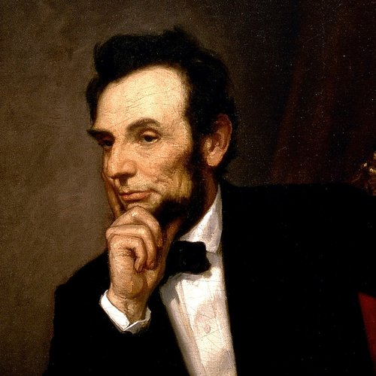
Questions & Discussion
“Laws Without Enforcement Are Just Good Advice.”
Abraham Lincoln
Local Tavern Owner
16th President of the United States
John Bodnovich | Executive Director | American Beverage Licensees
bodnovich@ablusa.org | www.ablusa.org | @ablusa
Notes:
8. During his time in New Salem, Illinois, Abraham Lincoln was a business partner of William F. Berry. Together they operated a store. On March 6, 1833, Berry and Lincoln were issued a tavern license (liquor license), but Berry alone signed the $300 bond for the license. He signed both his own and Lincoln's name. A resident named Bowling Green also signed the bond. The license was issued by the Sangamon County Commissioners and was good for one year. The license itself cost Berry and Lincoln $7. The liquor license allowed them to sell 1/2 pint of wine or French brandy for $.25. Also, they could sell 1/2 pint of rum, peach brandy, or Holland gin for $.1875. http://rogerjnorton.com/Lincoln92.html

