Slide 1
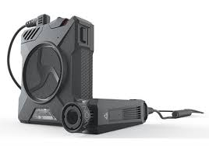
Milwaukee Police Department
Police
Body
Cameras
Wisconsin Legislative Council: Study Committee on the Use of Body Cameras
September 13, 2018
For more information please contact: Sergeant Doug Wiorek, 414-935-7399; DWIORE@milwaukee.gov
Alfonso Morales
Chief of Police

Slide 2
About the presenter:
Douglas J. Wiorek – Milwaukee Police Department
Sergeant since 2004. Since 2015, he has fulfilled the role as the BWC Administrator/Program Manager and also serves as the Executive Officer for the IT Department.
Has been a licensed law enforcement officer since 1988, including over twenty one years serving the City of Milwaukee.
In addition to his law enforcement experience, Sgt. Wiorek has several years of private security supervisor experience in North America's largest shopping mall, the Mall of America, and has served as a volunteer firefighter.

Slide 3
The Road to Implementation of Body Cameras
07/13: The City of Milwaukee began considering the rollout of body cameras to increase transparency and accountability in modern policing
07/13 - 09/13: MPD instituted a 60 day Body Camera Pilot at District Five in Milwaukee's North side
Tested 5 cameras by 4 manufacturers including Panasonic, VieVu, Axon (2), & Digital Ally
02/15/14 - 05/14/14: Request for Proposal (RFP) developed/submitted
10/17/14 - 11/20/14: RFP issued by City Purchasing
03/10/15 - 06/30/15: In response to ongoing public feedback the City decides to expand to full program at cost of $4.5 million
11/16/15: State Public Records Board approves MPD’s proposed data retention schedule
06/30/15 Contract award issued to Axon
5 year camera and storage solution for $4,351,014
03/31/18 Axon contract extended 5 additional years

Slide 4
The Road to Implementation of Body Cameras (continued)
Any rollout or changes to the body camera program must be approved by the City of Milwaukee’s Fire and Police Commission
The BWC program is governed by publicly available policies within Standard Operating Procedure 747 - Body Worn Camera

Slide 5
Camera Deployment - Phases 1 and 2
PHASE 1
10/21/15: Phase 1 Camera “Go-Live date (179 cams)
PHASE 2
03/21/16: Phase 2 Camera “Go-Live” date (280 cams) and study funded by the U.S. Department of Justice begins

Slide 6
Camera Deployment - Phases 3 and 4
PHASE 3
June - Sept 2016: Phase 3 “Go Live” (295 cams)
Various start dates
PHASE 4 (Final Phase)
Nov - Dec 2016: Phase 4 “Go Live” (430 Cams)
Various start dates
Dec 2016 - Present: Full Enactment (1,100+ Cams)

Slide 7
BWC Program…By the Numbers
Body Camera Program Manager/Administrator
Assisted by one full-time limited duty officer
1,100+ body cameras deployed – largest in state
Oct 2015 to present | Total Stored
Number of Active Videos Stored | 1,480,374
Hours of Videos Stored | 291,994
Gigabyte (GB) of Videos Stored | 296,480 (296.4 Terabytes)
via cloud upload through evidence.com
 | Averages Per Day
Number of Videos Uploaded | 1,552
Hours of Video Uploaded | 298
GB of Video Uploaded | 297

Slide 8
The Axon Flex 2 Body Camera
Demo:
How the camera works
Camera mounting options
Docking / uploading cameras

Slide 9
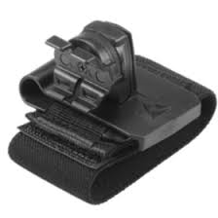
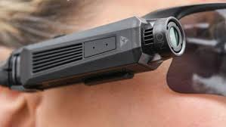
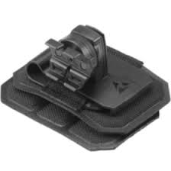
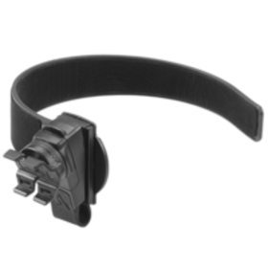
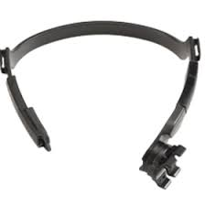
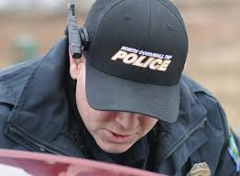
BWC Mounts for MPD
Vest Mount Sunglasses Mount Epaulette Mount
POV Head Mount Ball Cap Mount Collar Mount

Slide 10
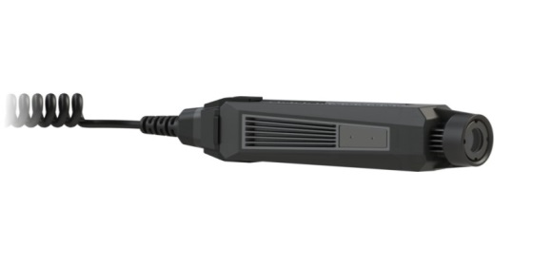
Axon Flex 2 Cameras
Cams are individually serial numbered/assigned
64 GB storage capacity = 23½ hours of video storage (Up from 8GB and 9½ hours)
Records @ 30 fps with a 30 second pre-buffer (video only/no sound)
The lens has a 120 degree field of view
(Up from 75 degrees).

Slide 11
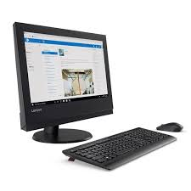
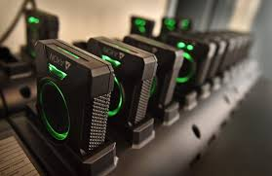
BWC Data Work Flow

Slide 12
Strategies for Policing Innovation (SPI) Grant
MPD awarded a competitive federal grant of $660,000 to study the implementation of the program from 2015- 2018
The study is a collaborative effort between MPD and Strategies for Policing Innovation (SPI); U.S. Department of Justice Bureau of Justice Assistance (BJA); and the Urban Institute
Study required a randomized selection of 252 sworn members city-wide to wear a camera (randomized by grant partners). Another group of 252 members formed the control group which did not wear cameras.

Slide 13
Budget Realities and Next Steps
Estimated for full-scale deployment of body cameras for 2018: $1.2 million
Projected costs for ongoing enactment for 2019: ≈$1.2 million
Potential to add body cameras to 25 undercover agents if necessary resources are secured

Slide 14
Questions?
Sergeant Douglas J. Wiorek
Executive Officer – Office of Police Information Systems
Milwaukee Police Department Office of Police Information Systems
2333 N. 49th Street, Room 301
Milwaukee, WI 53210
Direct Office Line: 414-935-7399
Email: dwiore@milwaukee.gov
Danielle Decker
Intergovernmental Relations | City of Milwaukee
City Hall | 200 E Wells St, Room 606 | Milwaukee, WI 53202
414-286-5589
www.milwaukee.gov/ird

