Slide 1
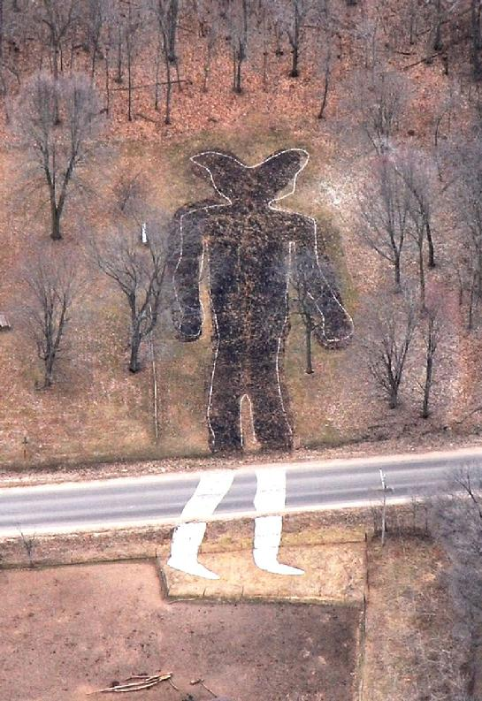
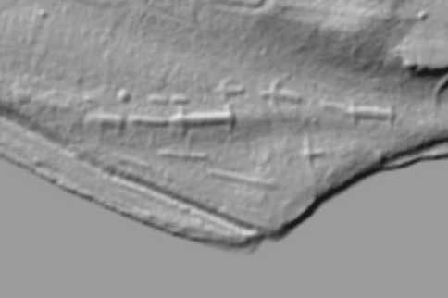
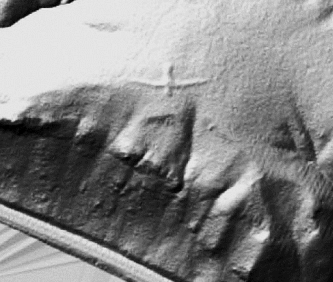
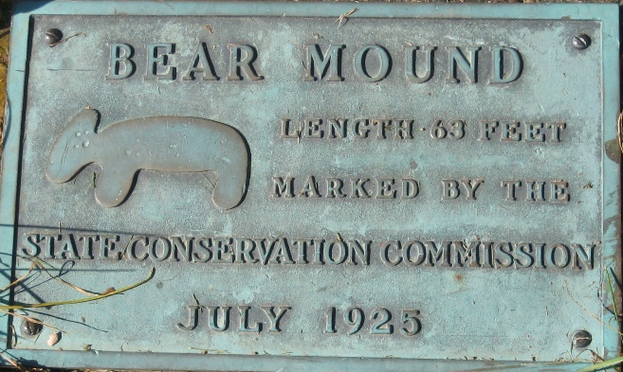
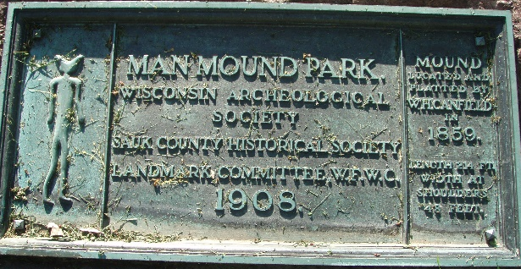
A Brief Overview
of
Native American Burial Practices
In
Wisconsin’s Archaeological Record
Robert “Ernie” Boszhardt

Slide 2
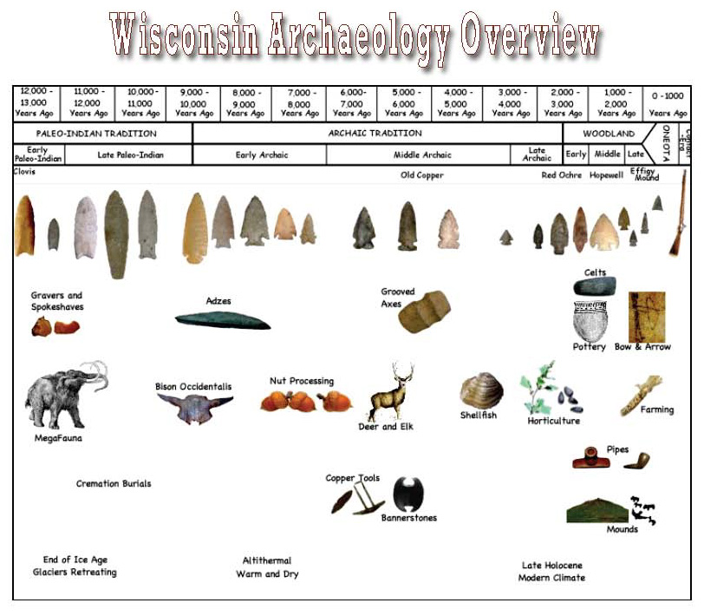
Columbus
United States
“PRE-CONTACT”
Wisconsin Statehood
Four Traditions:
Paleoindian
Archaic
Woodland
Mississippian/Oneota
Changes over Time:
Environmental
Technological
Social

Slide 3
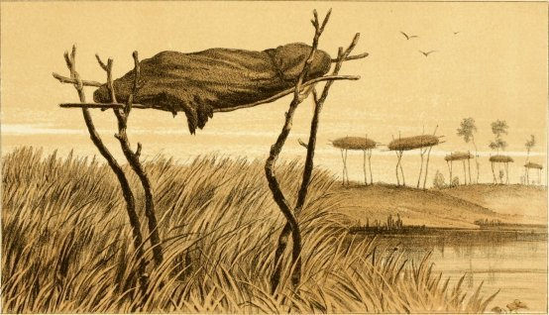
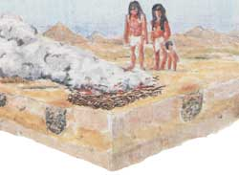
Four Main Types of Burials
Cremation
Flexed
Bundle
Extended

Slide 4
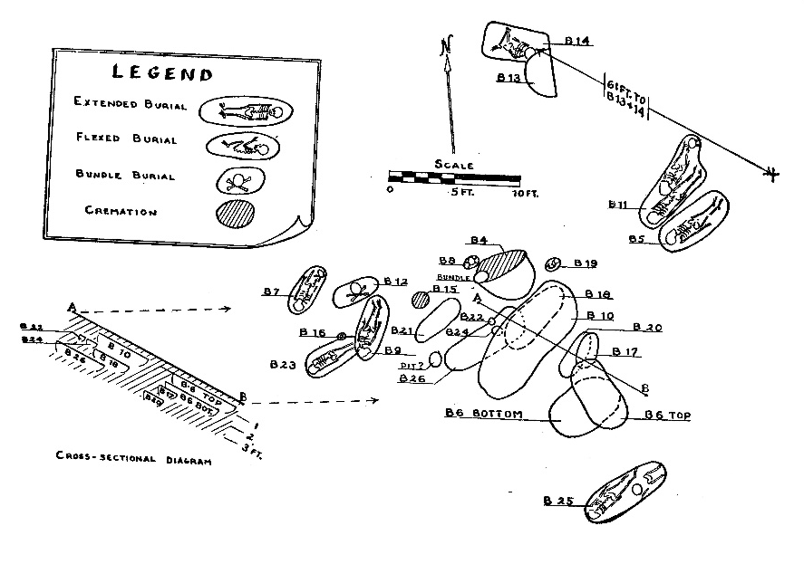
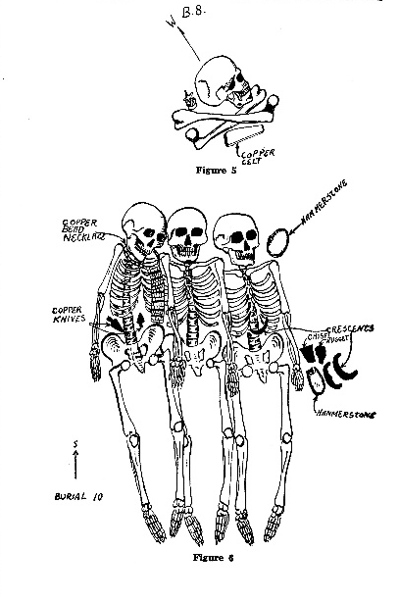
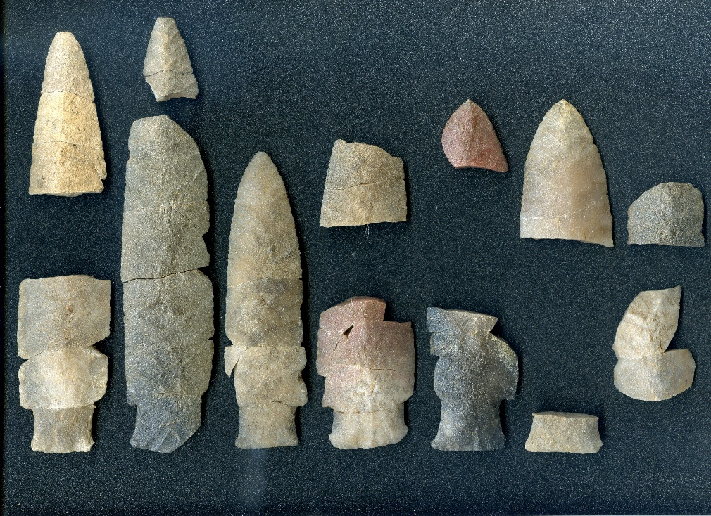
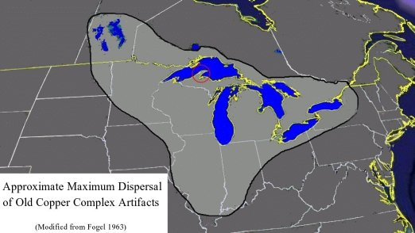
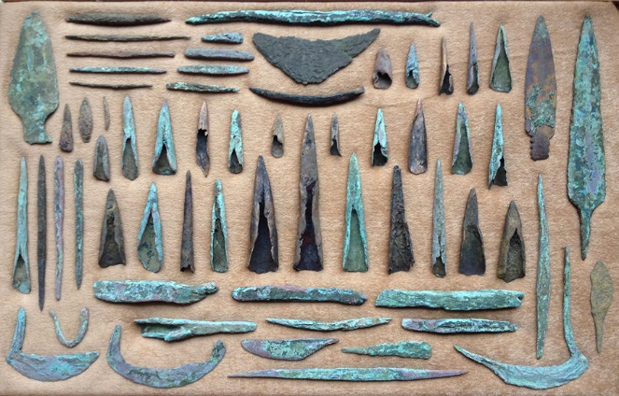
Paleoindian and Archaic Burial Practices
Archaic 5,000 – 3,000 B.P. (Cemeteries)
Late Paleoindian 10,000 B.P.
(Isolated Cremations)
Reigh Site
Pope Site
Copper
Red Ochre

Slide 5
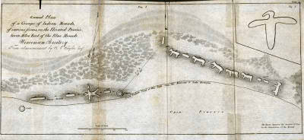
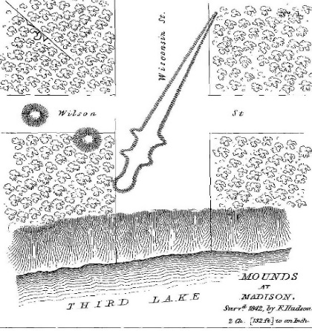
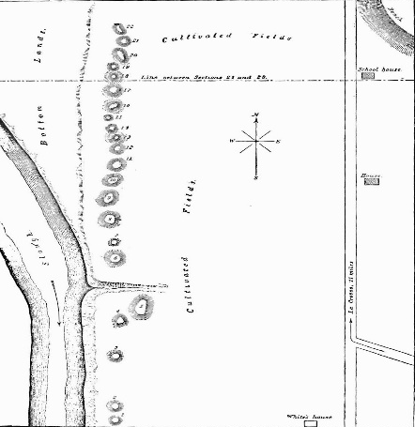
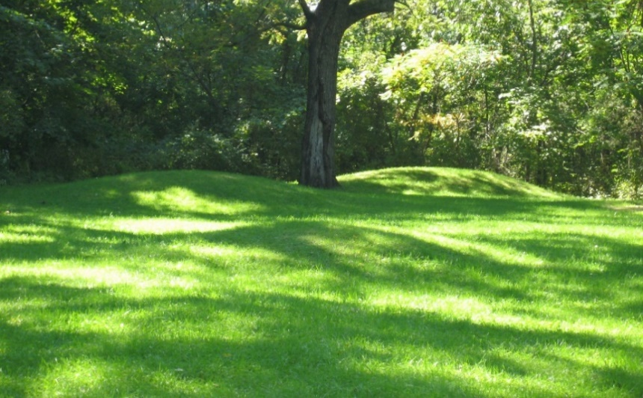
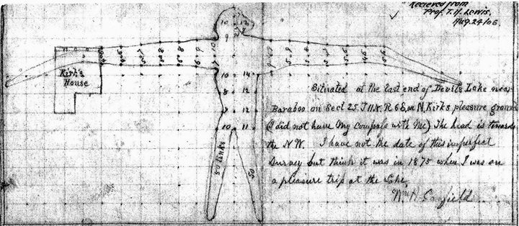
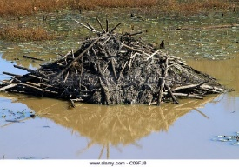
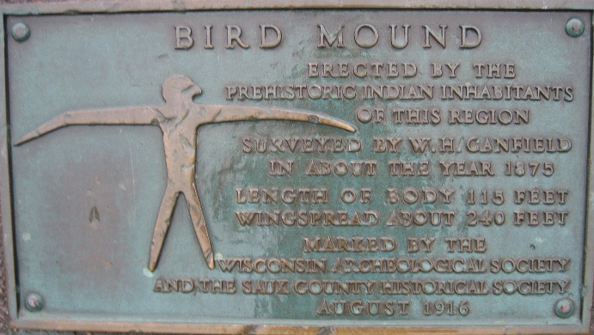
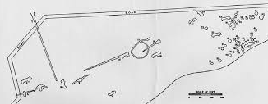
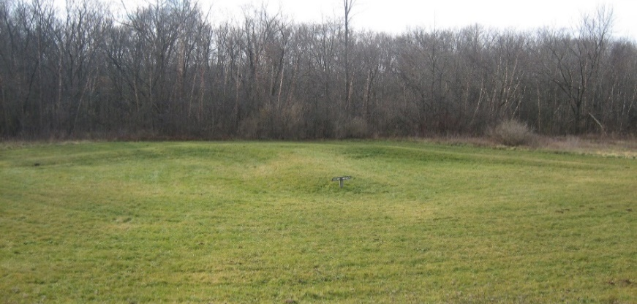
Woodland Tradition
2,500 -1,000 B.P.
Mounds
Taylor (1837)
Lewis (1880s)
Lapham (1855)
B.A.E. (1880s)
Conical
W.A. Society 1900s
Milwaukee Public Museum (early 1900s)
Effigy

Slide 6
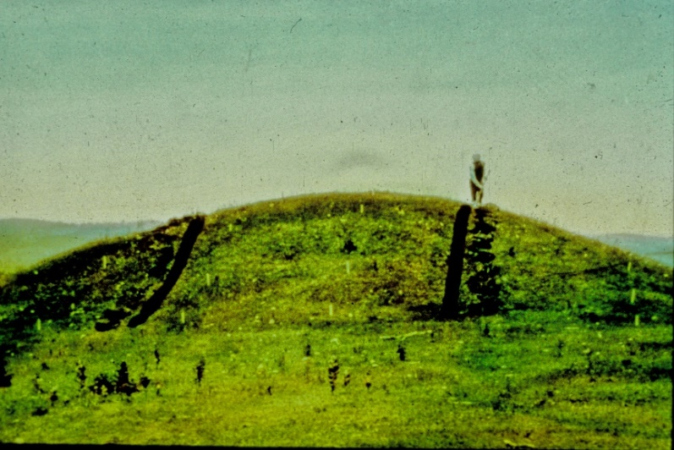
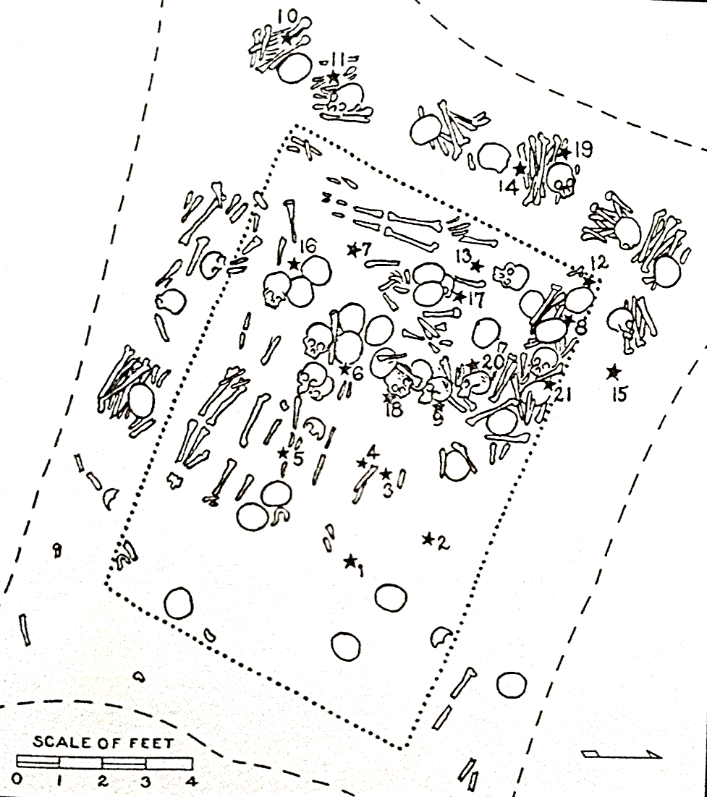
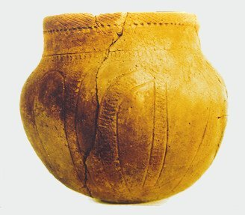
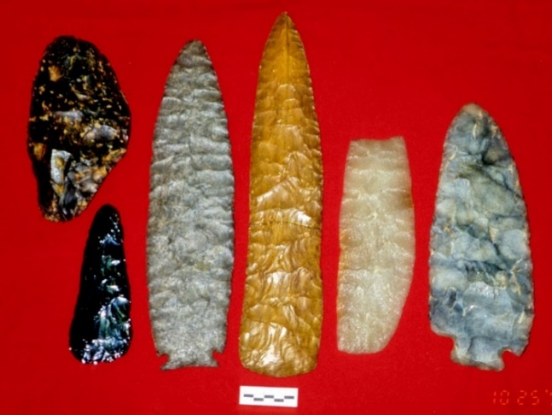
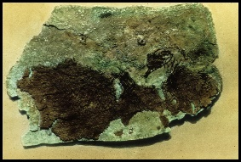
Hopewell
2,000 B.P.
Interaction Sphere
Schwert Mound 18
Nicholls Mound

Slide 7
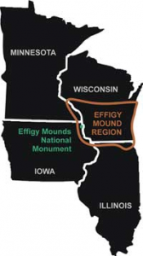
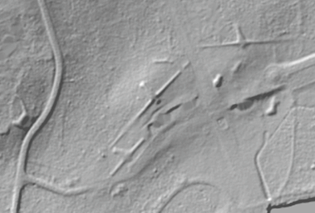
Effigy Mounds
1,000 B.P
10 feet high
643 foot wingspan
Mendota Mental Health Institute

Slide 8
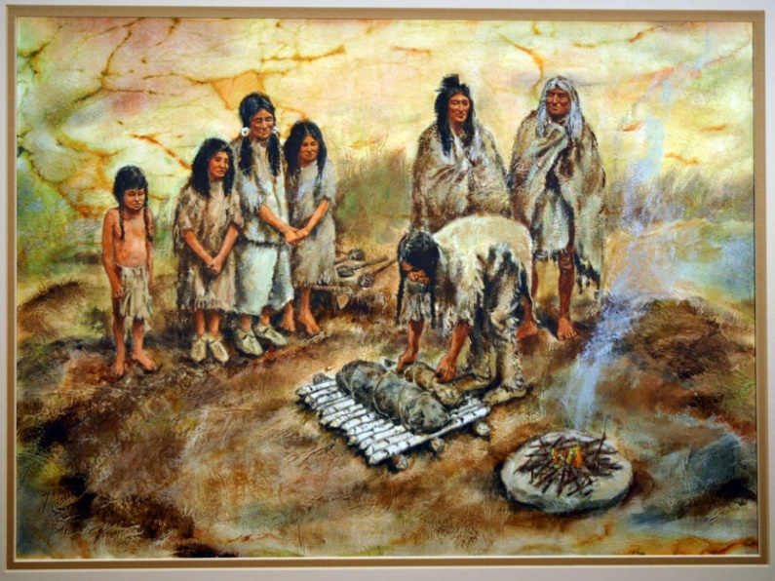
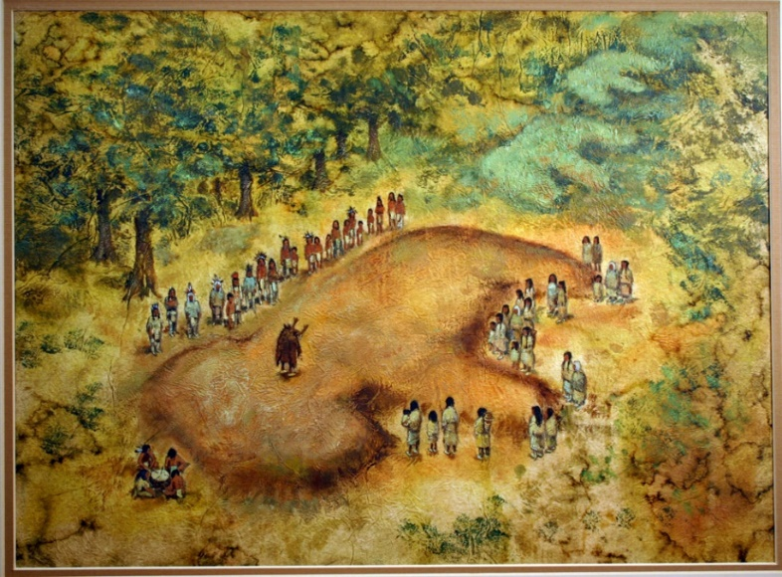
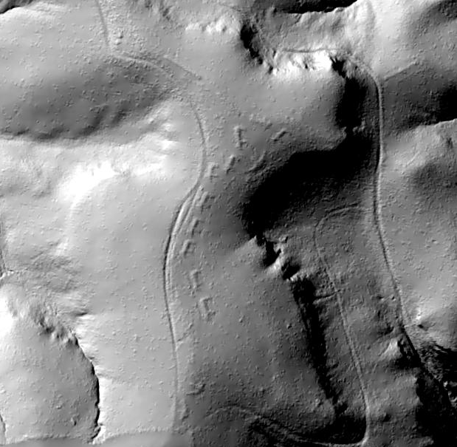
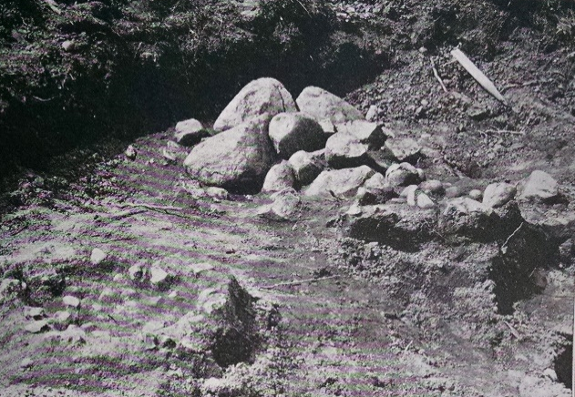
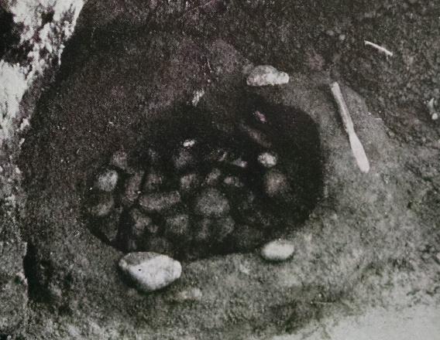
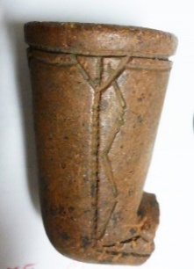
Effigy Mounds
Clay
Pipe
Stone “Alter”
Stone “Cist”

Slide 9
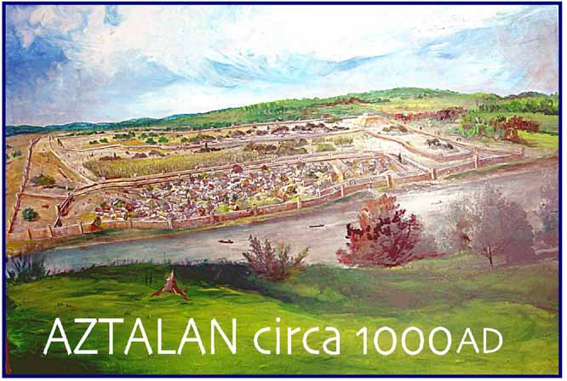
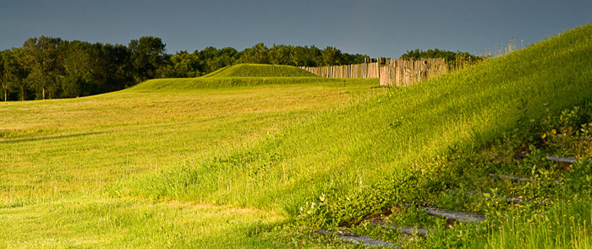
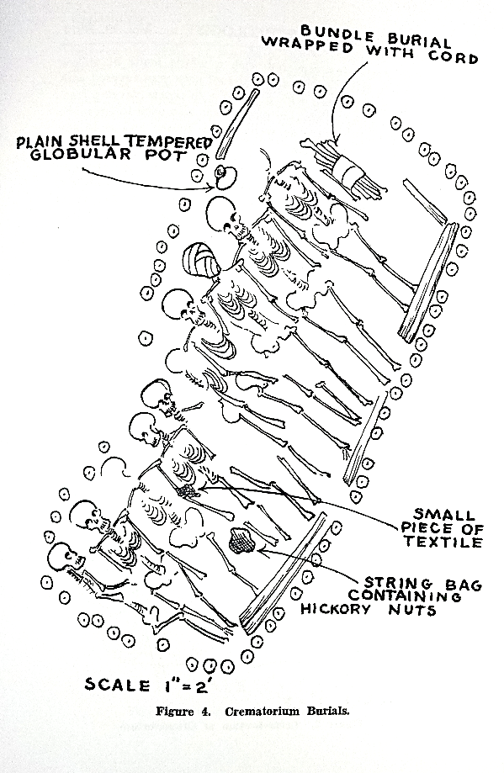
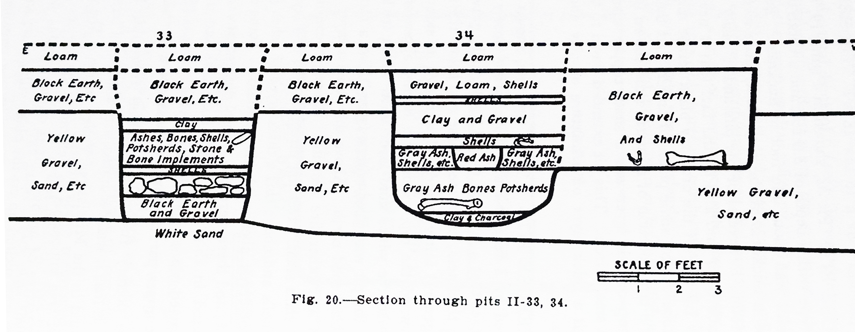
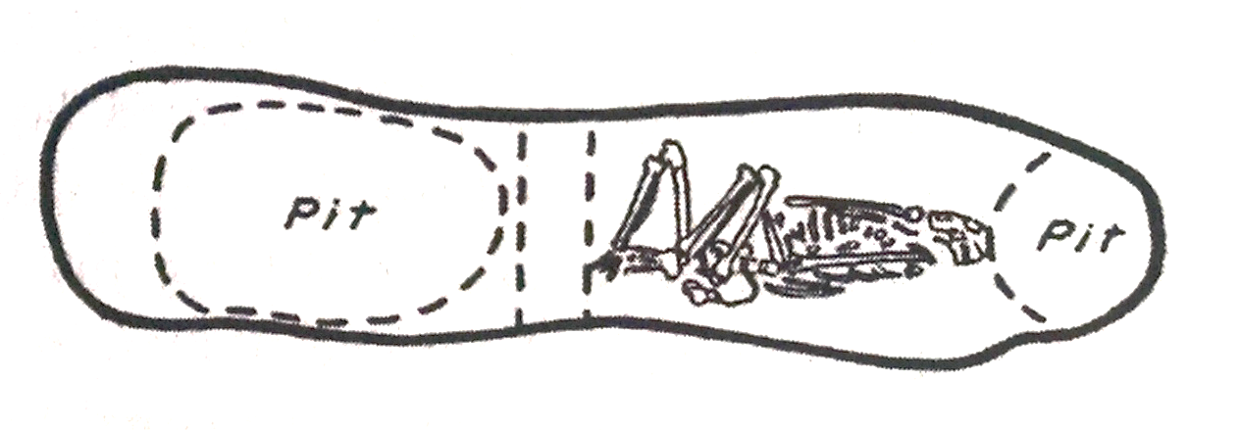
Mississippian
Burial Practices:
Aztalan
Human Remains in Refuse
Violence or Ancestor Worship
Platform Mound
Charnel House
Graves in Village

Slide 10
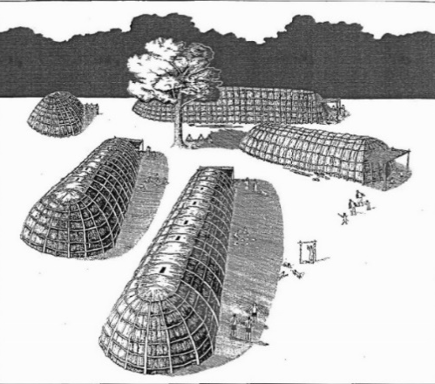
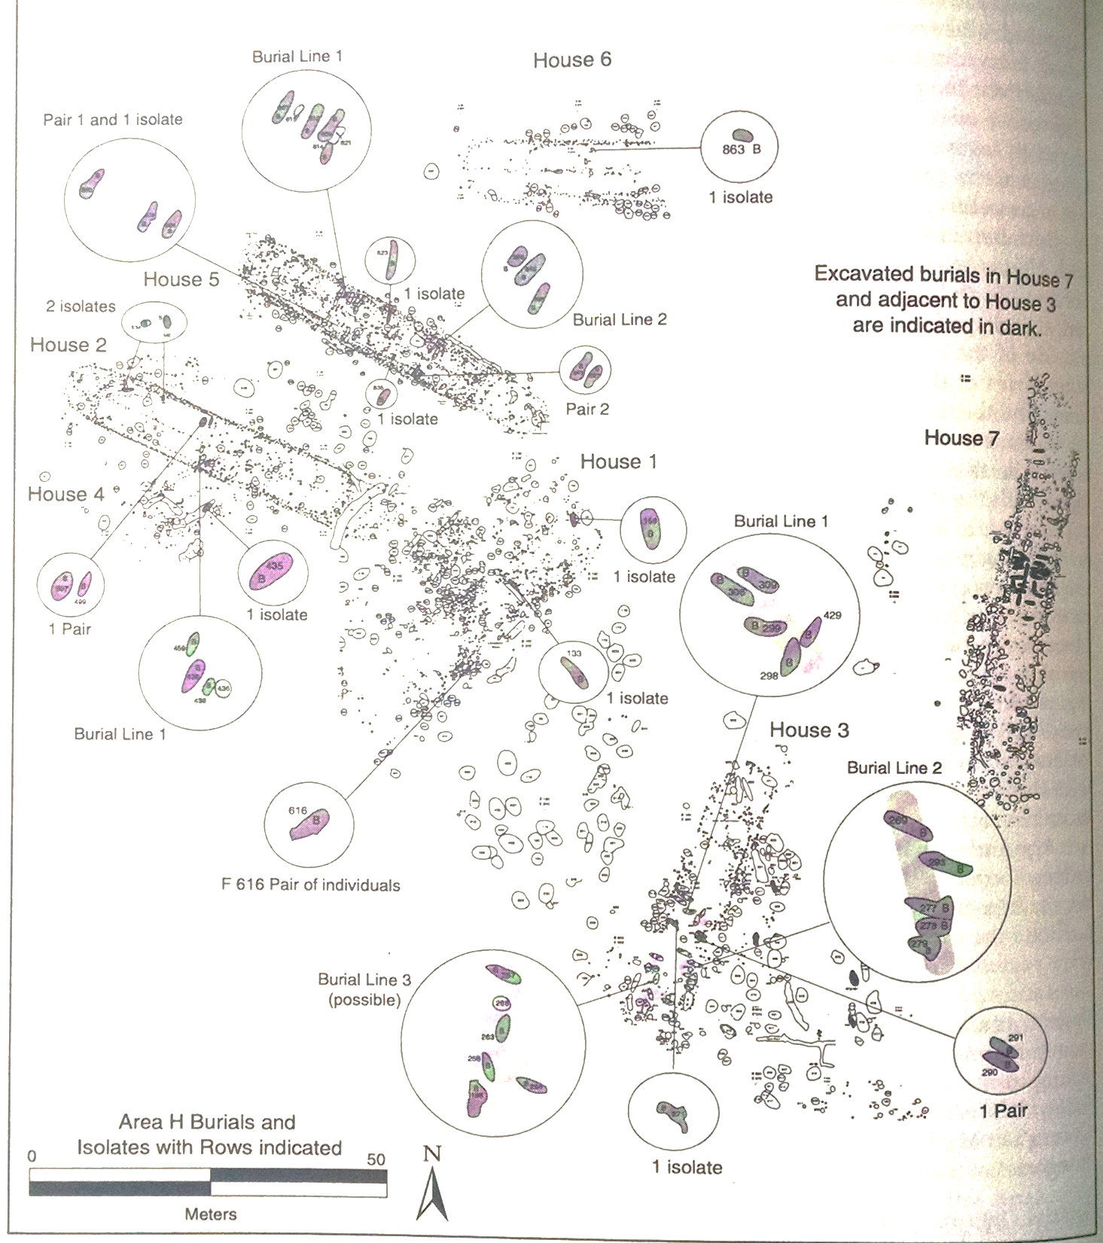
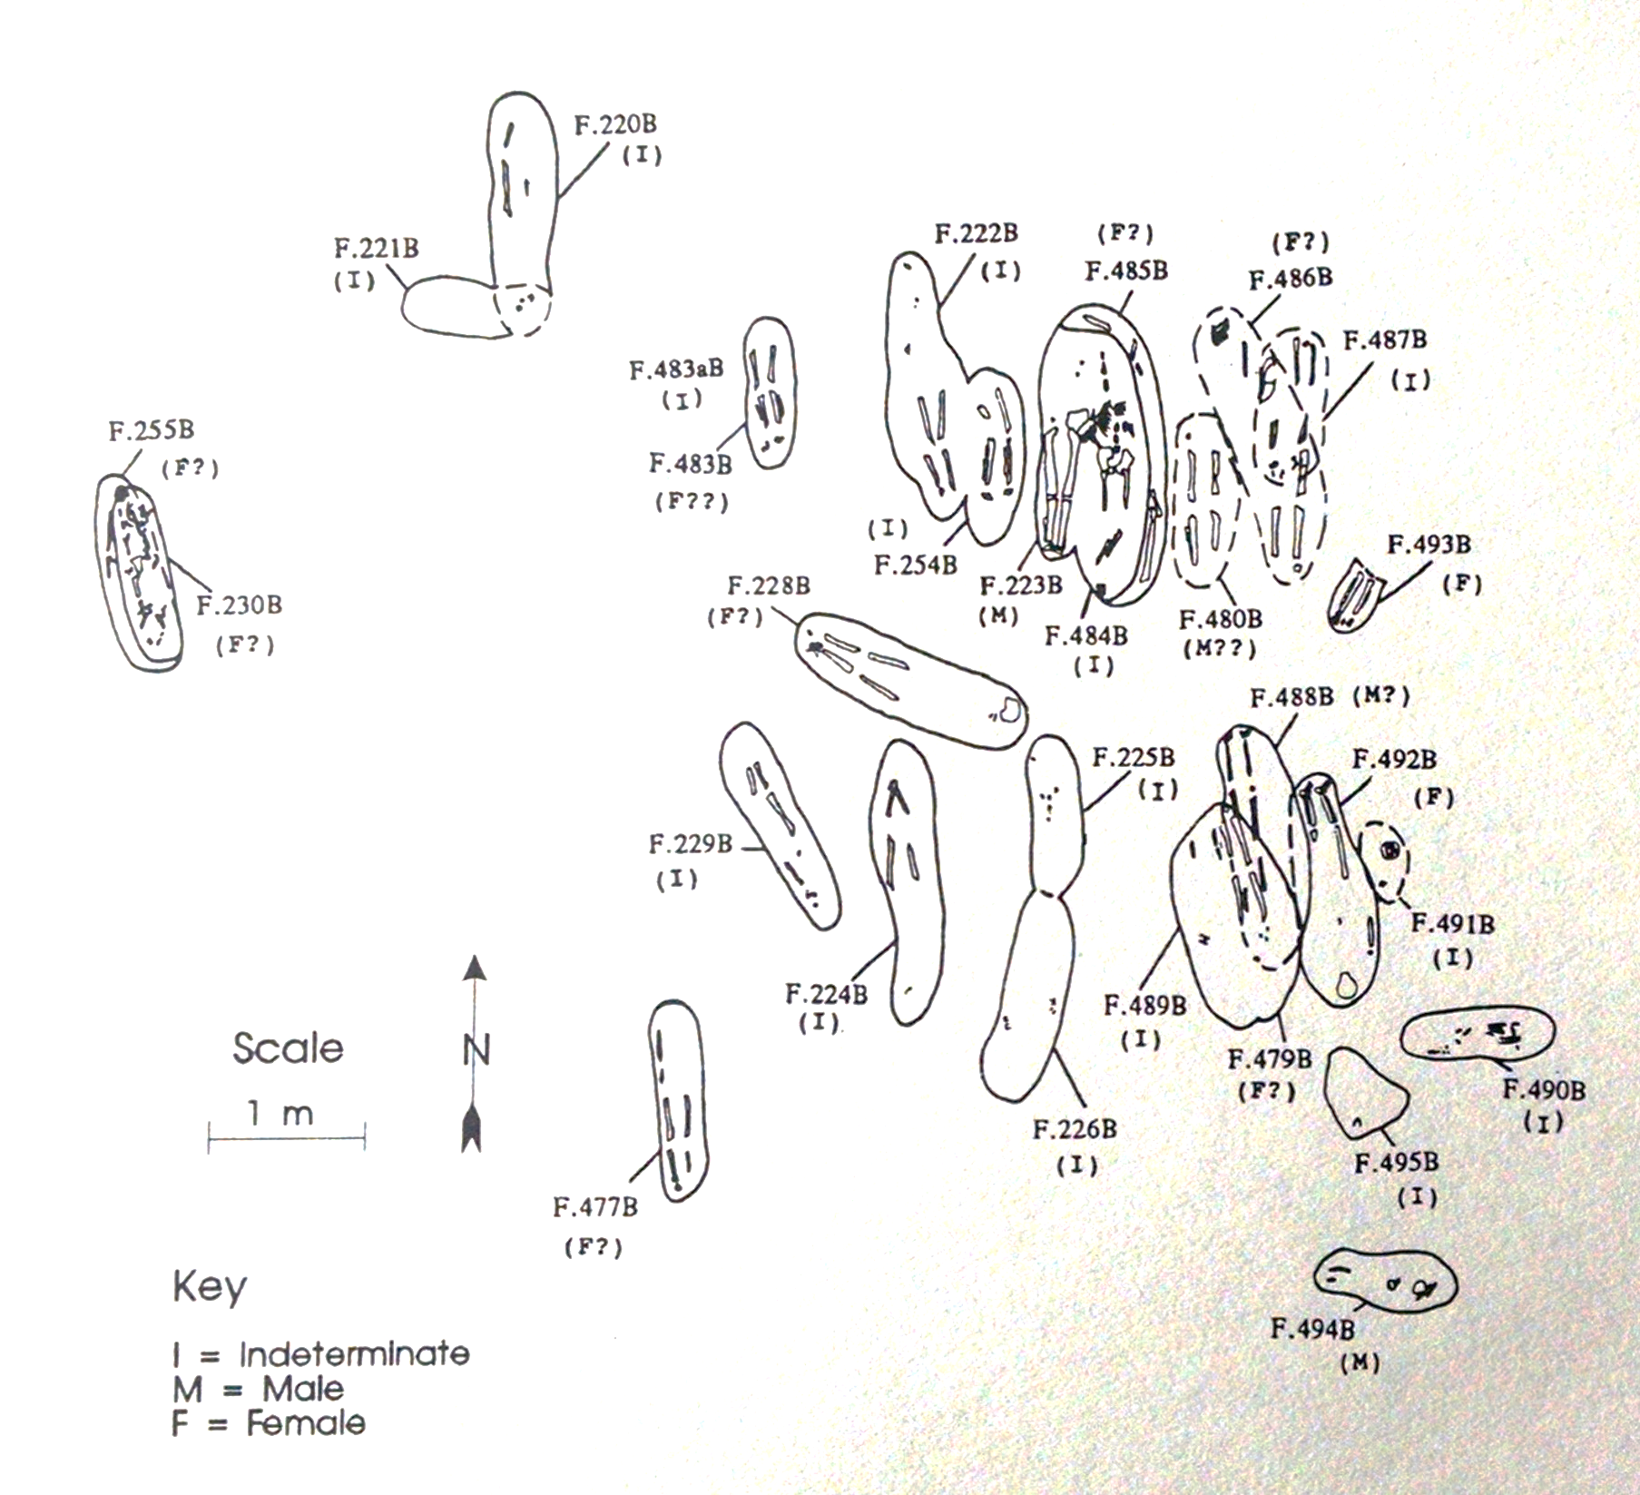
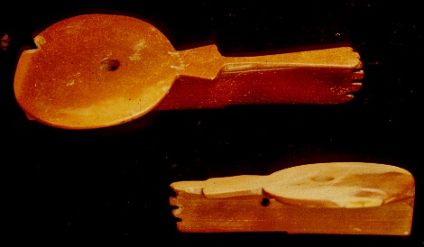
Oneota Burial Practices
(900 - 350 B.P.)
Catlinite
“Disk” Pipes
Gundersen Site
Tremaine Site

Slide 11
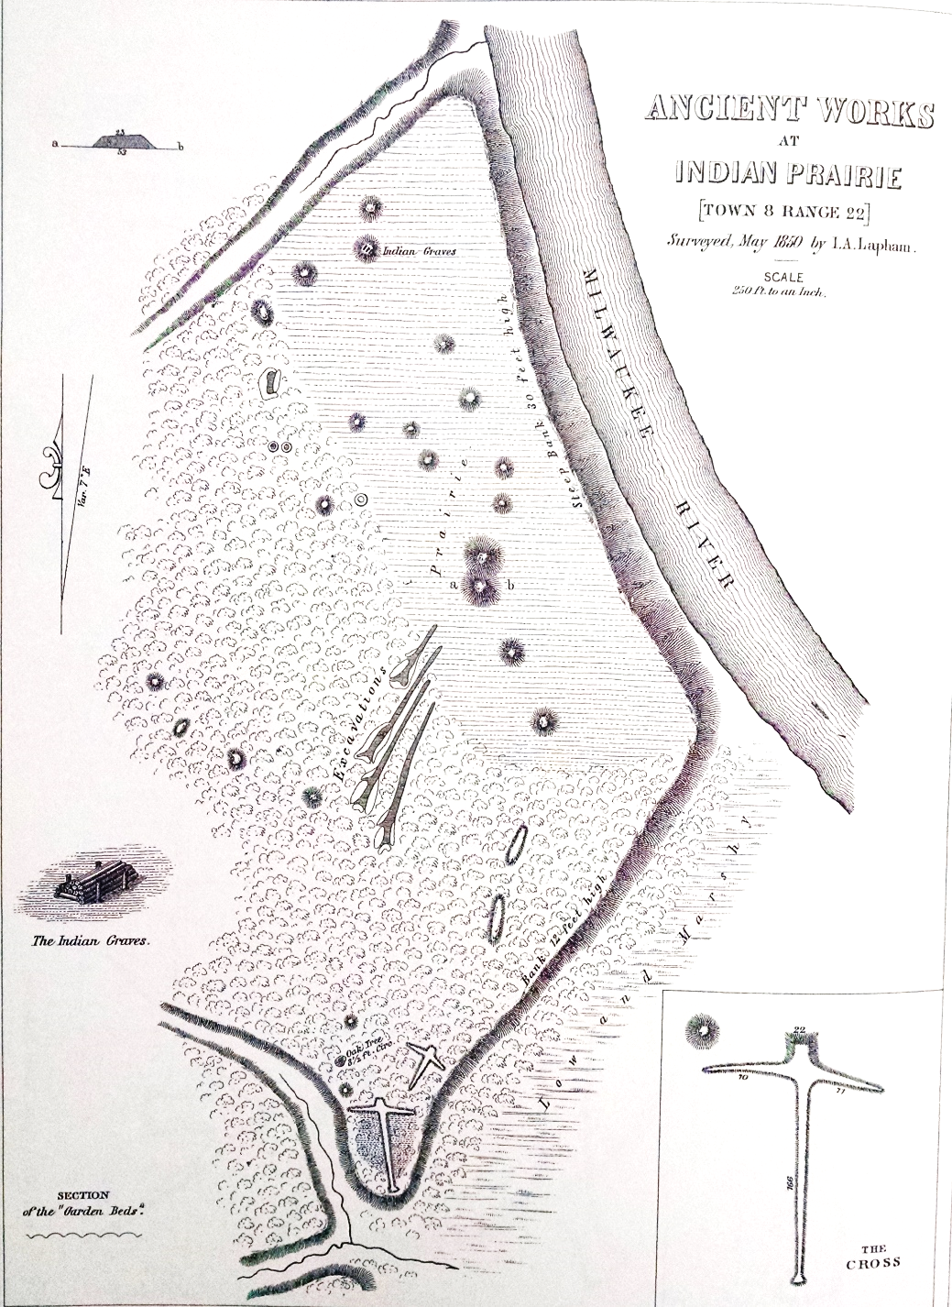
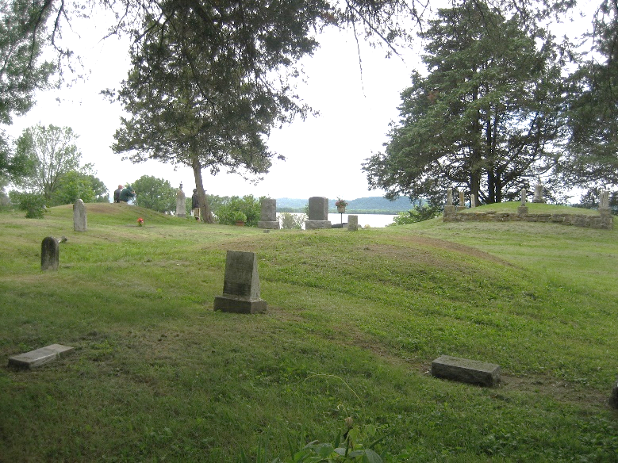
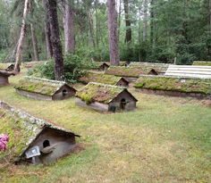
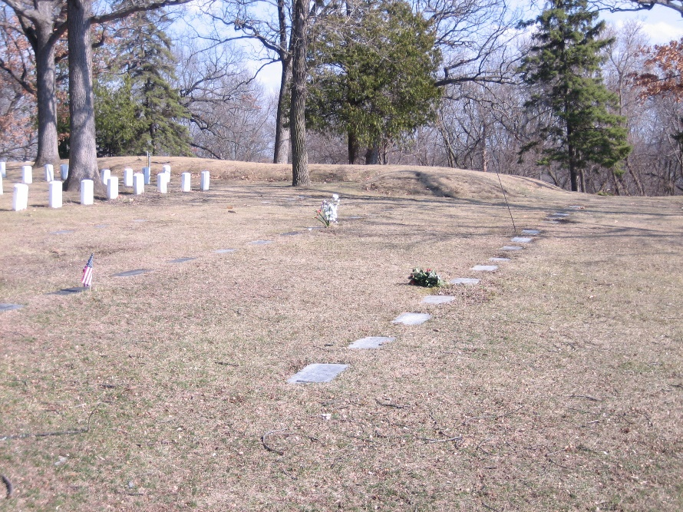
Post European Contact
Since 350 B.P.
(Intrusive burials into Mounds)

Slide 12
Do/Did all Mounds Have Burials/ Human Remains?
Frequency of Human Remains in 445 “Systematically” Excavated Mounds In 36 mound Groups (from Rosebrough 2011)
 | Conicals |  | Effigies |  | Other |  | Total
 | # | % | # | % | # | % | # | %
Positive | 269 | 89 | 55 | 87 | 64 | 80 | 388 | 87
Negative * | 33 | 11 | 8 | 13 | 16 | 20 | 57 | 13
Total | 302 | 100 | 63 | 100 | 80 | 100 | 445 | 100
All 36 Groups in sample had at least one Mound with human remains
*Negative frequencies are probably too high

Slide 13
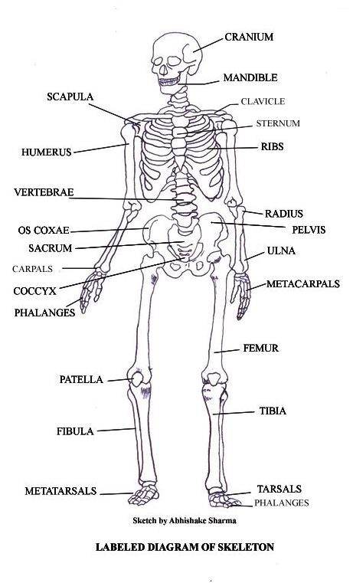
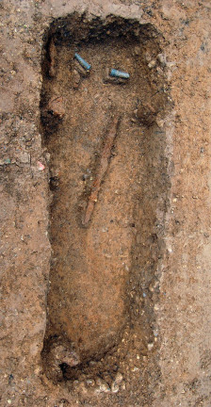


Some Skeletal Preservation Factors
Infant
Cremation (Europe)
Natural Decomposition
(Anglo Saxon Grave; Europe)
Adult

Slide 14



Excavation Sample Issues
Side Cutting
No Screens
Chunk Shoveling
Milwaukee Public Museum Excavations
Early 20th Century

Slide 15






Partial Mound Excavations
Effigies
Burials Encountered
(Neal and McClaughry 1928)
No Burials Detected
(Kratz Creek 1919)
Conicals
MPM Excavation Maps

Slide 16
Summary
13,000 years of human presence in Wisconsin.
No Mounds for first 11,000 years = unmarked burials can be anywhere.
Mounds only during last 2,000 years and primarily from 2,000-1,000 B.P.
First few hundred years = conicals/Hopewell. Very visible; most looted.
  Effigy Mounds follow, Unique to Wisconsin, Visible; some looted.
*In 1850 there were approximately 30,000 Mounds in Wisconsin.
Only 3,000-4,000 (about 10%) remain).
Fewer than 600 Mounds systematically excavated
Nearly 90% contained human remains
Pre-Burial Law: Most Native American burial sites unprotected.
When Human Remains were encountered, nearly always excavated.
Since Burial Law: All burial sites protected.
Many now preserved in place.

