Slide 1
Lost Cemeteries
Patricia B. Richards
University of Wisconsin-Milwaukee
Presentation to the Joint Legislative Council Study Committee on the Preservation of Burial Sites - August 2, 2016.

Slide 2
Discussion today
Introduction
Why study cemeteries?
A bit of historical context
The legislation
Identification, excavation and analysis of human remains
and navigating WisStats.157.70 from the perspective
of three case studies:
47 MI-0254 (47 BMI-0073) The Old Catholic Cemetery
47 MI-0527 (47 BMI-0076) Milwaukee County Grounds
Froedtert Tract Cemetery
47 MI-0523 (47 BMI-0088) Second Ward or Gruenhagen
Cemetery
Introduction

Slide 3
Mortuary Analysis 101
Mortuary ritual (how we treat the dead) is understood as a way of mending the torn social fabric caused by death.
Burial (inhumation), cremation, mausoleum (immurement), exposure, dissolution, cannibalism, space burial, dismemberment, and promession all methods of disposal of the dead within a social and ideological framework.
Some but not all of these methods involve creating a space for the living to memorialize the dead.
Cemeteries are widely recognized as distinct places with at least one common purpose – that of burying the dead. Beyond that a cemetery may represent a link with a specific person, or with the more generalized past, or both. In those instances where the link between burials and the social, ethnic, religious or cultural present is tenuous or lacking, cemeteries are abandoned or forgotten.
WisStats 157.70 provides for protection of human burials including those that are “lost” or abandoned; provides framework for mitigation when cemeteries are damaged or must be disturbed.
Why study cemeteries?

Slide 4
Lynne Goldstein
Department of Anthropology
University of Wisconsin-Milwaukee
January 20, 1984
“The Archaeological Community views itself as “stewards of the past.” Our interest is in conserving the past as well as understanding and interpreting it.
Our major concern is the conservation of archaeological data for the present and future citizens of this country. Contrary to public belief, this does not mean that we are not interested in progress nor does it mean that we believe that every archaeological site should be preserved. However, archaeological resources are non-renewable, and must be carefully and cautiously guarded. Sometimes the public good is best served by excavation, other times by preservation.
The study of human skeletal remains is a critical one for anthropology; we can learn much about the past from the study of these remains, including the areas of demography, biological (genetic) relationships, health and disease, diet, and social organization.”
A bit of historical context

Slide 5
Wisconsin Burial Sites Preservation Statute
WisStats 157.70: THE LEGISLATIVE BASIS
A burial site, under the law, refers to any place where human remains are buried and includes marked and unmarked cemeteries, Native American mounds, small family cemeteries, and other less obvious locations that are reported to the Wisconsin Historical Society.
No burials, regardless of age, ancestry, cultural affiliation or condition may be intentionally disturbed without first obtaining a permit from the director of the Wisconsin Historical Society, even if that burial is on one’s own land.
The legislation

Slide 6
Wisconsin Burial Sites Preservation Statute
PROCESS OF OBTAINING A PERMIT TO DISTURB BURIALS (OWNER RESPONSIBILITY)
It is important to distinguish between “cataloged” and uncataloged” burial sites.
“Cataloged burial site” means a piece of land that has a record of having buried human remains and is recorded with the county register of deeds. This shall be the case even if the recorded burial site is untended, abandoned, and has no surface indications of burials.
“Uncataloged burial site” means any burial site that has not been cataloged according to s. HS 2.03 and is not recorded with the register of deeds.
The legislation

Slide 7
“Cataloged burial site”
“Uncataloged burial site”
1. Must apply to disturb to the director of the Wisconsin Historical Society (WHS).
2. Must notify “interested” persons on the WHS registry by certified mail, return receipt requested.
3. Once a 30 day period for comment is complete the owner can apply to disturb.
4. If there is no request for a hearing the director will decide whether to grant a permit to disturb.
5. HOWEVER, if an interested party requests a hearing, the director will request the Wisconsin State Division of Hearings and Appeals to conduct a hearing to decide if a cataloged burial site may be disturbed.
6. The owner must hire a “qualified archaeologist” according to the terms set out in a contract provided by the WHS executed by the archaeologist, the owner and WHS.
1. Must apply to disturb to the director of the Wisconsin Historical Society (WHS).
2. Must arrange a schedule of excavation with the director of the WHS.
3. If the excavation work can not be done in a reasonable time by the director, the owner must hire a “qualified archaeologist” according to the terms set out in a contract provided by the WHS.
4. Once the contract is completed, the director will give both oral authorization and written permission to the owner allowing the disturbance of the burial site.
The legislation

Slide 8
35 cataloged
69 uncataloged
104 total
The legislation

Slide 9
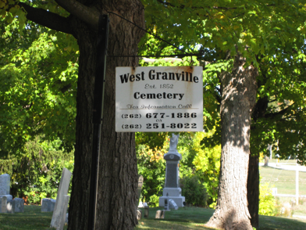
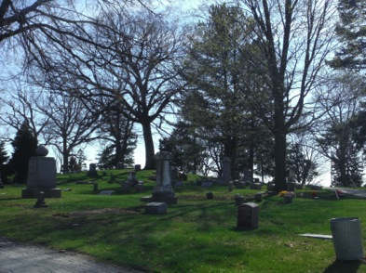
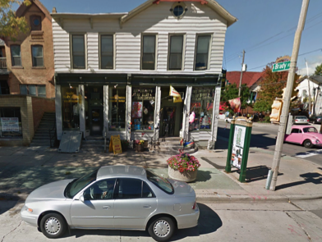
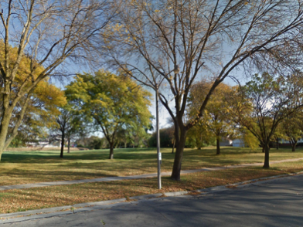
West Granville Cemetery
(47 BMI-0012) Uncatalogued
Wauwatosa Cemetery
(47 BMI-0004) Catalogued
First Ward Cemetery
(47 BMI-0087) Uncatalogued
Windsor Court Tract Cemetery (47 BMI-0173) Catalogued
The legislation

Slide 10
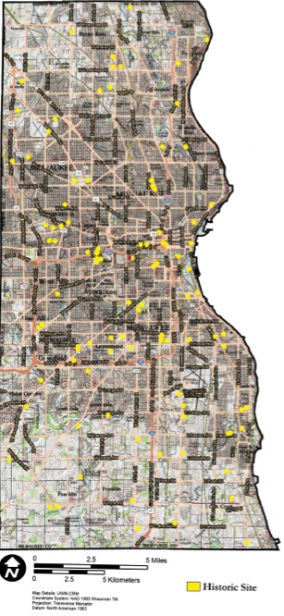
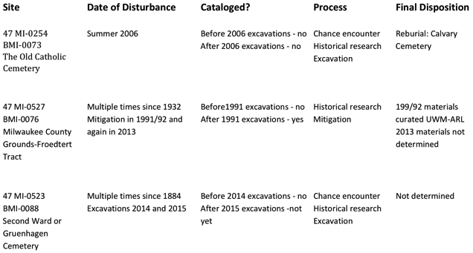
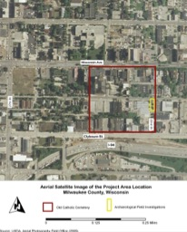
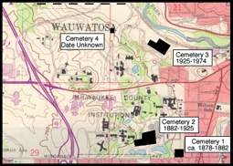

Case Studies

Slide 11
Discussion of each site in terms of
Disturbance (when and how)
Kind of site
Permitting/permission process
Benefits, findings
Case Studies

Slide 12
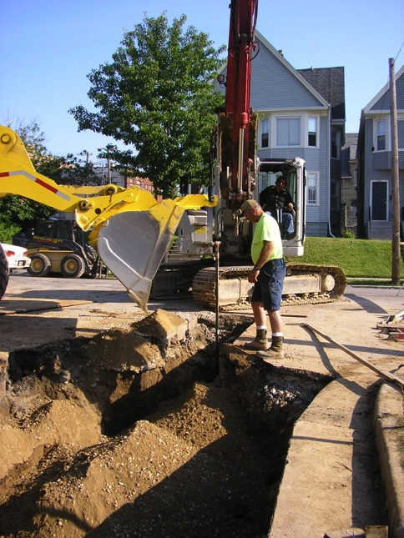
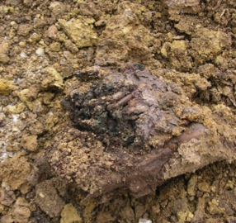
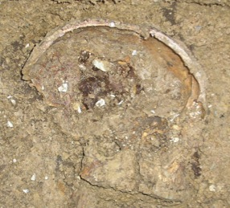
Old Catholic Cemetery,
City of Milwaukee
Intersection of
North 22nd Street and West Michigan Street
Old Catholic Cemetery-Identification

Slide 13
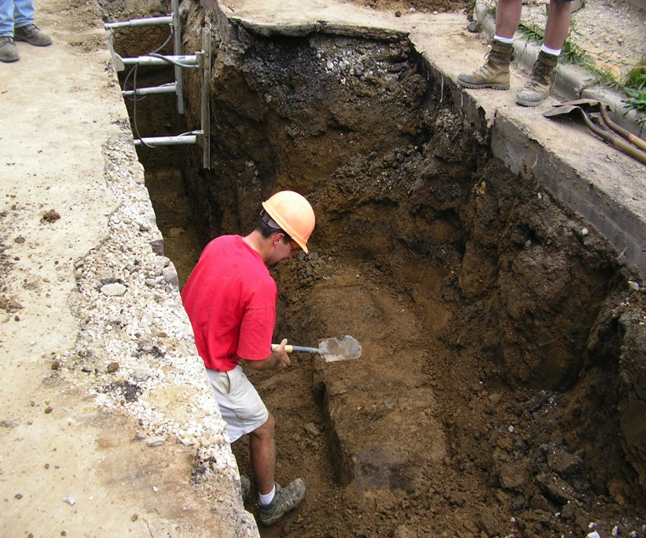
Old Catholic Cemetery-Excavation

Slide 14
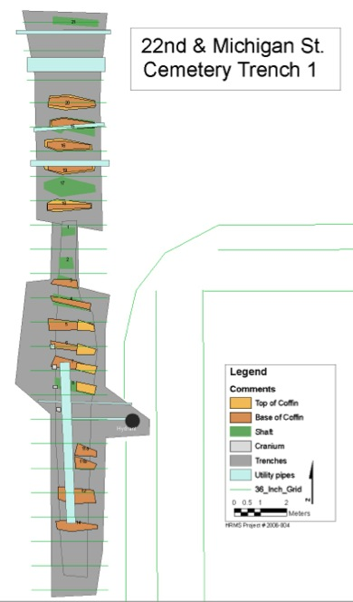
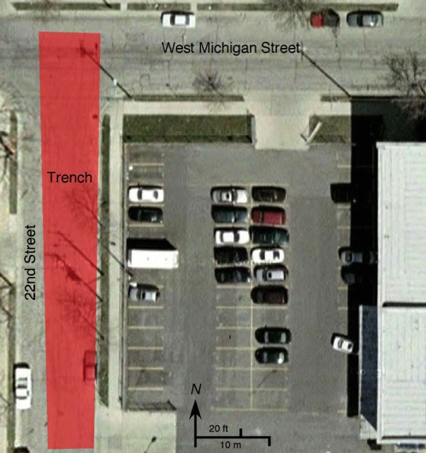
Old Catholic Cemetery-Excavation

Slide 15
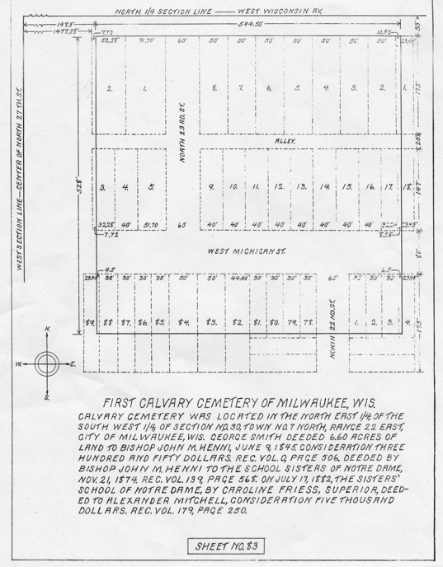
Old Catholic Cemetery-Analysis

Slide 16
Age Categories
Ancestry Categories
Old Catholic Cemetery-Analysis

Slide 17
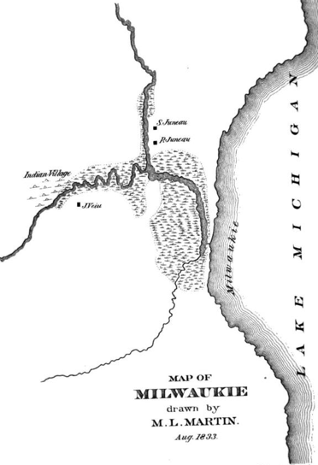
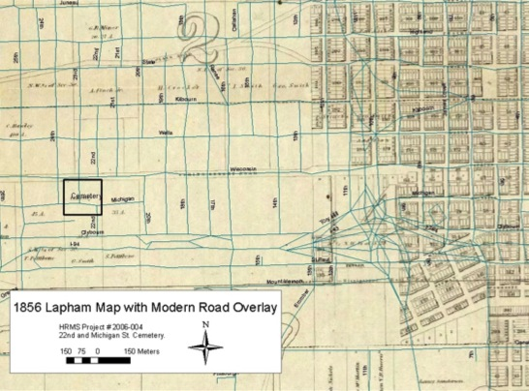
Old Catholic Cemetery Located Outside of City Limits in 1856
Blue represents current streets
1833 Martin map showing location of Lime Ridge or Pohquaygeegun's Village coincident with location of the Old Catholic Cemetery
Old Catholic Cemetery-Analysis

Slide 18
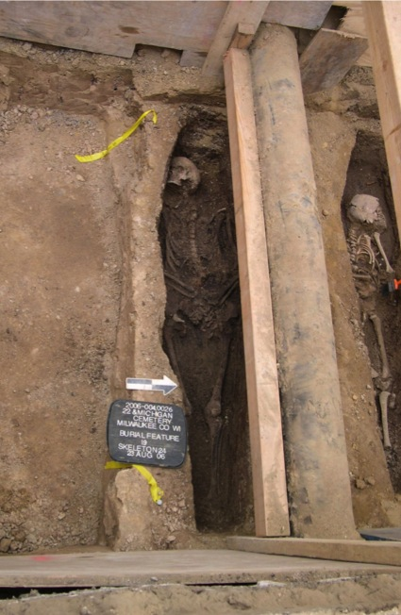
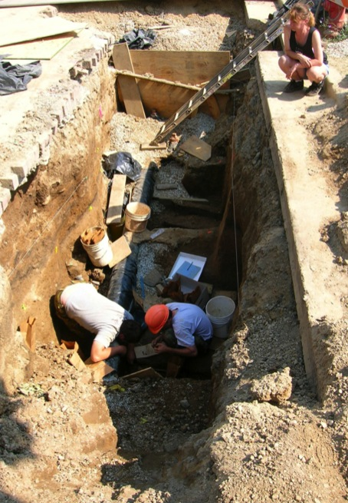
Burials intact under gas main
Burials disturbed by water installation
Old Catholic Cemetery-Excavation

Slide 19
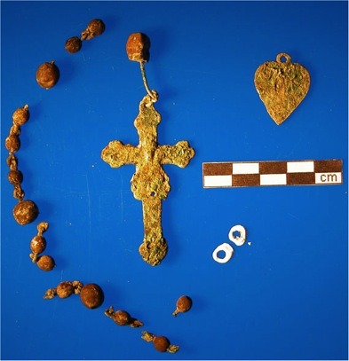
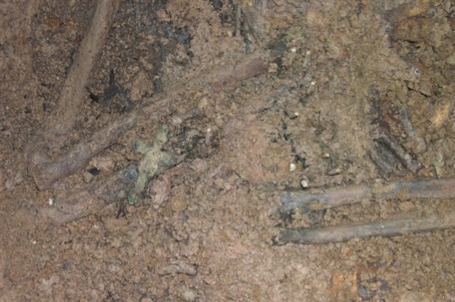
Religious Medal
Crucifix with Wooden Beads
Copper jewelry findings
Rosary recovered in situ
Old Catholic Cemetery-Excavation

Slide 20
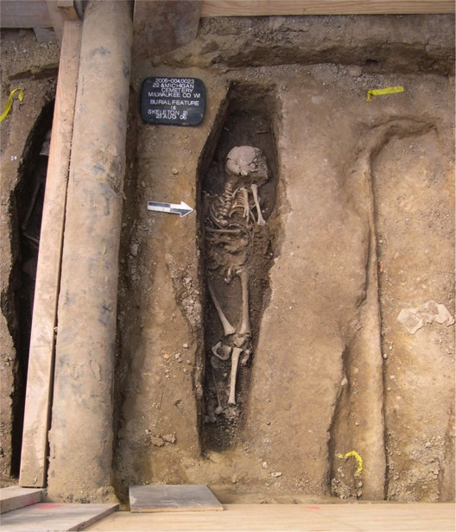
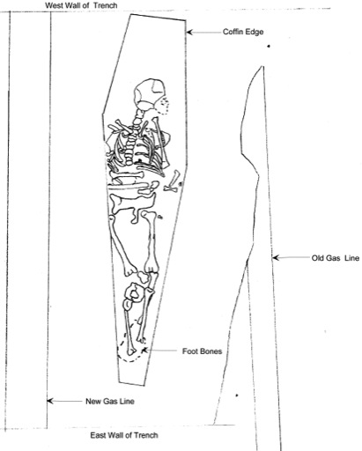
Burial 16, Skeleton 21
Old Catholic Cemetery-Excavation

Slide 21
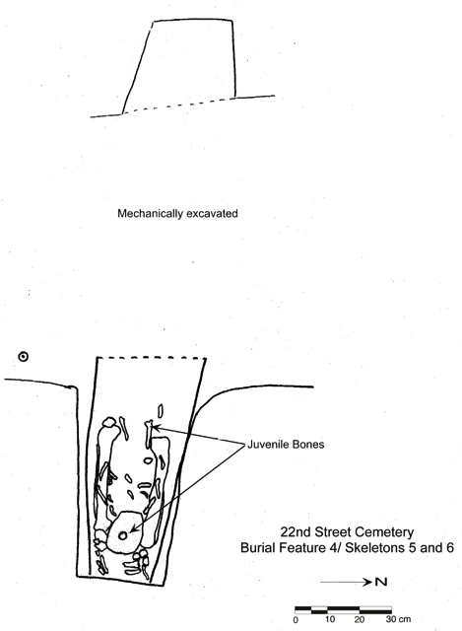
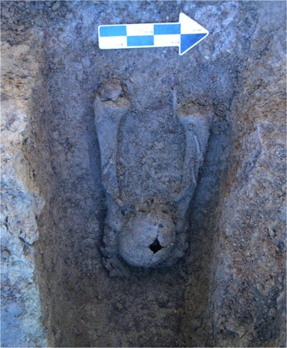
Burial 4, Skeletons 5 and 6
Old Catholic Cemetery-Excavation

Slide 22
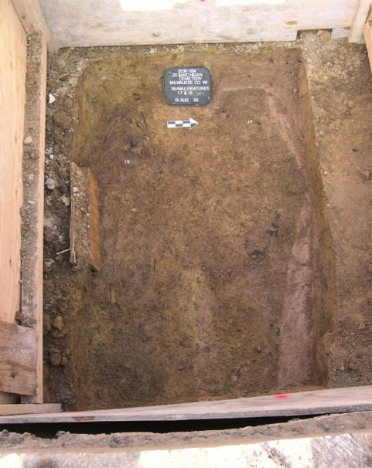
Burial 17
Old Catholic Cemetery-Excavation

Slide 23
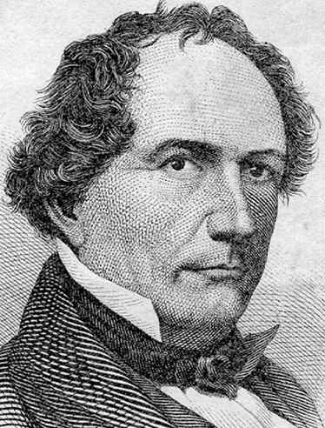
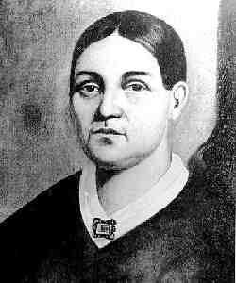
Solomon Juneau, ca. 1818
Josette Juneau
Old Catholic Cemetery-Summary

Slide 24
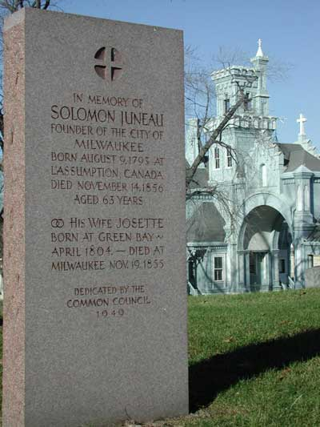
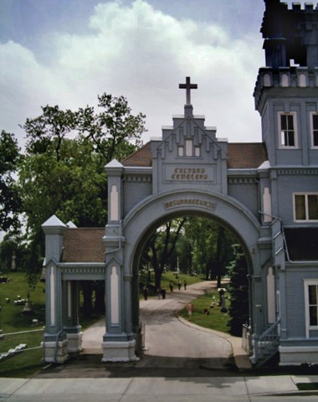
Calvary Cemetery
Old Catholic Cemetery-Summary

Slide 25
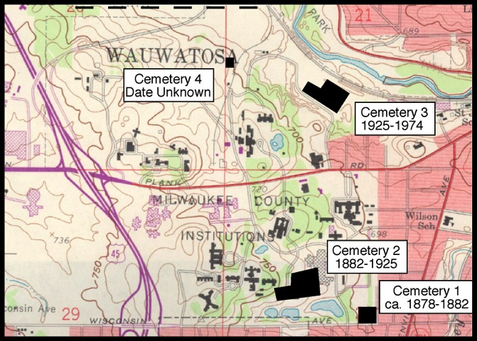
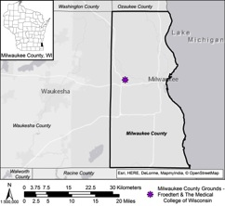
Milwaukee County Institution Grounds, Froedtert Tract Cemetery
Source: USGS 7.5 Wauwatosa Quad 1958
Milwaukee County Poor Farm Cemetery-Identification

Slide 26
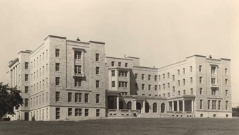
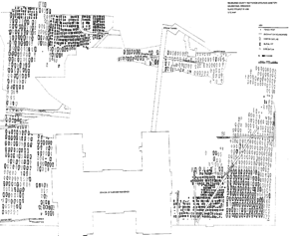
Digging for Nurses' Home; Find Coffins
Source: The Milwaukee Sentinel - Apr. 7, 1932
Power shovels excavating for the new county hospital nurses' residence in Wauwatosa Wednesday unearthed a number of coffins from the potter's field abandoned in 1929. The site of the nurses' residence is almost in the center of the 15 acre field which was set aside 70 years ago for the graves of the penniless and unknown.
Pauper Cemetery in Tosa could hold 4,700 graves.
By Joe Manning Sentinel staff writer
Source: The Milwaukee Sentinel - Oct. 25, 1991
A lost pauper cemetery discovered during construction at the Milwaukee County Medical Complex in Wauwatosa this summer could contain the remains of 4,700 early county residents, an archeologist and a state historical expert said Thursday.
A 1930s map of the County Grounds shows that the cemetery, which was not used after 1929, encompasses about 5 1/2 acres, said David Overstreet of the Great Lakes Archaeological Research Center, the firm hired to remove old graves where the hospital's ambulatory care facility is being built.
Milwaukee County Poor Farm Cemetery-Identification

Slide 27
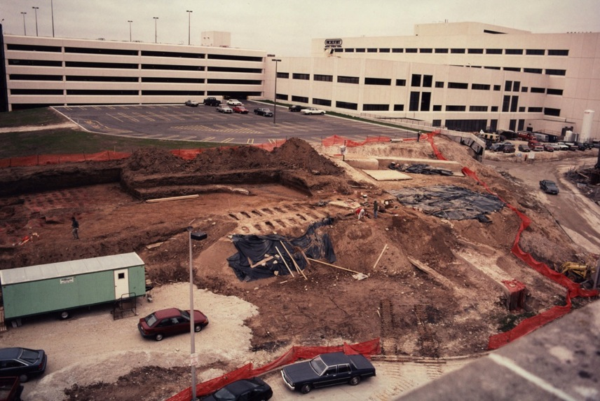
Overview of 1991 and 1992 recovery operations
Location of 2013 excavations
Milwaukee County Poor Farm Cemetery-Identification

Slide 28
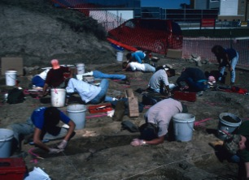
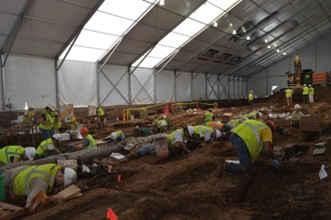
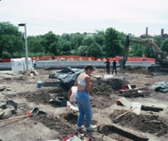
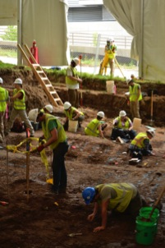
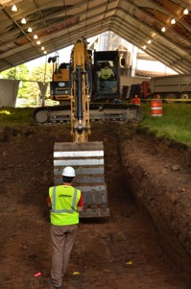
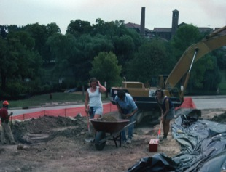
1991/1992
2013
Milwaukee County Poor Farm Cemetery-Excavation

Slide 29
2013 Project Timeline

Slide 30
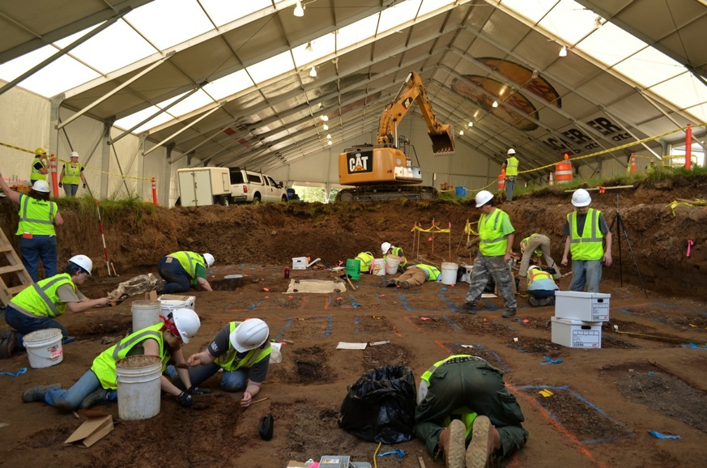
Milwaukee County Poor Farm Cemetery-Excavation

Slide 31
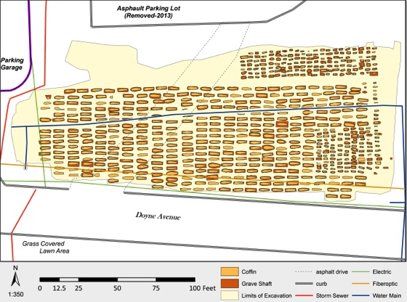
263
368
631 Mapped Coffin Locations
The Milwaukee County Poor Farm Cemetery Project
2013 excavations
Milwaukee County Poor Farm Cemetery-Analysis

Slide 32
294 single adult lots
57 mixed adult lots
10 juvenile lots
7 mixed adult and juvenile lots
368
mapped coffins
381 individuals
263
mapped coffins
284
individuals
246
single juvenile
lots
7 empty
9 mixed juvenile lots
1 dog
Mapped Coffin Totals
Milwaukee County Poor Farm Cemetery-Analysis

Slide 33
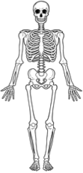

100 individuals from mixed
lots
age exclusive - only adult or only juvenile
550 single individuals in a single coffin
294 single lots
256 single lots
81 individuals from mixed lots
19 individuals from mixed lots
15 individuals from mixed lots
mixed age – adults and juveniles
665
6 individuals from mixed lots
9 individuals from mixed lots
381
284
Individuals recovered from the 2013 MCIG Cemetery Excavations
Milwaukee County Poor Farm Cemetery-Analysis

Slide 34
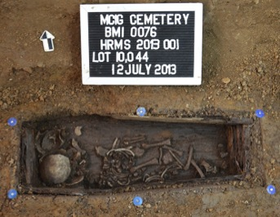
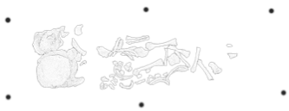
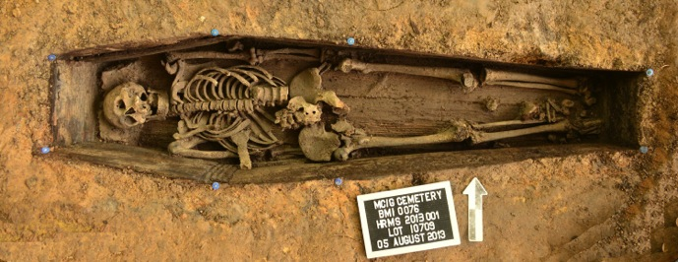
single individual in a coffin
Milwaukee County Poor Farm Cemetery-Analysis

Slide 35
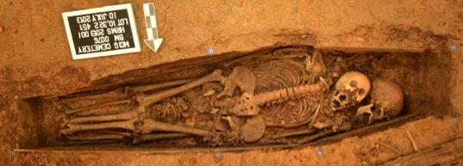
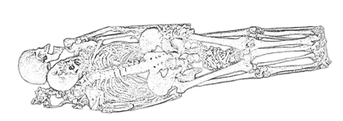
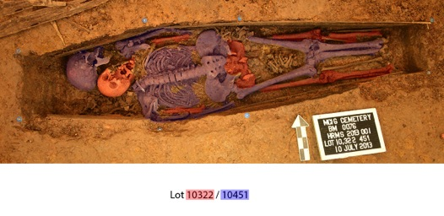
“mixed” context assigned multiple lot numbers
Milwaukee County Poor Farm Cemetery-Analysis

Slide 36


commingled context
Milwaukee County Poor Farm Cemetery-Analysis

Slide 37




Entire 91/92 excavation area
Existing Cancer Center Froedtert Hospital
Area in photo
View East
View West
1991/92 area of excavation
2013 area of excavation
1991/92 area of excavation
2013 intact burials
2013 area of excavation
Milwaukee County Poor Farm Cemetery-Analysis

Slide 38

Area of intact burials
2015
Excavated Burials 1991,1992, and 2013
Milwaukee County Poor Farm Cemetery 2
Milwaukee County Poor Farm Cemetery-Analysis

Slide 39




Burial Lot # 10655
Bandage wrapped hand
Gauze and Vaseline bottle recovered from Burial Lot # 10655
Milwaukee County Poor Farm Cemetery-Analysis

Slide 40



Shirt before clothing removal
Pants before clothing removal
After clothing removal
Broken femora
pipes
Burial Lot # 10736
Milwaukee County Poor Farm Cemetery-Analysis

Slide 41



Cleaning and Stabilization
Milwaukee County Poor Farm Cemetery-Analysis

Slide 42



Analysis
Milwaukee County Poor Farm Cemetery-Analysis

Slide 43
Second Ward Cemetery
2014 rain garden disturbance
2015 north addition disturbance
Second Ward Cemetery-Identification

Slide 44
History of permitting process for the Second Ward Cemetery
Accidental Disturbance/ rain garden construction (removal of three disturbed burials from uncataloged burial site)
date requested – June 20, 2014
date granted – June 30, 2014
2. Request to work within the boundaries of uncataloged burial site (addition to the Guest House)
date requested – March 30, 2015 *archaeological monitor recommended
date granted – April 17, 2015
3. Burials encountered during monitoring, : contract and permission to disturb requested
date requested – July 22, 2015
date granted – July 25, 2015
Second Ward Cemetery-Identification

Slide 45



Second Ward Cemetery June 2014
Second Ward Cemetery-Identification

Slide 46


3 Burials
1 year old of indeterminate sex
16 year old of indeterminate sex
34 year female
Second Ward Cemetery-Identification

Slide 47

Map of the city of Milwaukee, Wisconsin/ from surveys under the direction of H.F. Walling 1859; M.H. Tyler, Publisher
Second Ward Cemetery-Identification

Slide 48


Plan of Milwaukee. Entered 1879 by S. Augustus Mitchell, Washington. (1880)
Second Ward Cemetery
Second Ward Cemetery-Identification

Slide 49




Second Ward Cemetery-Excavation

Slide 50


Burial Lots 128 (background) and 117 (foreground) disturbed in similar manner; no concrete slab located between burials or in Lot 117 view north
Burial Lot 64 - an adult underneath the house foundation, bisected by two large ceramic pipes, disturbed bone not recovered
Second Ward Cemetery-Excavation

Slide 51


*80 individuals were recovered
*Field assessment of ages indicates 54 adults and 26 juveniles
*Juveniles include: 13 infants, 8 children and 5 adolescents
Second Ward Cemetery-Excavation

Slide 52




Summary and Concluding Remarks

Slide 53



Summary and Concluding Remarks

Slide 54



Summary and Concluding Remarks

Slide 55

Summary and Concluding Remarks

Slide 56


http://ihja.blogspot.com.br/2010/11/os-escravos-do-camorim.html
An artist's rendition of the Rio Olympics facilities for the 2016 Summer Games. Some of the media accommodations were apparently built on top of remnants of Brazil's slave history. (Rio Olympics)
http://www.smithsonianmag.com/smart-news/media-village-rio-olympics-built-mass-grave-slaves-180

