Slide 1
Examining the Wisconsin Personal Property Tax
Scott Drenkard
Economist & Manager of State Projects
Tax Foundation

Slide 2
Tax Foundation
Founded in 1937
Non-profit, non-partisan research organization
Federal, state, and legal centers
Our principles: simplicity, neutrality, transparency, stability, pro-growth

Slide 3
State Business Tax Climate Index
Measure of tax structures, not tax burden
Hundreds of variables that states compete on
Guide to beneficial tax reform options
Wisconsin FY 2014 Ranking
Overall | 43
Corporate | 33
Individual | 43
Sales | 15
Unempl. Insur. | 25
Property | 36

Slide 4
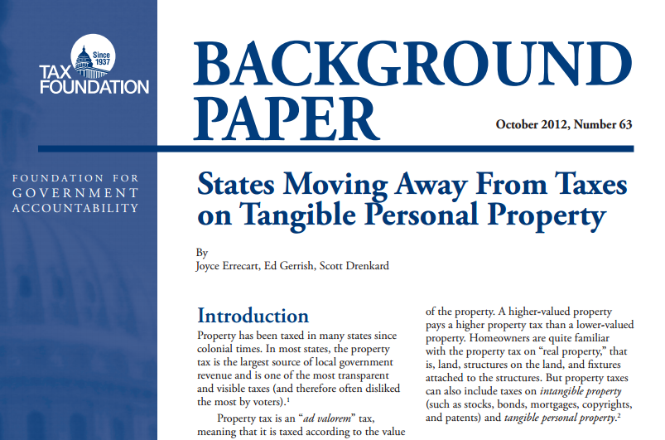
Personal Property Taxes
32 state levy taxes on tangible personal property
Seven states eliminated personal property taxes entirely, four have eliminated most

Slide 5
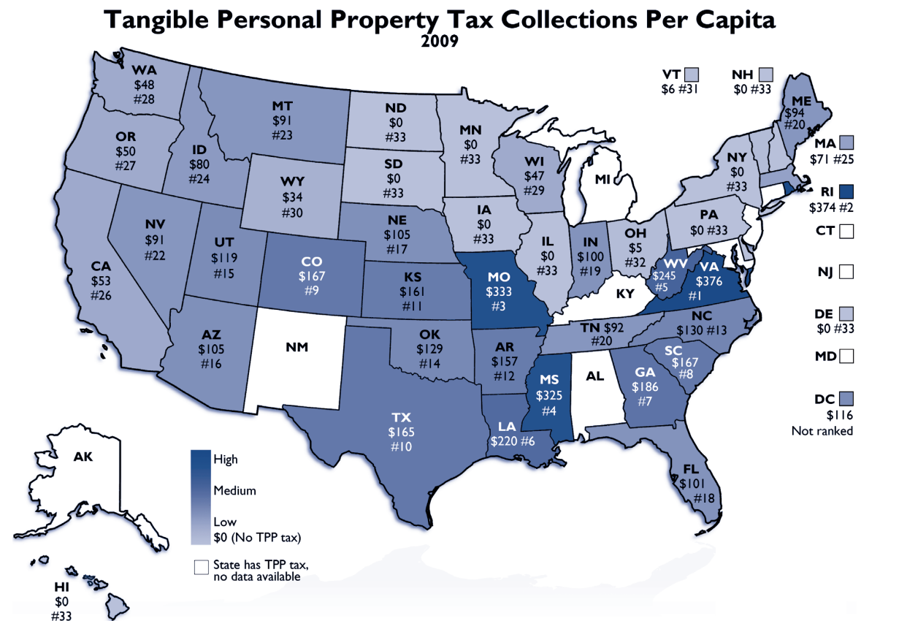

Slide 6
Problems with Personal Property Taxes
TPP taxes distort economy by punishing capital purchases
Tax burden is hidden from view of public
TPP taxes are “taxpayer active”:
Calculation involves various assessment ratios, tax rates, depreciation schedules
Higher compliance costs than real property taxes
Levied at the local level

Slide 7
Personal Property Tax Reduction Options
Exempt inventory (Already done in WI)
De minimis exemption
Exempt new property
Local options

Slide 8
Failures: Illinois and Ohio
Ohio: eliminated the TPP tax, but replaced with the Commercial Activity Tax (CAT), a tax on gross receipts
Illinois: eliminated the TPP tax, but replaced with a 2.5 percent “replacement tax” on corporate income that officials pretend is not there

Slide 9
Success Story: Indiana
2014: Gave localities the option to increase their de miminis exemption or exempt new property
Beyond: Governor aiming to repeal the whole tax

Slide 10
Success Story: Michigan
2014: By 69-31 initiative vote:
Exempted new property
Increased de minimis exemption to $80,000
Result is a healthy phase-out
Made locals whole by earmarking state use tax revenues
$500 million net tax cut

Slide 11
Q and A
drenkard@taxfoundation.org
(202) 464-5111 (Direct line)
www.TaxFoundation.org

