Slide 1
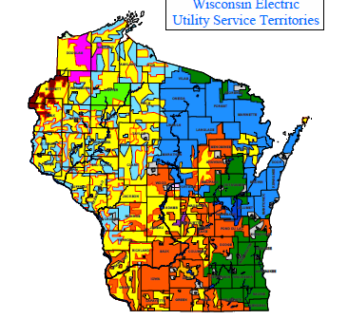
Where is GeoExchange
in Wisconsin?
Presentation for:
Special Committee on Strategic Job Creation
September 23, 2010

Slide 2
Where are we? September 2010
GeoExchange Industry remains immature and fractured.
Majority of public still believes “artificial facts” about Geo.
Wisconsin lacks any clear regulations concerning the borefields.
No clear industry leaders.
Frustration for those who do “get it”
Calls to the College (from homeowners) running 4:1 negative.

Slide 3
National Advisory Bodies
GEO NII Geothermal Heat Pump National & International Initiative 1615 M.Street N.W. Suite 800 Washington DC 20036

Slide 8
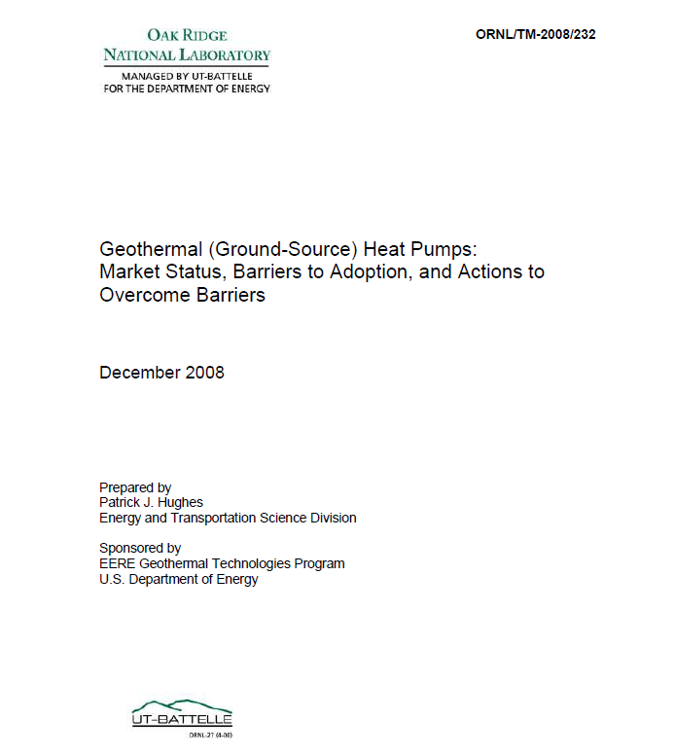

Slide 9
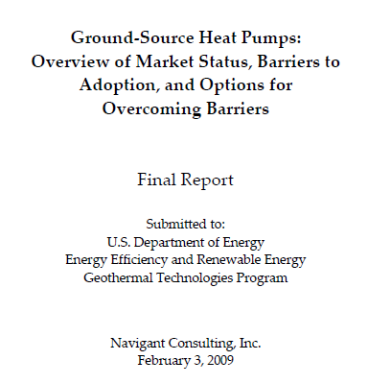
1 of 3

Slide 10
2 of 3

Slide 11
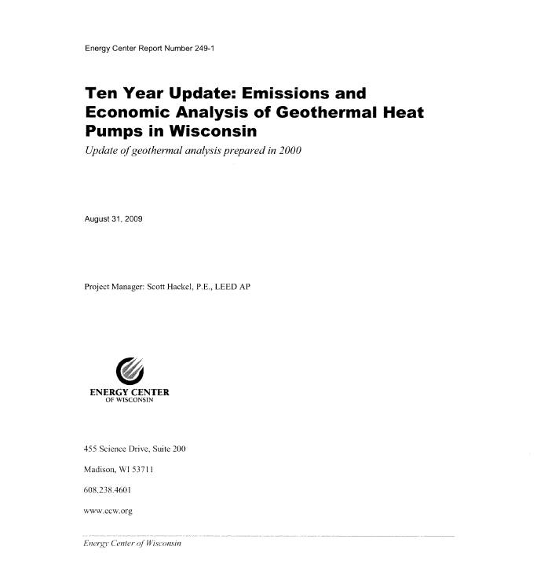

Slide 12
Wisconsin Statistics
Wisconsin data shows approx. 2.2 million single family homes.
Wisconsin has approx. 400 Licensed water well drillers who install more than 17,000 water wells/year ( last few years < 8000 do to downturn in economy)
Nationwide less than 20% of water well drillers have any interest in Geo.
Jan 09: 101 IGSHPA Certified GeoExchange Installers in WI.
Sept 10: 281 Certified GeoExchange Installers (20 in SE WI, 30 more from the M7 region)
Only 7 Certified drillers and 5 Certified Designers

Slide 13
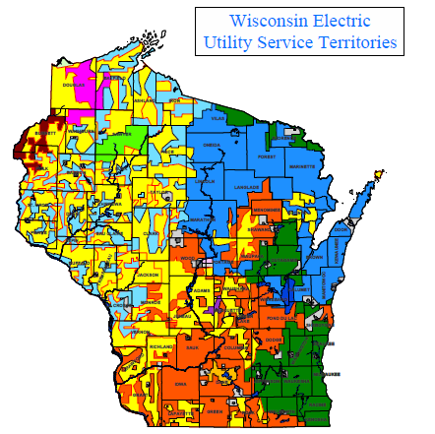
Knowledge/ Action Barrier

Slide 14
So what is doing?
Received both a State and an Federal NSF Grant for GeoExchange Curriculum development.
We are presently working through the WTCS approval process for both our 1 yr Diploma and our 2 yr A.A.S. Degree in GeoExchange.
Have purchased a drill rig and auxiliary support equipment to train the future technicians.
We are offering 5 of the courses developed for the Grant this Fall and 5 more for Spring.
We are the first College or University in the Northern Hemisphere to have a Geo drilling program.
We currently serve on the Steering Committee for Green Jobs for the WTCS

Slide 15
Looking to the Future
We have a STRONG Federal Policy with Incentives to 2016
We need an Energy Policy in Wisconsin
Aggressively pursue Manufacturers to “Build it in Wisconsin”

Slide 16
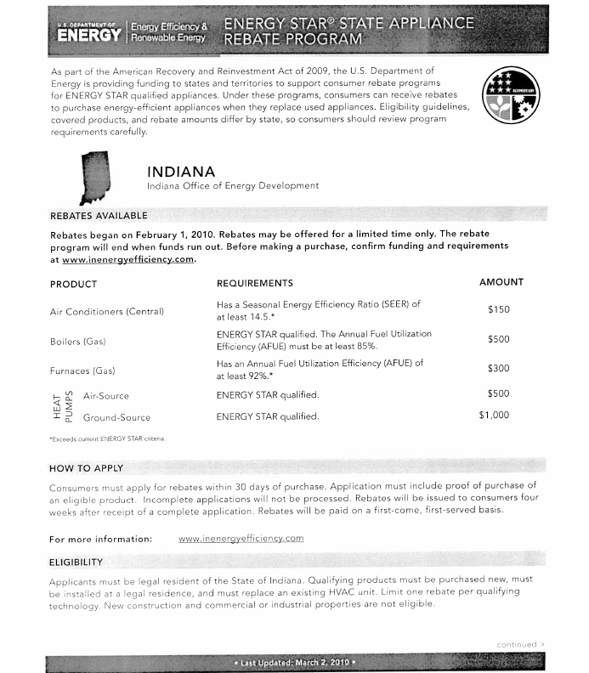

Slide 19
