Slide 1
Special Committee on Strategic Job Creation
Horizon Center, Kenosha
September 23, 2010
Michael A. Lanser, President
Lakeshore Technical College
Randy Zogbaum, Education Director
Wisconsin Technical College System

Slide 2
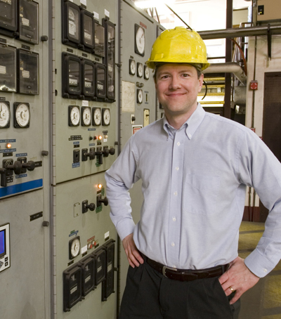
Outline
Strategic Area of Focus
Green Jobs Steering Committee
LTC Energy Education

Slide 3
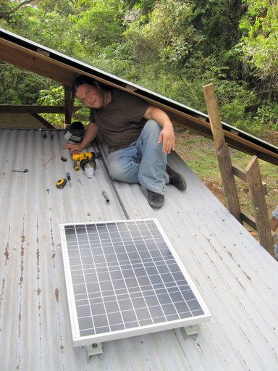
Strategic Area of Focus
AACC Sustainability Task Force
COWS Report
MGA Green Jobs Committee
Presidents Association
Optimize technical college resources and partnerships

Slide 4
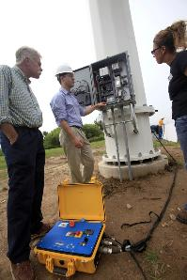
Green Jobs Steering Committee
Coordinate WTCS Efforts
Advise on programming
Facilitate response to
national initiatives
Project jobs
Share best practices
Promote WTCS role

Slide 5
WTCS Specialization
Specialty | College
Biofuels | Mid-State, Fox Valley, Madison, Northeast
Energy Efficiency | Fox Valley, Mid-State, Milwaukee, Nicolet, Northeast, Indianhead
Geothermal | Gateway
Green Manufacturing | Moraine Park, Southwest
Nuclear | Lakeshore
Rescue | Lakeshore
Solar | Mid-State, Northeast, Milwaukee
Torque Certification | Gateway, Lakeshore
Water | Milwaukee, Gateway, Moraine Park
Wind | Lakeshore

Slide 6
Job Classifications
Before Meter
Coal - Electrical Power
Nuclear
Wind
Solar/PhotoVoltaic
Geothermal
Biofuels/Refinery/Digesters
Hydro
Distribution - Utility Line Workers
After Meter (Commercial and Residential)
Weatherization
Building Design
Auditing
Energy Management
Solar Thermal
Energy Auditing
Sustainable Operations - Facilities Management
Water Resources/Management

Slide 7
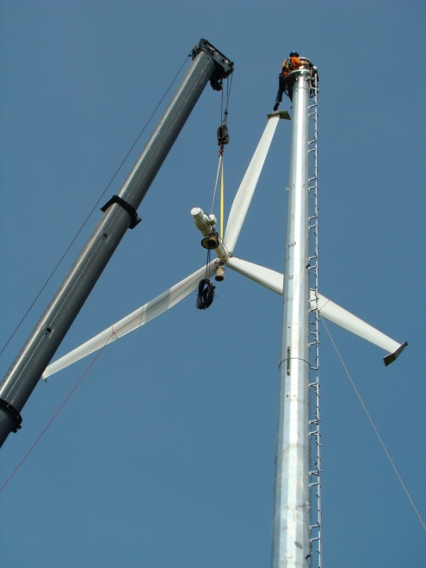
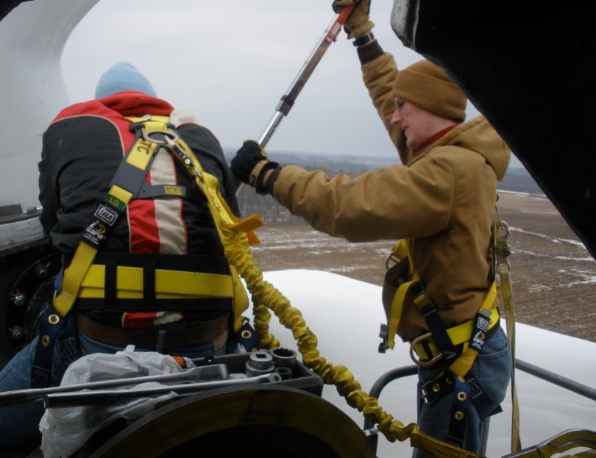
Wind Energy Technology
Associate Degree
128 Students enrolled since 2008
10 Graduates since 2008
51 State-wide jobs
20% Wind Grant
Notes:
Wind Energy students
2008: 5 enrolled, 4.17 FTE
2009: 25 enrolled, 12.50 FTE
2010: 49 enrolled, 34.43 FTE
2011: 49 enrolled, 21.13 FTE
Wind Energy graduates = 10 total
2008: 0
2009: 3
2010: 6
2011 (Summer): 1
State-wide job openings = 51 total
31 existing
2010-11: 10
Future: 10
US Department of Energy 20 Percent Wind by 2030: Overcoming the Challenges ($199,236)
Project Title: POWER Purposeful Partnerships cOordinating Wind Education Resources
Objectives:
1. Promote wind energy careers through industry and educational partnerships.
2. Increase the quality and value of LTC’s Wind Energy core curriculum.
3. Increase the annual number of graduates that complete LTC’s core wind energy curriculum..
Benefits/Outcomes:
1. Increases reach of LTC’s Wind Energy Technology program creating an additional 20 to 25
graduates annually.
2. Creates career pathway to access Wind Energy Technology programs at technical colleges
statewide.
3. Provides opportunity for rapid credentialing for previous graduates of related programs and
apprenticeships.
4. Provides comprehensive career outreach and exploration to high school students, dislocated
workers, veterans, and other untapped labor pools.
Major Participants:
1. Moraine Park Technical College
2. Gateway Technical College
3. Mid-State Technical College
4. Milwaukee Area Technical College
5. Blackhawk Technical College
6. Snap-on Incorporated
7. ENSA
8. Vestas

Slide 8
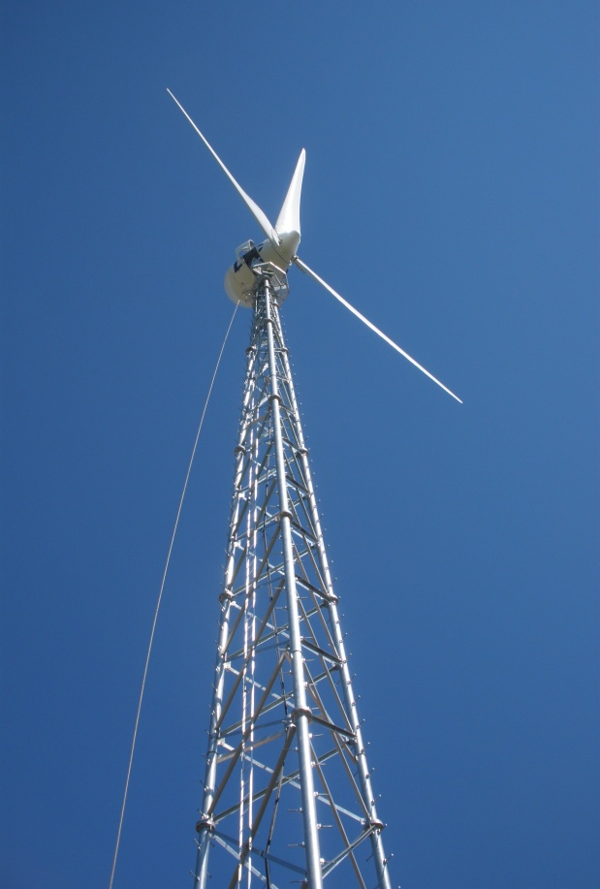
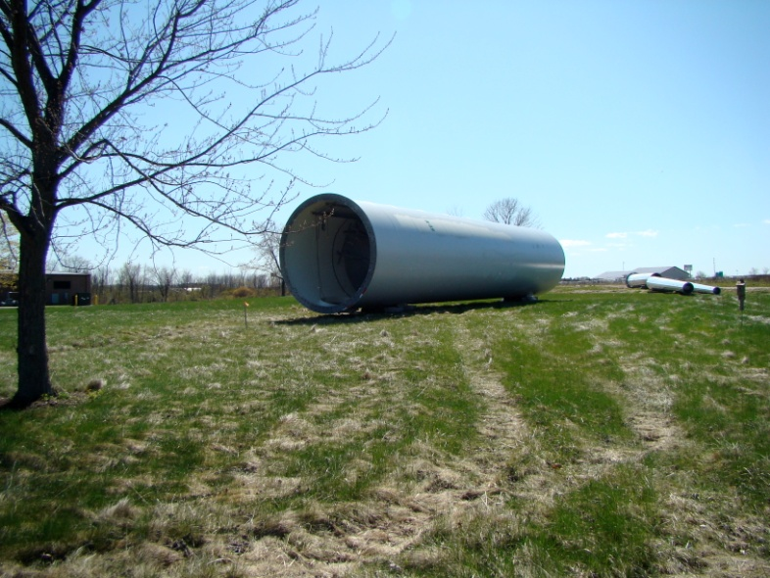
Wind Lab
Entegrity
Vestas
Endurance
Tower
Nacelle

Slide 9
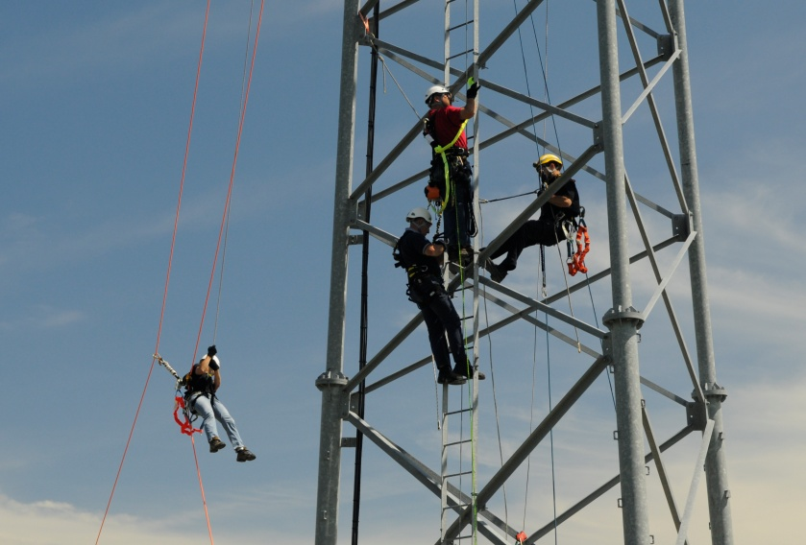
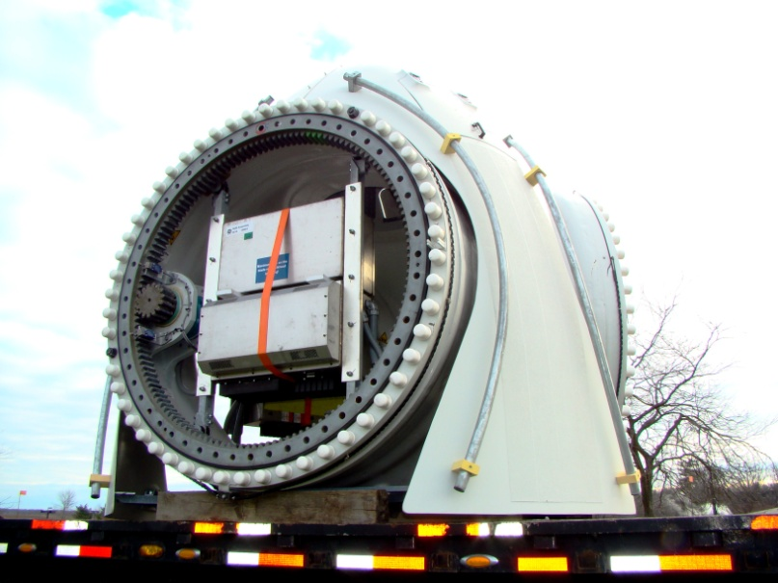
Rescue
High angle
Confined space
Notes:
High Angle/Confined Space students = 68 duplicated
2008: 0
2009: 6
2010: 62

Slide 10
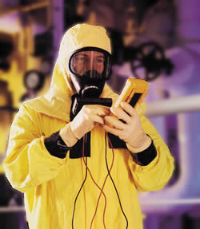
Nuclear Technology
Associate Degree
232 Students enrolled since 2008
14 Graduates since 2008
206 State-wide jobs
Grants
Department of Labor
Nuclear Regulatory
Commission
Notes:
Nuclear Technology students
2008: 22 enrolled, 4.93 FTE
2009: 36 enrolled, 19.57 FTE
2010: 94 enrolled, 49.83 FTE
2011: 80 enrolled, 24.30 FTE
Nuclear Technology graduates = 14
2008: 0, 6 online
2009: 0, 0 online
2010: 1, 1 online
2011 (Summer): 6, 0 online
5 students graduated from the program in May 2010 (first graduates from new NT program)
3 graduates have been hired in the nuclear industry (2 at Dominion – Kewaunee Power Station, 1 at NextEra Energy – Point Beach Station)
1 graduate has decided to continue his education in order to earn a 4-year degree
1 graduate is presently seeking employment
3 students are completing their internships this Fall and are scheduled to graduate in December
16 students are entering their second year of the program this Fall and are projected to graduate in May 2011 or December 2011
2 students have left the program
1 student could not handle the math in the program and has transferred to different program at LTC
1 student has dropped from school because of poor grades
24 students entered their first year of training in August 2010
State-wide jobs
2010: 206 jobs, 11 annual openings
Future (nuclear medicine technologists): 403 jobs, 13 annual openings
Department of Labor Grant ($987,904)
Brief Description of Workforce Challenges Addressed (100 words)
The NEW Energy project is designed to address the shortage of skilled electrical power generation
workers in Northeast Wisconsin. Both nuclear and non-nuclear electric producers in the region are
facing workforce shortages caused by the aging demographics of the region and the corresponding
impact on the workforce.
Brief Description of the Proposed Solution & how it will be Different from Original Model (150 words)
The NEW Energy project is composed of four objectives:1) provide comprehensive career
awareness and outreach to increase enrollments and graduations from associate degree programs at
partnering colleges; 2) provide support for LTC’s newly modified Nuclear Technology associate
degree program; 3)develop a General Utility Technology Associate of Applied Science degree
program; and 4) provide skill development opportunities for the incumbent workforce.
Key Partners:
1. Lakeshore Technical College (LTC)
2. Northeast Wisconsin Technical College (NWTC)
3. Bay Area Workforce Development Board (BAWDB)
4. Dominion
5. Wisconsin Public Service Corporation (WPS)
NRC Grant: Trades School and Community College Scholarship Grant ($149,472)
Objectives and Benefits: Provide financial assistance to full-time enrollees to Lakeshore Technical College’s Nuclear Technology program and support
critical workforce needs in the nuclear power sector

Slide 11
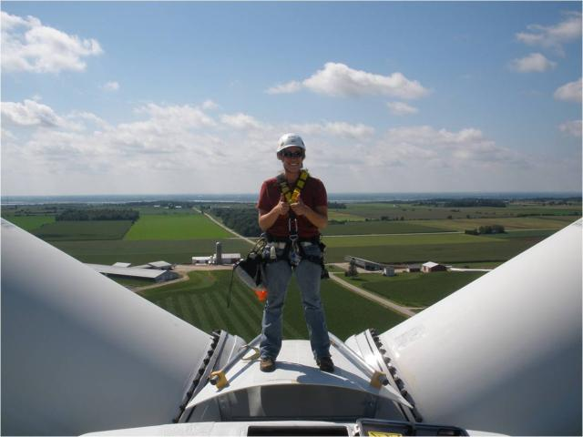
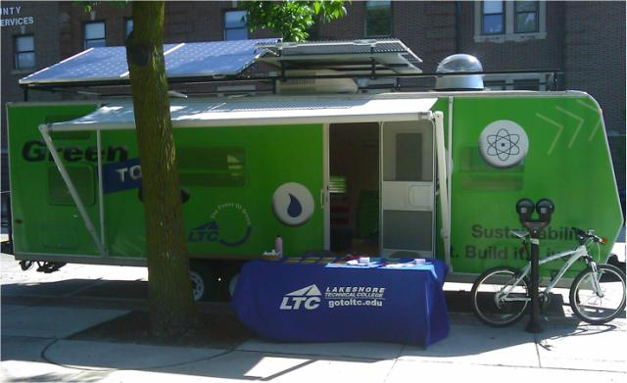
Closing Comments
Presidents Association
Green Jobs Steering
Committee
College Specializations

