Slide 1
Recycling Film Plastic in Wisconsin: Ready, Set, ??
Roger Springman,
Genesis Poly Recycling
Single-Use Plastics Committee
August 2010

Slide 2
Spent Film Plastic Remains Challenging for Recycling
Being light and spongy (high memory) , significant densification (baling) is required for economical transport.
Often dirty, especially ag, horticultural, and construction films, washing is needed to maintain market value.
Poses operational problems in MRFs and sorting facilities without discrete handling.

Slide 3
Often limitations for direct re-use or sales after shredding and cleaning. Processing into pellets maximizes market value and re-use potential.
Film recycling requires significant volumes for profit maximization. Significant investments in collection networks, infrastructure, and trucking are usually required. Truck loads in excess of 25,000 to 30,000 lbs. sought.

Slide 4
Common Film Plastic Uses:
Agricultural: Bunker covers, silo bags, hay wraps, polypipe, grain covers,
Horticultural : Hoop houses, mulch,
Construction: Worksite enclosures, mobile home wrap, concrete curing
Marine: Boat wrap
Packaging: Product (pallet) wraps, container liners, equipment wraps, grocery bags
Structures: Golf domes, portable garages, cattle housing. **Generally not single-use.

Slide 5
Film Use Background
Common Resin types: LDPE, LLDPE, HDPE, PVC, PP, EVA.
Mill thicknesses from <1 for grocery bags/liners up to 12 for boat wraps and silo bags and up to 20 for reinforced grain covers.
Produced in grocery bag sizes up to many hundreds of feet long/wide for agriculture, construction, and structures.
No studies on annual WI use, but likely exceeds 40 million lbs. per year

Slide 6
Genesis Poly Recycling, Mankato, MN
Accepts both rigid plastics like nursery pots, trays, pesticide containers, and pallets along with agricultural and horticultural film plastics and shrink wraps.
Works with HDPE, LDPE, LLDPE, PP, and PS.
Remainder of slide program will concentrate on agricultural and horticultural film plastics.

Slide 8
Ag/Horticultural Film Disposal Overview
Many dairy and livestock farmers along with nursery and greenhouse operators see films as a nuisance waste.
Lacking recycling , most films are landfilled and some farmers burn them . . even though illegal. Landfill tipping or tonnage fees provide a baseline cost consideration.
Until convenient collection networks are created, the above practices will continue.

Slide 10
A Look at the WI Setting
WI has 1.2 million dairy cows residing on about 13,000 dairy farms. Replacements not included.
Annual silage plastic use per cow ranges from 4-6 pounds for bunker operations to 12-15 for silo bag operations. Hay wraps and twine excluded.
Silo bags commonly range in sizes from 8 – 10 ft. in diameter to 200 – 300 ft. long.
Weights for each silo bags are generally 200 to 400 lbs. Bunker covers can be 300 to 500 lbs.

Slide 11
Setting (cont’d)
300 to 400 nurseries and greenhouses can also use films each year.
Netting and specialized cover plastics are increasing in use , but they do not recycle well. Woven plastic films such as supersacks do not recycle well either.
LDPE and LLDPE are the predominant films used for agricultural and horticultural purposes. Total film plastic use for these two sectors is likely 10 - 20 million lbs. per year.

Slide 12
Spent Film Practices
Silo bags and bunkers are unloaded via mechanical means, (e.g. front-end loaders).
Cut plastic is placed in dumpsters, burn barrels, or open fires. Burning releases furans and dioxins. Small pieces may blow around farms and litter landscape.
Greens industry landfills virtually all films.
No formal estimates available on film plastic disposal in WI. The following slide estimates situation in New York State.

Slide 14
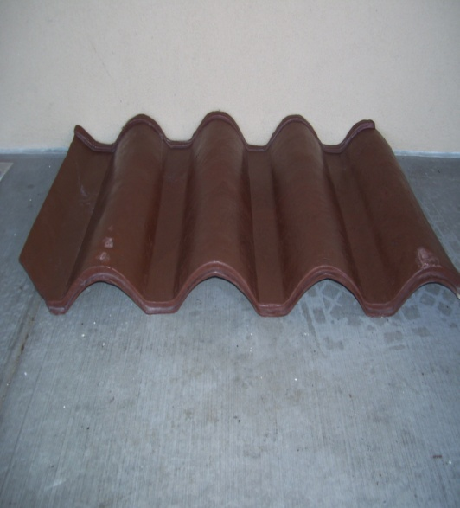
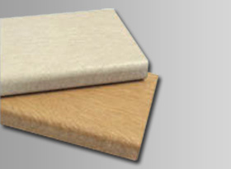
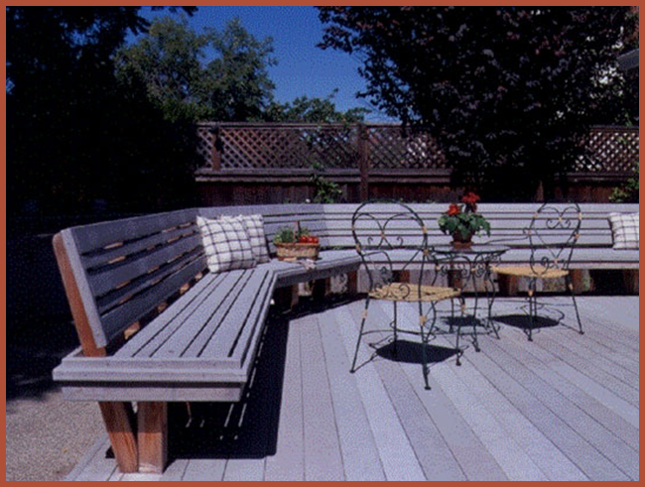
Film Can Be Re-used or Now Refined into Crude Oil
Film can be processed into pellets and then made into plastic lumber materials such as decking, tile roofing, fence posts, baleboard, or even sheeting.

Slide 16
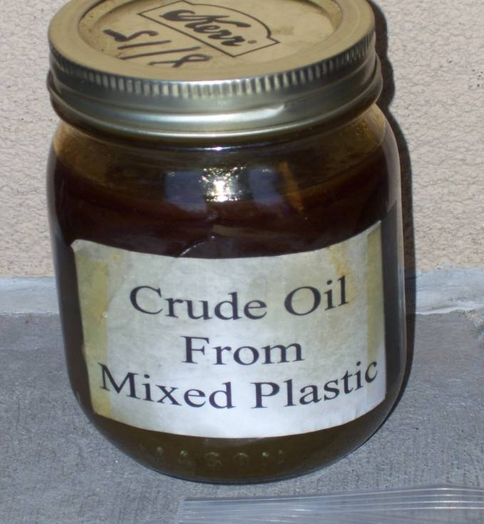
Advanced Pyrolysis and Depolymerization Technologies are Yielding Results
North America is catching up with world-wide activity in plastics-to-fuels.
Perhaps most advanced is Agri-Plas in Oregon which has sent several tanker loads of sweet crude to a Tacoma refinery.

Slide 17
Collecting Ag and Horticultural Film Plastics Requires Infrastructure, Coordination, and Networking
Dispersed at 1,000s of locations
Normally small to modest amounts per site
Generators very busy. Waste management not primary concern
Film plastics often dirty or contaminated. Silo bag contamination can be in excess of 20%.
On-site handling must be convenient

Slide 18
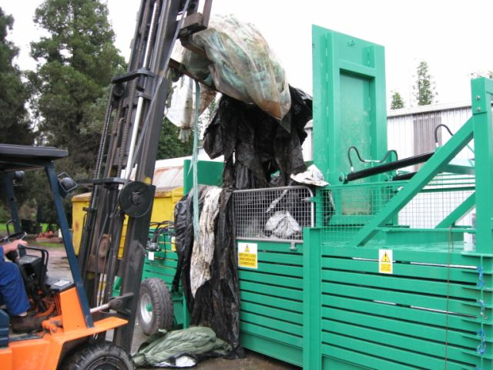
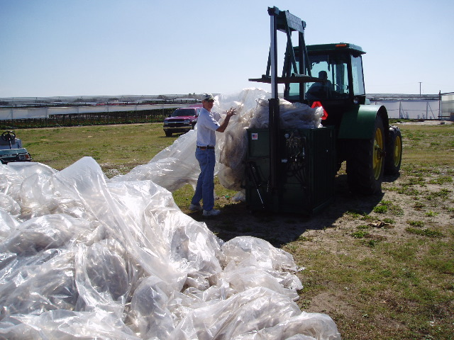
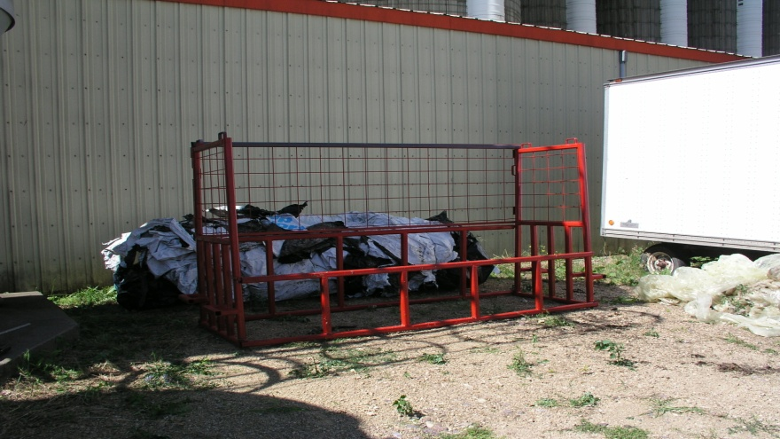
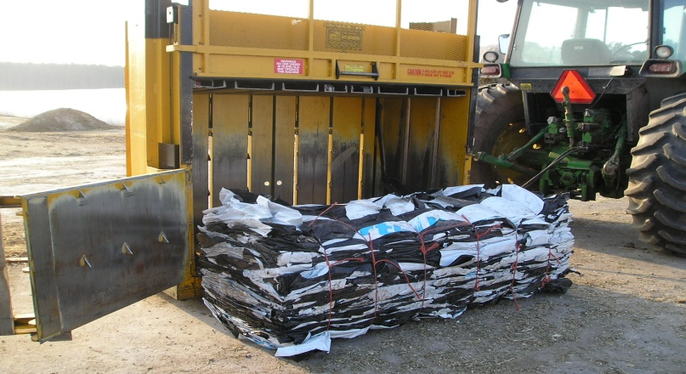
On-site Baling Equipment is Available when Recycling/re-use conditions Improve

Slide 19
Film Issues of Concern for Single-Use Plastics Committee
Infrastructure Needs: WI has less than 5 public balers capable of handling loose film plastic (horizontal, floor-mounted balers). Private waste sector has shown no interest. If recyclers cannot provide mobile baling services and if local sponsors do not want to invest in baling, significant recycling will not occur in WI.
Networking and Local Partnering: To create sustainable film collection networks, significant coordination is needed with generators, local >

Slide 20
Issues (cont’d)
governments, and professional organizations such as UWEX and DNR to provide information on logistics, film quality concerns, on-farm education, etc.
Demonstration Grants and Technical Assistance: No one collection system will work everywhere. Providing $ for innovative, multi-governmental collection schemes, perhaps through Recycling Fund, could prove very helpful.

Slide 21
Issues (cont’d)
Product Stewardship Needs: Film mfgs. have shown no interest in assisting recycling. Narrow margins and virgin material use are the primary excuses. While WI baggers and retailers have shown some interest, without greater incentives or mandates, this situation may not change. The potential value of a landfill film ban should be explored.
Market Development Incentives: While films have good re-use potential, to maintain >

Slide 22
Issues (cont’d)
markets and encourage sustained product purchase, improved recycled content labeling, green purchasing strategies, and consumer education/awareness should be explored.
New Technologies and Regulatory Review: If a new technology like plastics-to-fuel is to consider WI, it will be important that our current regulatory system is ready so non-essential delays and costs can be avoided.

Slide 23
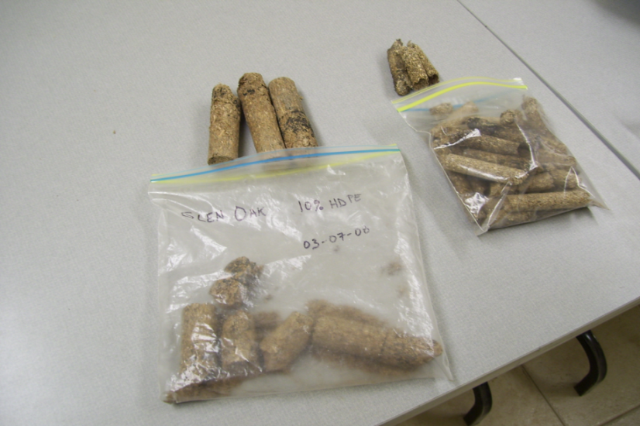
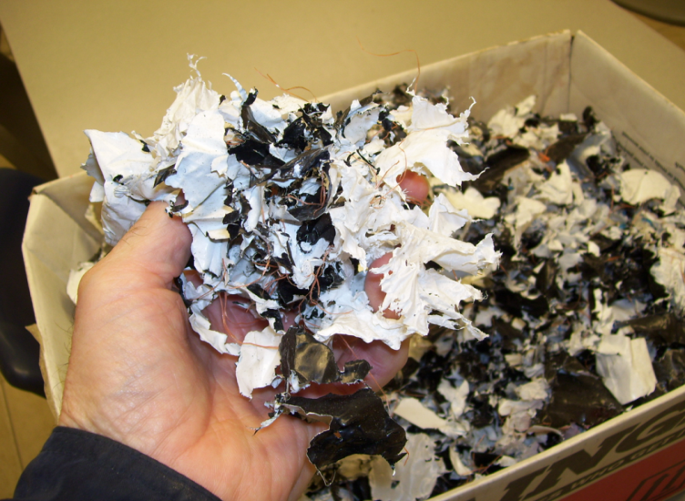
Wisconsin is in a unique position to take advantage of its film volumes, recycling traditions, public recycling infrastructure, and market position to move better solutions.
This potential is seen by Wood Residuals Solutions, Montello, WI who is using films as a binder and to increase the BTU value of wood pellets for industrial boilers.

Slide 24
The future seems at hand and now it needs some enhancing and focusing to reach its full potential . . . a perfect job for the Single-Use Plastics Committee. Thank You.
Contact Information:
Roger Springman, Network Development Director
Genesis Poly Recycling
608-617-1027 (c)
608-429-3403 (h and w)
Several slides in this presentation were provided through Dr. Lois Levitan, Environmental Risk Analysis Program, Cornell University.
A number of her reports and presentations can be found at http://environmentalrisk.cornell.edu

