Slide 1
Collecting and Marketing Film Plastics
Joe Van Rossum
UW Extension
Recycling Specialist

Slide 2
Markets for Plastic
Good demand for clean plastics
Separate by resin and type
Prices rebounded quickly from late 2008 Swoon
Domestic/Export ~65/35

Slide 3
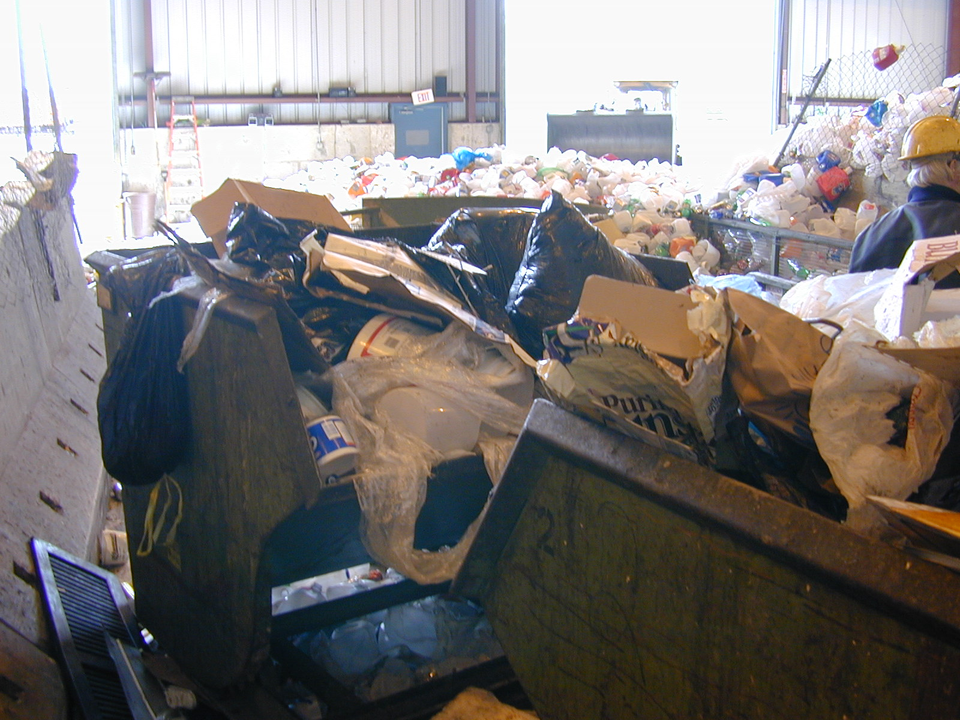
Collecting Bags, Sacks & Wraps
Not generally compatible with current infrastructure for paper & containers
MRF Design
Remove at front end
Tangle on rotating shafts

Slide 4
Practices in Use
Paper Compactor Boxes
Bagged film included
Picked out at MRF
Sandwich bale
Film and OCC in same bale
Separated at MRF

Slide 5
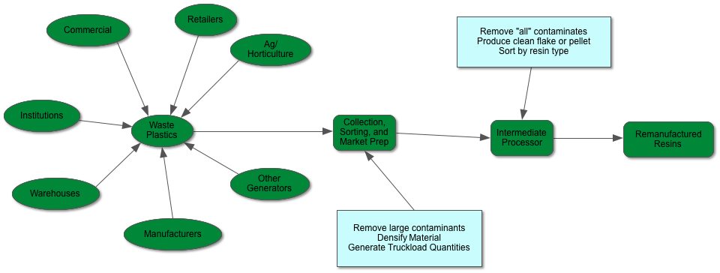
The Collection Challenge

Slide 6
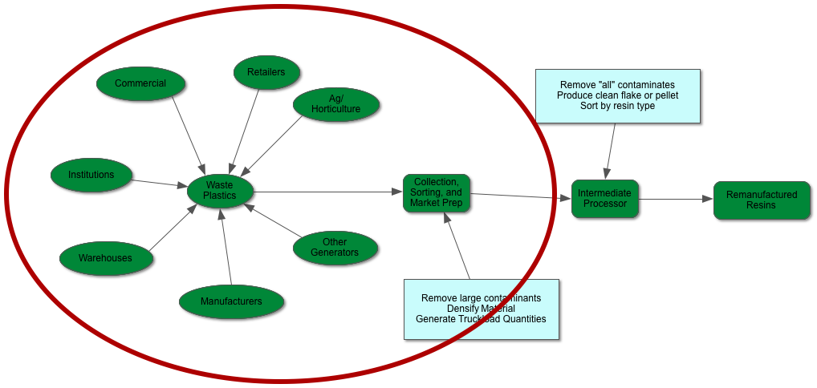
Where to Focus Efforts?

Slide 8
Current Market Development Efforts
Joe Van Rossum
UW Extension
Recycling Specialist

Slide 9
Technical Assistance
UW Extension, DNR, WasteCap Resources, others
Connecting generators w/Recyclers
Wisconsin Recycling Markets Directory

Slide 10
Navigating Regulations
Fit w/in existing laws/rules
Alternative approvals
Low hazard exemption
Beneficial reuse

Slide 11
Funding Sources for Market Development
Waste Reduction and Demonstration Grant - $0
UW System Solid Waste Research Program
Faculty and Student projects
$154,300/year
“Stand-in-line” with other businesses
Energy funding – i.e. anaerobic digestion

