Slide 1
STATE OF WISCONSIN HIGHER EDUCATIONAL AIDS BOARD
PRESENTATION TO THE
LEGISLATIVE COUNCIL STUDY COMMITTEE
REVIEW OF HIGHER EDUCATION FINANCIAL AID PROGRAMS
AUGUST 17, 2010

Slide 2
State Financial Aid Programs
Programs for Students with Financial Need
Student must file the Free Application for Federal Student Aid (FAFSA)
Wisconsin Higher Education Grant
Wisconsin Tuition Grant
Programs for Students with Financial Need who must also meet Additional Requirements - FAFSA and additional Application or Nomination
Hearing & Visually Handicapped Student Grant
Indian Student Assistance Grant
Minority Undergraduate Retention Grant
Nursing Student Loan
Talent Incentive Program Grant
Programs Not Based on Financial Need - Do not require the FAFSA
Academic Excellence Scholarship
Minnesota-Wisconsin Tuition Reciprocity Program
Minority Teacher Loan
Teacher of the Visually Impaired Loan
Marquette University School of Dentistry Capitation Program
Veterans Tuition Remission Reimbursement

Slide 3
Who May Receive State Aid?
State financial aid is available to residents of the State of Wisconsin enrolled at non-profit colleges and universities based in Wisconsin:
University of Wisconsin System
Wisconsin Technical Colleges
Independent Colleges & Universities
Tribal Colleges

Slide 4
Other Requirements for State Aid Eligibility
State statutes require that students receiving state financial aid must be:
Wisconsin Residents
Citizens or Permanent Non-Citizens
Registered with Selective Service (males)
Up to Date on Child Support

Slide 5
Applying for State Aid
Free Application for Federal Student Aid
HEAB receives FAFSA data for all Wisconsin residents.
The FAFSA is the only application for Wisconsin's 2 major grant programs:
Wisconsin Higher Education Grant
(UW, Technical Colleges, Tribal Colleges)
Wisconsin Tuition Grant
(Independent Colleges & Universities)

Slide 6
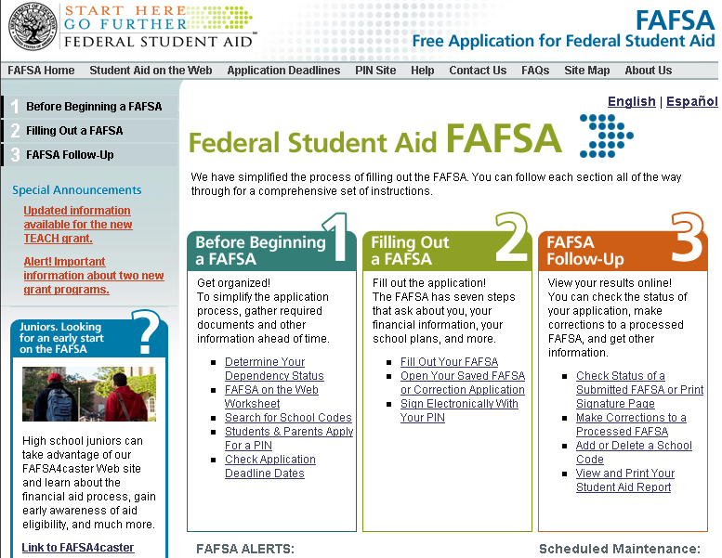
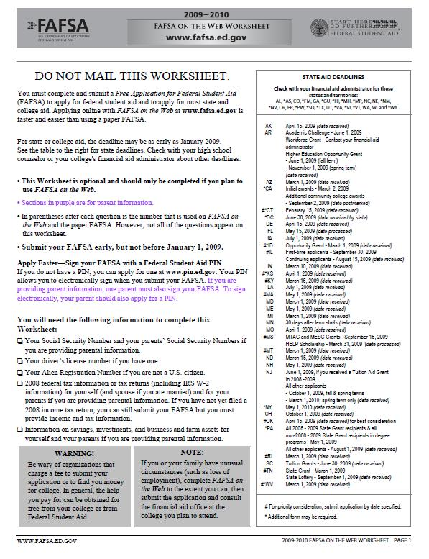
The State uses the Estimated Family Contribution (EFC) in Calculating
State Aid Amounts for Students

Slide 7
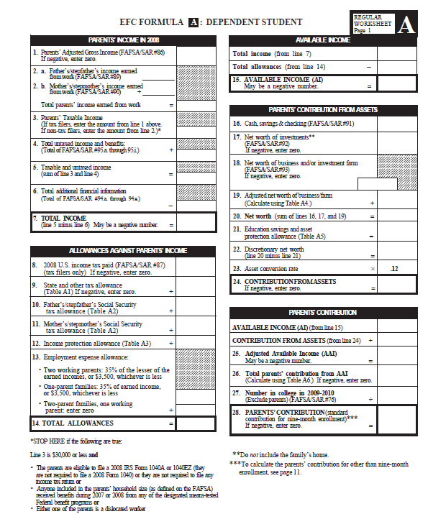
Main Determinants of the EFC
Income of both student and parents
Assets of both student and parents
Family size
Number in College
Age of the older parent
Adjustments to EFC may be made by the Financial Aid Office due to Verification and/or Special Circumstances that limit ability to pay
Notes:
Parents of a dependent student cannot be included in number in college.

Slide 8
Receiving State Financial Aid
HEAB notifies the college or university financial aid offices of each student’s eligibility for state financial aid.
The financial aid offices include the state aid in the student’s financial aid package.
HEAB does not disburse money to individual students

Slide 9
WISCONSIN HIGHER EDUCATION GRANT
One State Statute
Maximum Grant - $3,000
Minimum Grant - $250
Three (3) Sectors
University of Wisconsin System (UWS)
Wisconsin Technical College System (WTCS)
Wisconsin Tribal Colleges
Three (3) Formulas
Three (3) Appropriations

Slide 10
WISCONSIN HIGHER EDUCATION GRANT 2010-2011 FORUMLAS
WTCS ($9,270 – EFC) x 13% = Award
Maximum Award: $1,205
Minimum Award: $529
UWS ($5960 – EFC) x 43% = Award
Maximum Award: $2563
Minimum Award: $843
Tribal ($6,560 – EFC) x 27.44% = Award
Maximum Award: $1,800
Minimum Award: $250

Slide 11
Wisconsin Tuition Grant
One Sector
Wisconsin Association of Independent Colleges and Universities (WAICU)
Minimum Grant - $250
One Formula
One Appropriation

Slide 12
Wisconsin Tuition Grant 2010-2011 Formula
Maximum award: $2,900
Minimum award: $1,000
Inflation Factors: Dependent 340% Independent 740%
UW-Madison Tuition: $8,314
Base Maintenance: $11,800

Slide 13
DETERMINING INDIVIDUAL STUDENT GRANTS FOR WHEG AND WTG
Presidents of each sector submit a recommended formula for the following academic year to HEAB
The Board considers the formula recommendations at the February board meeting
HEAB begins calculating individual student awards once the formulas are approved
Institutions begin notifying students of their total financial aid packages in March
Student awards may be readjusted if formulas have to be revised due to the state biennial budget decisions

Slide 14
5 YEAR APPROPRIATION HISTORY
 | WHEG –UW | WHEG – WTCS | WHEG – TRIBAL | WTG
10/11 | $58,345,400 | $18,797,900 | $440,000 | $26,870,300
09/10 | $55,000,000 | $18,162,200 | $432,500 | $26,338,300
08/09 | $55,000,000 | $17,548,000 | $424,000 | $26,077,500
07/08 | 50,000,000 | $17,130,200 | $414,000 | $25,456,600
06/07 | $39,280,600 | $16,712,400 | $404,000 | $22,754,649
Some factors that are considered in formula development are the appropriation,
the projected number of eligible students, and the meaningfulness of the award.
Notes:
CHECK TO SEE THAT THE NUMBERS ARE CORRECT

Slide 15
MANAGING THE APPROPRIATED FUNDS
Provide meaningful awards to as many students as the funds will support.
Over-commit at a level that all funds will be spent.
Predict when all funds will be committed and additional calculation of awards will be suspended.

Slide 16
These are initial FAFSA applications for each year. This does not include FAFSAs transmitted to HEAB that have been updated or
corrected after the initial submission by the applicant.
Notes:
In August, 2007 there were more FAFSAs filed than for the 15 months of applications in 0303 and 0405

Slide 17
Talent Incentive Program (TIP)
TIP recipients are nominated by either a financial aid counselor or by a Wisconsin Education Opportunities Program (WEOP) counselor
Students must have significant financial need and be educationally disadvantaged
Must be a WI resident
Be a first time college freshman
This program receives federal matching funds
Notes:
Nomination forms are provided in the HEAB packet
Eligible for 10 semesters

Slide 18
TIP EXPENDITURES 2008-2009
State Appropriation: $5,949,200
LEAP $ 627,045
Leveraging Educational Assistance Partnerships
SLEAP $ 806,579
Special Leveraging Educational Assistance Partnerships
Dollars Spent 2008-2009 *$6,009,176
Number of Grants 4,815
*Unspent funds from the 2007-2008 academic year were carried over to 2008-2009

Slide 19
GRANTS
Hearing and Visually Handicapped Student Grants
Annual Appropriation: $99,000
Dollars Spent in 2008-2009: $98,197
Number of Grants 66
Indian Student Assistance Grants
Annual Appropriation: $ 779,700
Dollars Spent in 2008-2009: $766,691
Number of Grants 870

Slide 20
MINORITY UNDERGRADUATE RETENTION GRANT
Grant similar to the Lawton Grant available to UW students
Serves students at the technical colleges, the nonprofit private and independent colleges and universities, and the tribal colleges
Total Appropriation 2008-2009: $794,400
Total Spent $ 818,904
$24,504 was carried over from the 2007-2008 appropriation

Slide 21
Loans
Minority Teacher Loan
The loan is available to students attending the Milwaukee Teacher Education Center. This loan is 100% forgivable in four years: 25% forgiven each year of teaching. Loans that are not forgiven are repaid at 5% interest.
2008-2009 Appropriation $262,100
Dollars Spent $149,354
Number of Loans 63

Slide 22
LOANS
Nursing Student Loan
This loan is 50% forgivable in two years: 25% is forgiven the first year of nursing in Wisconsin and 25% is forgiven the second year. Loan repayment then begins for the final 50% of the loan at an interest rate of 5%. Loans that are not forgiven are repaid at 5% interest.
2008-2009 Appropriation $450,000
Dollars Spent $433,075
Number of Loans 236

Slide 23
LOANS
Teacher of the Visually Impaired Loan
This loan is 100% forgivable in three years: 25% forgiven for the first and second year of teaching and 50% forgiven the third year of teaching. Loans that are not forgiven are repaid at 5% interest.
2008-2009 Appropriation $100,000
Dollars Spent $103,200
Number of Loans 13
*Unspent funds from 2007-2008 were carried into 2008-2009.

Slide 24
LOANS
Teacher Education Loan
This loan is 100% forgivable within two years: 50% is forgiven for each year of teaching in the Milwaukee Public Schools. Loans that are not forgiven are repaid at 5% interest.
2008-2009 Appropriation $275,000
Dollars Spent $263,875
Number of Loans 82

Slide 25
Academic Excellence Scholarship (AES)
Awarded to Wisconsin’s top high school seniors who are Wisconsin residents and are US citizens or permanent US residents.
Earned by the high school senior with the highest cumulative grade point average in the class at the end of the fall semester of senior year.
Up to $2250 per year, for up to four years, toward tuition at participating Wisconsin colleges or universities. HEAB pays $1,125 and the institution pays $1,125.
The number of Academic Excellence Scholarships that may be awarded per school is based on student enrollment, as shown in the following table:
Enrollment Number of Scholarships
1-79 total of 10 available
80-499 1
500-999 2
1000-1499 3
1500-1999 4
2000-2499 5
Over 2500 6

Slide 26
ACADEMIC EXCELLENCE SCHOLARSHIP
RECIPIENT SURVEY
2008-2009
 | Yes | No | No Response
Did the AES influence you to attend a Wisconsin School rather than an out-of-state school? | 364 | 396 | 22
Did the AES influence you to attend a different Wisconsin school than you had first planned? | 36 | 724 | 22
Did the AES allow you to attend college when you otherwise may not have? | 160 | 640 | 22

Slide 27
AES 2008-2009 Recipient Survey

Slide 28
WISCONSIN/MINNESOTA TUITION RECIPROCITY
Beginning in 2008-2009, students are charged the higher of the tuition rate of ‘the campus attended’ or of a ‘comparable campus in their home state’.
Wisconsin Reciprocity Supplement Program: The difference between the Minnesota resident rate for the campus attended and the tuition rate at a comparable Wisconsin institution.
Minnesota campuses apply the Wisconsin Reciprocity Supplement to the student’s account.
At the end of each semester, Wisconsin reimburses Minnesota campuses for the total supplements disbursed.

Slide 29
WISCONSIN RECIPROCITY SUPPLEMENT EXAMPLE
University of Minnesota – Example Campus Annual Tuition | $10,000
University of Wisconsin – Comparable Campus | $7,500
Per-student Supplement paid by Wisconsin to UM Example Campus | $2,500
A Wisconsin student attending UM Example Campus is charged $10,000 in tuition.
UM Example Campus applies the Wisconsin Supplement of $2,500 to the bill.
Student pays $7,500 in tuition.
Wisconsin Reimburses UM Example Campus $2,500.

Slide 30
WISCONSIN RECIPROCITY PAYMENTS
 | STATE PAYMENT | UOF MN | MSCU | TOTAL
2008-2009 | $10,529,953 | $1,726,195 | $304,636 | $12,560,785
2009-2010 | $9,232,407 | $3,373,400 | $456,863 | $13,062,670

Slide 31
RECIPROCITY TUITION REMITTED TO GPR
Students from Minnesota attending a Wisconsin University also pay the higher of the tuition rate of the campus attended or of a comparable campus in their home state. Minnesota tuition rates are typically higher than those of Wisconsin universities. Tuition collected by UW campuses for reciprocity students, above the resident rate, is remitted to the Wisconsin General Purpose Revenue.
ACADEMIC YEAR | TUITION REMITTED TO GPR
2009-2010 | $8,765,739
2008-2009 | $8,944,233
2007-2008 | $9,063,320

Slide 32
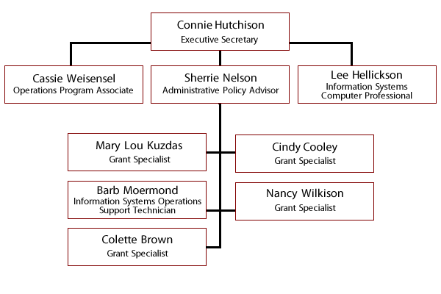
HIGHER EDUCATIONAL AIDS BOARD STAFF

Slide 33
NEW PROGRAM RESPONSIBILITIES
2010
John R. Justice Federal Loan Forgiveness
2011
Wisconsin Covenant Grants

Slide 34
THANK YOU
For additional information contact
Connie Hutchison, PhD
Executive Secretary
Higher Educational Aids Board
Connie.hutchison@wi.gov
(608)264-6181

