Slide 1
Community Leadership in
Improving Healthcare in Wisconsin
Cindy Schlough
Director of Strategic Partnerships
Wisconsin Collaborative for Healthcare Quality
cschlough@wchq.org; (608) 826-6839
Special Committee on Infant Mortality
October 13, 2010

Slide 2
Goals for Today
Introduce Wisconsin Collaborative for Healthcare Quality
Describe experience using performance measurement and public reporting to drive breakthroughs in quality
Review pilot with Wisconsin Department of Health Services

Slide 3
About WCHQ
Who We Are
Voluntary consortium of organizations learning and working together to improve the quality and cost-effectiveness of healthcare for the people of Wisconsin
Board of Directors includes representatives from member healthcare organizations, healthcare purchasers, consumers, and healthcare associations
Staff includes performance measurement experts, collaborative bridge-builders, service professionals, and quality champions

Slide 4
Member Organizations
Health systems, medical groups, hospitals & health plans
Aurora Advanced Healthcare
Aurora Healthcare
Aurora UW Medical Group
Bellin Health
Columbia St. Mary’s
Dean Health System
Fort Healthcare
Franciscan Skemp Healthcare – Mayo Health System
Froedtert and Community Health
Gundersen Lutheran
Luther Midelfort – Mayo Health System
Marshfield Clinic
Medical College of Wisconsin
Mercy Health System
Meriter Hospital
Monroe Clinic
Prevea Health
ProHealth Care Medical Associates
Quad Med
Sacred Heart Hospital
St. Joseph’s Hospital
St. Mary’s Hospital
ThedaCare, Inc.
West Bend Clinic
UW Hospital and Clinics
UW Medical Foundation
Wheaton Franciscan

Slide 5
Purchaser & Strategic Partners
AARP Wisconsin
American Cancer Society
Business Health Care Group
Coalition of Wisconsin Aging Groups
GE Healthcare
Greater Milwaukee Business Foundation on Health
MetaStar
Robert Wood Johnson Foundation
Survey of the Health of Wisconsin
The Alliance
The Commonwealth Fund
University of Wisconsin Population Health Institute
Webcrafters
WEA Trust
Wisconsin Department of Health Services
Wisconsin Health Information Organization
Wisconsin Hospital Association
Wisconsin Manufacturers and Commerce
Wisconsin Medical Society

Slide 6
About WCHQ
What We Do
Raise the bar by developing better performance measures for assessing the quality and value of healthcare services
Guide collection, validation and analysis of data
Publicly report performance measurement results for use by healthcare providers, purchasers, and consumers
Share best practices of organizations that demonstrate high quality care, enabling others to adopt successful methods

Slide 7
Developing Better Performance Measures
Create and maintain a portfolio of ambulatory care measures that enable medical groups and health systems to collect and publicly report quality of care based on clinical and administrative data on all patients regardless of the payer
Develop and maintain innovative measures of healthcare value to demonstrate the relationship between quality and cost

Slide 8
Ambulatory Care Measures 1 of 2
Primary Care
Preventive Care
Chronic Care
Breast Cancer Screening
Cervical Cancer Screening
Colorectal Cancer Screening
Osteoporosis Screening
Adult Tobacco Use
Pneumococcal Vaccinations
Diabetes Care
- A1c Screening
- A1c Control
- LDL-C Screening
- LDL-C Control
- Nephropathy Monitoring
- Blood Pressure Control
- All-or-None Process Measure for Optimal Testing

Slide 9
Ambulatory Care Measures 2 of 2
Primary Care
Chronic Care
Episodic Care
Uncomplicated Hypertension/Blood Pressure Control
Cholesterol Management of Patients with Cardiovascular Conditions
- LDL-C Screening
- LDL-C Control
Postpartum Follow-up
Access
Time to Third Next Available Appointment
- Family Practice
- Pediatrics
- Internal Medicine
- OB / GYN

Slide 10
Specialty Care Measures
Specialist/Non-Primary Care
Society of Thoracic Surgeons
  Isolated Coronary Artery Bypass Grafting (CABG)
    Deep sternal wound infection
    Post-operative permanent stroke
    Operative mortality
Chronic Kidney Disease – implement in 2010 and 2011
Cardiovascular, Orthopedics, Gastrointestinal, and Behavioral Health – under consideration

Slide 11
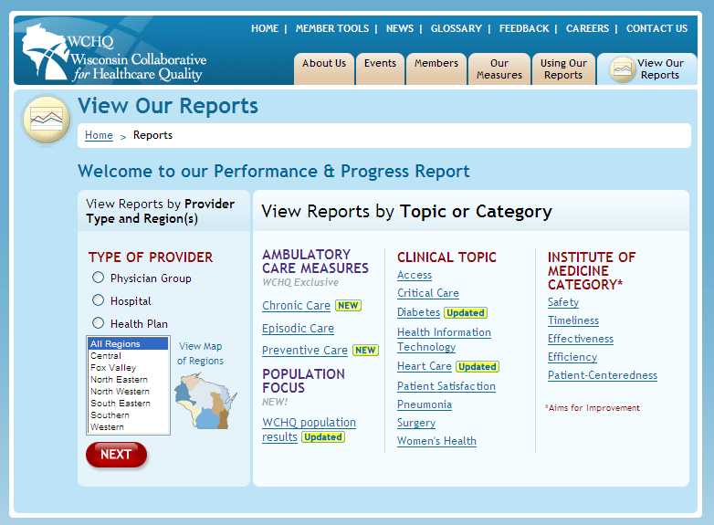
Web Report: www.wchq.org
View reports by Clinical Topic or IOM Category.
View reports by Type of Provider or Region.

Slide 12
Selected Examples
Cardiovascular Conditions: LDL Cholesterol Testing
  Process measure: Percentage of people 18 to 75 years of age with a diagnosis of CAD or a CAD risk-equivalent condition who received LDL-cholesterol test in measurement period
Cardiovascular Conditions: LDL Cholesterol Control
  Outcome measure: Percentage of people 18 to 75 years of age with a diagnosis of Coronary Artery Disease (CAD) or a CAD risk-equivalent condition whose most recent LDL cholesterol test shows good control (less than 100 mg/dl), fair to poor control (greater than or equal to 100 mg/dl and less than 130 mg/dl), uncontrolled (greater than or equal to 130 mg/dl), or those not tested in measurement period
Postpartum Care

Slide 13
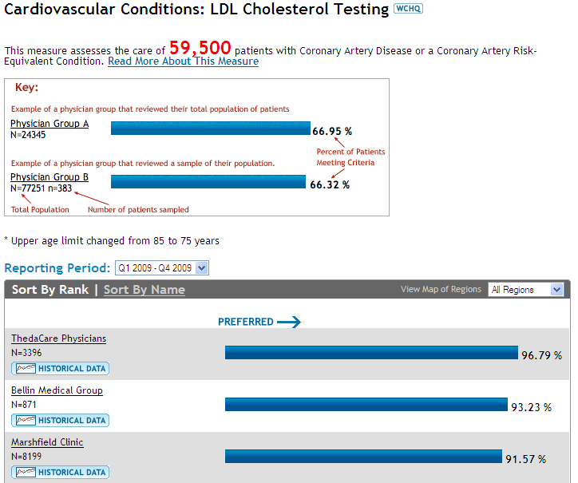

Slide 14
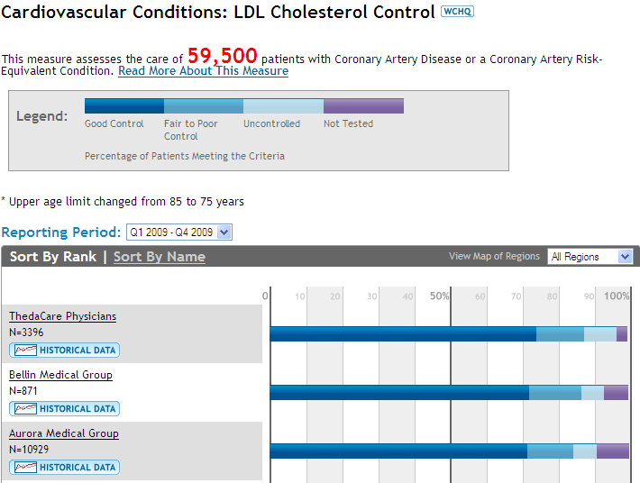

Slide 15
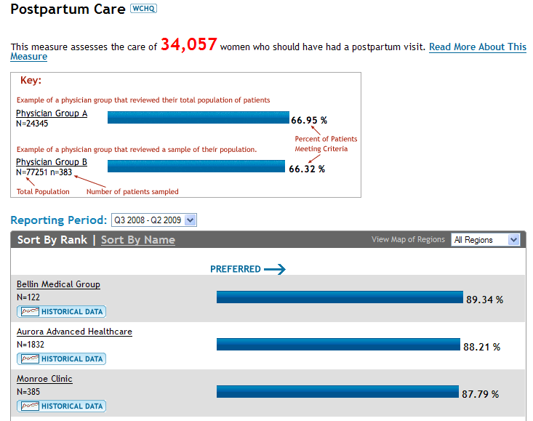
Process measure: Assesses the percentage of women who delivered a live birth in the designated time frame and who have had a postpartum visit on or between 21 and 56 days after delivery.

Slide 16
Leveraging Participation
Healthcare organizations
Use internal data at aggregate, clinic, and individual levels
Establish improvement priorities
Create alignment with compensation and incentive plans
Participate in pay for performance programs
Share results and best practices at Assembly meetings

Slide 17
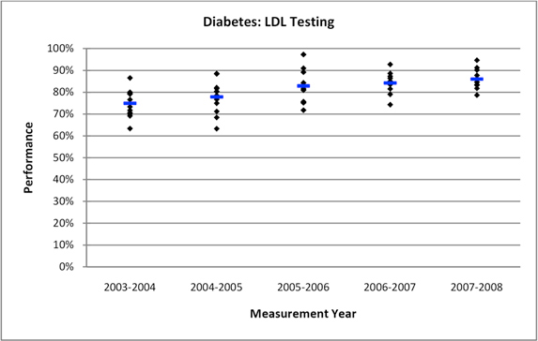
Analyst's Perspective: Statistically Significant Improvement
Performance of twelve organizations who continuously submitted Diabetes LDL Testing data from 2003-2004 through 2007-2008
Black dots indicate performance by organization; blue lines indicate overall unweighted mean
Mean performance increased from 75 to 86 percent and standard deviation from mean decreased from 6.3 to 4.4 percent

Slide 18
Pilot with the Wisconsin Department of Health Services
Tested effectiveness of intervention to engage patients in their care
Focused on increasing patient-provider communication
Based on Ask Me 3 health literacy program
  What is my main problem?
  What do I need to do?
  Why is it important for me to do this?
Piloted program at community health centers
Tested high intensity and low intensity approaches

Slide 19
Lessons Learned
Did not appear sufficient to motivate patients to ask questions to healthcare providers
Influenced patient perceptions at high intensity sites: viewed visit less positively after the pilot
Increased healthcare provider and staff awareness of the importance of clear communication with patients
Provided opportunity to explore shared commitment to improving healthcare by nine leading Wisconsin organizations

