Slide 1
Special Committee on Health Care Access
10/22/10
Valerie J. Gilchrist, MD
Millard Professor in Community Health
Chair, Department of Family Medicine
University of Wisconsin School of Medicine and Public Health

Slide 2
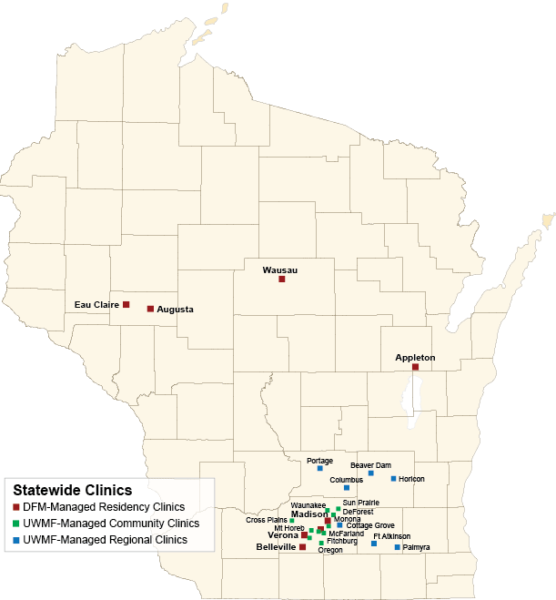
Notes:
Since 1971 - ~70% of our grads practice in Wisconsin

Slide 3
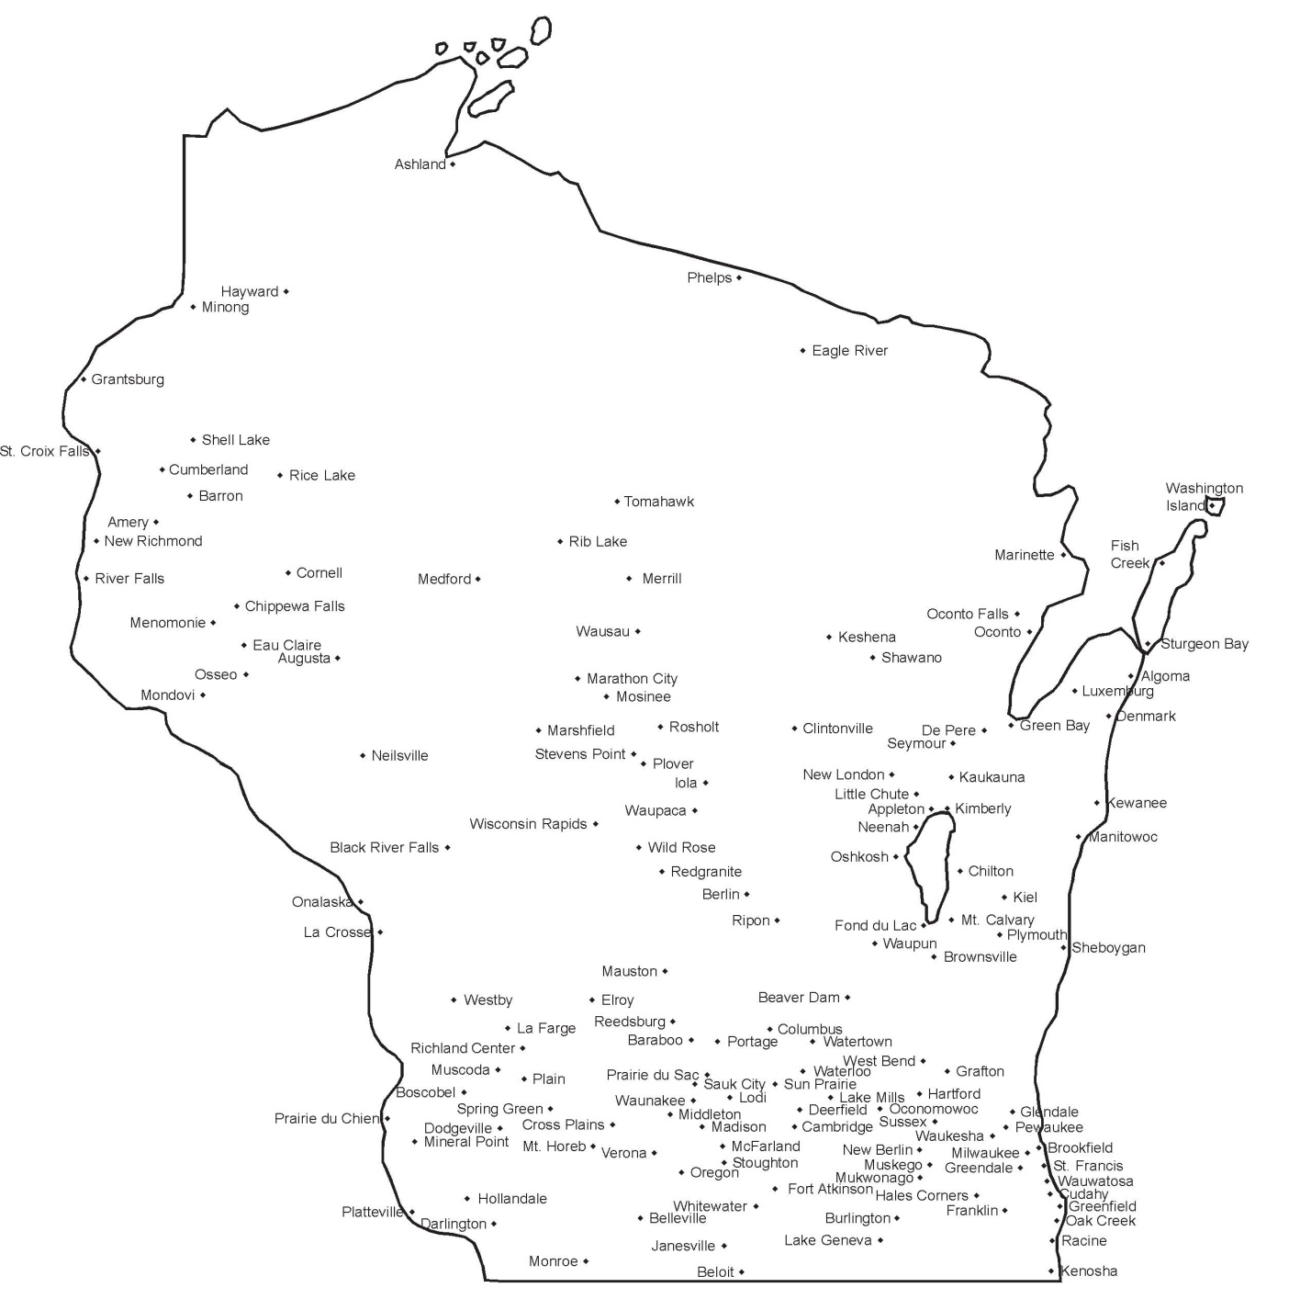
Notes:
UW grads

Slide 4
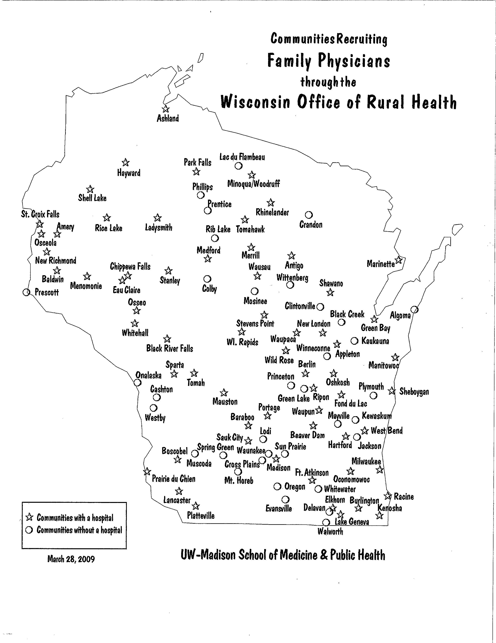

Slide 5
Why to we need primary care practitioners?

Slide 6







Countries’ age-standardized death rates, list of conditions considered amenable to health care Source: E. Nolte and C. M. McKee, Measuring the Health of Nations: Updating an Earlier Analysis, Health Affairs, January/February 2008, 27(1):58–71
37th by WHO

Slide 7
Average spending on health
per capita ($US PPP)
Source: K. Davis, C. Schoen, S. Guterman, T. Shih, S. C. Schoenbaum, and I. Weinbaum, Slowing the Growth of U.S. Health Care Expenditures: What Are the Options?, The Commonwealth Fund, January 2007, updated with 2007 OECD data

Slide 8
Primary Care Delivers Better
Health Outcomes
⬇ mortality
⬇ morbidity
⬇ medication use
per capita expenditures
patient satisfaction
greater equity in health care
  SOURCE: B. Starfield, et al., “The Effects of Specialist Supply on
  Populations’ Health,” Health Affairs (March 2005); W5-97

Slide 9
2008 report by the Wisconsin Council on Medical Education and Workforce
Shortfall of PC physicians
  2020 - 8%
  2030 - 14%
  worst-case shortfall -57%

Slide 10
Coming (grey) Tsunami
Aging population
Retiring physicians

Slide 11
Why don’t we have primary care practitioners?

Slide 12
Not enough PCC and they are not in the right places
1/3 physicians currently in PC but less than 1/5 students choosing PC careers
  Trend followed by DO, PA, NP
<10% physicians practice in rural areas where 20% population resides

Slide 13
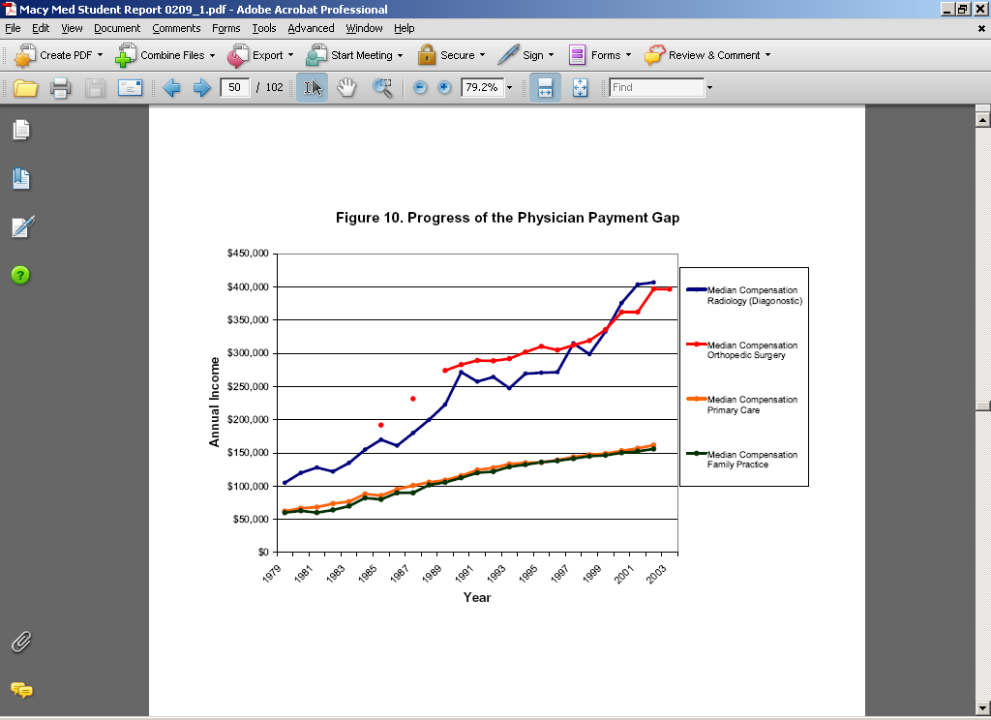
Physician payment gap

Slide 14
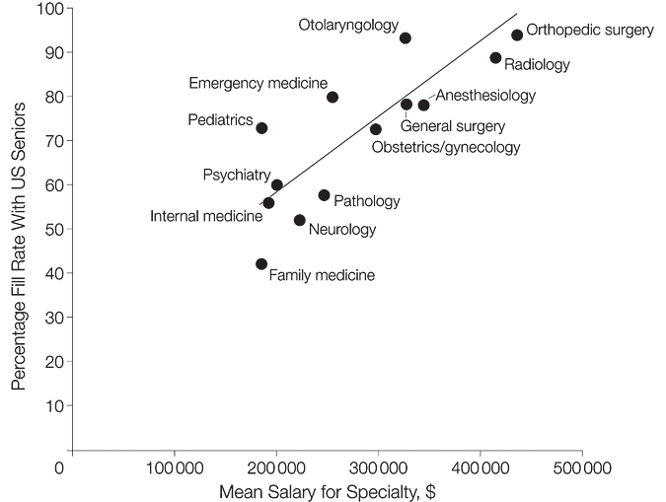
Percentage of Positions Filled With US Seniors vs Mean Overall Income By Specialty
Ebell, M. H. JAMA 2008;300:1131-1132.
Copyright restrictions may apply.

Slide 15
Physician income gap
Decreases choice of PC by 50%
-higher paid sub-specialties make 267% of PC income
-PC career ROI difference 3.5 million with average sub-specialties
Notes:
Starting salary of PC $180, radiologist $400 – regular hours, ancillary support

Slide 16
How can we get primary care practitioners?

Slide 17
Increasing primary care
Admissions
Training
  Medical school
  Residency
Support
  Debt load
Practice environment
  Patient centered care /PCMH/ new model care

Slide 18
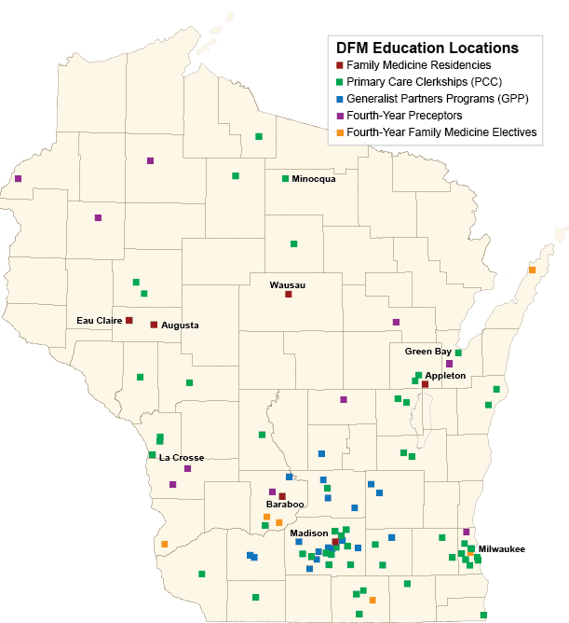

Slide 19
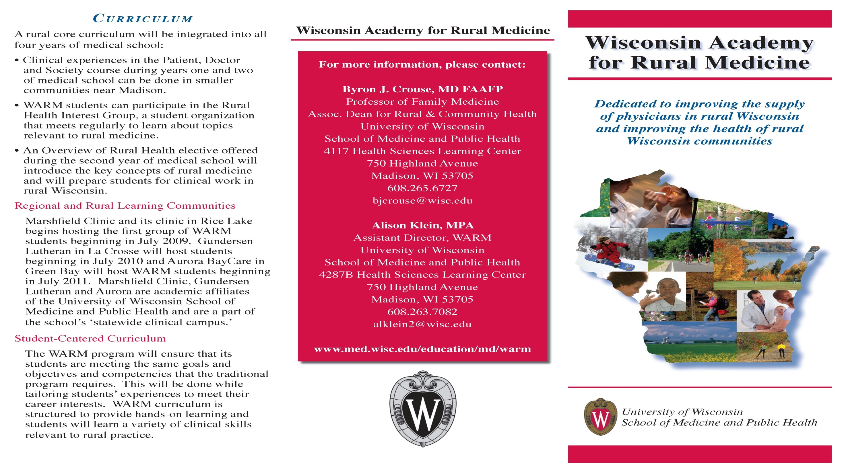

Slide 20
WARM Program
21 – 1st year students
19 – 2nd year students
13 – 3rd year students
3 – 4th year students
Maximum number per class – 25
2 students will graduate 2011

Slide 21


Slide 22
RUSCH Program
18 students 09/10
2 graduate 2010
8 will graduate 2011
Maximum number 20-30

Slide 23
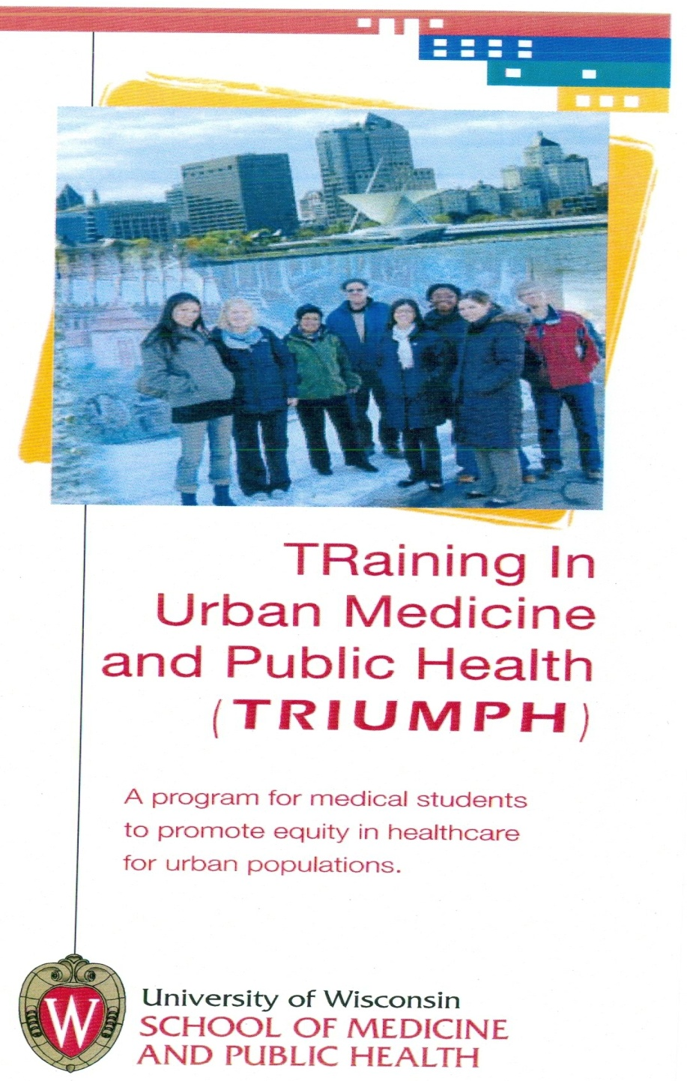

Slide 24
TRIUMPH Program
7 graduate 2011
8 starting January 2011
Maximum number per class - 8

Slide 25
Family Medicine Residency education
3 years
Accreditation Council of Graduate Medical Education establishes Residency Review Committees who establish rigorous criteria and review for each speciality residency training
Funding –CMS pays GME to hospitals based on a cost report for each resident
  – IME (indirect)
  - DME (direct medical education)

Slide 26
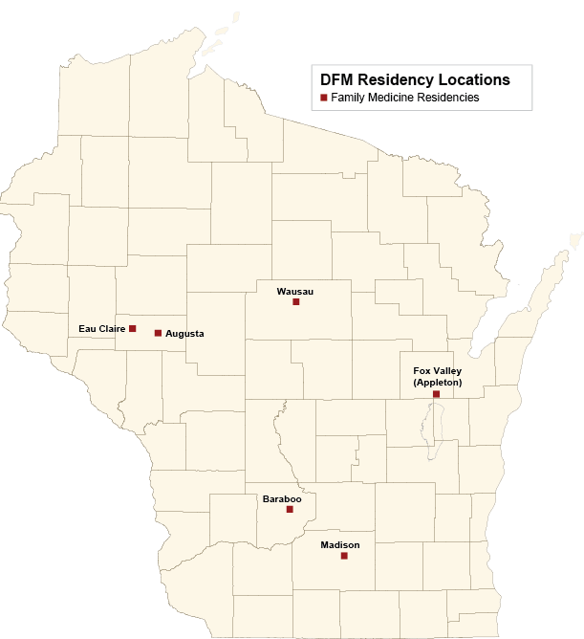
Notes:
Dual accredited MD/DO program

Slide 27
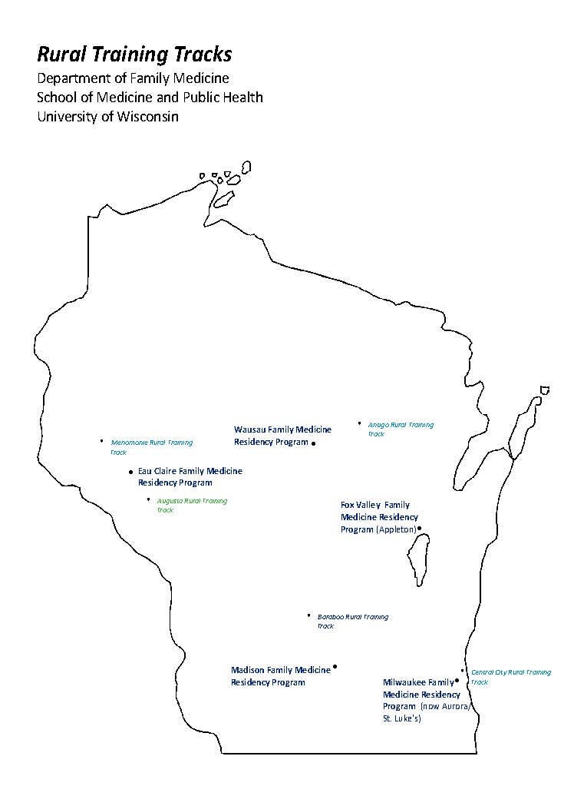
Notes:
Also now Black River Falls, Toma, Mauston, Portage ready but we have no teachers (Wausau decrease)

Slide 28
Primary Care Clinicians
Training MD/DO PA NP/APN
Undergraduate 4 years 4 years 4 years BSN
Professional 4 years med school 2 years MPAS 2 years MSN, DNP, PhD
3 years residency
TOTAL 11 years 6 years 6-8 years
Salary**
Average salary $147,000-192,000 $71,000-93,000 $70,000-90,000
**http://www.salary.com/mysalary.asp

Slide 29
Person power
MD/DO PA NP
State overall ~17,000 ~1,600 ~1,000
Primary Care 34%* 30-40% 43% FM
*includes FM, IM, Peds, OB
Notes:
Val –
These numbers are very general. For MD/DO – WAFP gave me numbers – not sure if primary care % included GIM and Peds
PA numbers were given over the phone with “my best guess would be 80% of applications received are for primary care”
NP numbers seem to be pretty accurate, however % in primary care is based on family practice only

Slide 30
DO distribution among medical specialties
Notes:
Do I need to list a source?

Slide 31
Medical student debt
2001 = $120,000
2006 = $160,000

Slide 32

The Patient Centered Medical Home
Great Outcomes
Practice Organization
Heath Information Technology
Health IT
Quality Measures
Patient
Experience
Patient
Experience
Family Medicine Foundation
Patient-centered | Physician-directed
www.pcpcc.net

Slide 33
Contradictions in health care payment
Medical practitioners are paid for illness not health
Hospitals survive on procedures and patients, … not keeping people out of the hospital
“We are getting what we pay for…”

