Slide 1
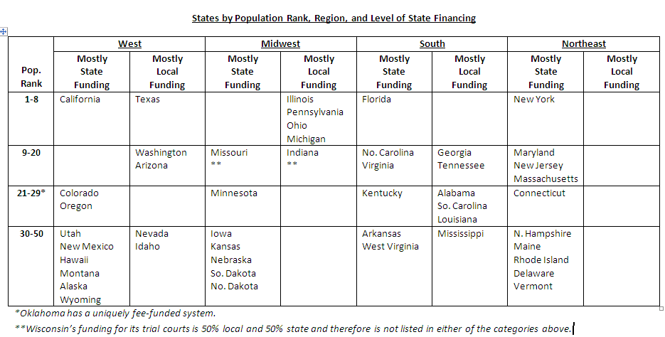
States by Population Rank, Region,
and Level of State Court Financing

Slide 2
“Pros” of State Court Funding
Traditional view--More stable and equitable funding
More uniform access to justice
More accountability
Improve efficiency and effectiveness of Court operations
Regional disparities can be equalized
Lessons learned in the new economy

Slide 3
“Cons” of State Court Funding
Shifts authority to officials outside the local orbit
Undue centralization and bureaucracy
Higher costs
Insensitivity to unique local and public needs
Loss of revenue for local governments
Possible loss of employee jobs or diminution of benefits
Overdependence on one funding source
Lessons learned in the new economy

Slide 4
Partial Listing* of State vs. Local Court Funding
For Adult and Juvenile Probation
Adult Probation |  |  | Juvenile Probation
State Funded | Locally Funded | Both State and Locally Funded | State Funded | Locally Funded | Both State and Locally Funded
Colorado Connecticut Delaware Hawaii Iowa Maryland Massachusetts Nebraska New Jersey North Dakota South Carolina South Dakota Utah West Virginia | California Georgia Indiana Kansas Missouri Nevada New York Ohio Oregon Washington | Alabama Arizona Arkansas Idaho Illinois Louisiana Michigan New Mexico Tennessee Texas Wisconsin | Arkansas Colorado Connecticut Delaware Florida Hawaii Maryland Massachusetts Montana New York North Dakota South Carolina South Dakota Utah West Virginia | Michigan Mississippi Nevada Oregon Tennessee Wisconsin | Alabama Arizona California Idaho Illinois Iowa Kansas Louisiana Missouri Nebraska New Jersey New Mexico Ohio Texas Washington
*Not all states provided statistical information.

Slide 5
State vs. Local Court Funding
For Pubic Defender Offices
States With State-Based Public Defender Offices |  | States With County-Based Public Defender Offices
Alaska Arkansas Colorado Connecticut Delaware Hawaii Iowa Kentucky Maryland Massachusetts Minnesota | Missouri Montana New Hampshire New Jersey New Mexico North Dakota Rhode Island Vermont Virginia Wisconsin Wyoming | Alabama Arizona California Florida Georgia Idaho Illinois Indiana Kansas Louisiana Maine Michigan Mississippi Nebraska | Nevada New York North Carolina Ohio Oklahoma Oregon Pennsylvania South Carolina South Dakota Tennessee Texas Utah Washington West Virginia

Slide 6
Midwest Regional States: General Jurisdiction Civil Filing Fees,
Ranked from Lowest to Highest
Fixed Fees
State | General Jurisdiction Civil Filing Fee
South Dakota | $50
North Dakota | $80
Nebraska | $82
Missouri | $100
Indiana | $100 base, +$10 per extra defendant
Michigan | $150
Kansas | $156
Iowa | $185 base, +$5 in counties with population in excess of 98,000
Ohio | $225
Minnesota | $320
Variable Fees
State | General Jurisdiction Civil Filing Fee
Illinois | Varies ($10 to $240), dependent upon matter and county population
Pennsylvania | Varies ($35 to $172), dependent upon matter and county population
Wisconsin | $94.50 (up to $5,000) and $265.50 (over $5,000)
Amount s include surcharges. In Wisconsin’s little of the revenue collected goes to the courts.

Slide 7
Definitions
General purpose revenue: legislature appropriates money from the general fund (from taxes, fees and fines, etc.) to pay for judicial operations.
Program revenue—revenues from fees and fines are committed by statute for a specific purpose (technology, court security, or general use to cover core judicial operations) and appropriated by the legislature.
Pursuant to Wisconsin's Constitution all revenue from fines goes to a designated school fund

Slide 8
How Do State Courts Use Program Revenue?
States Responding | Authorized to Fund Judicial Responsibilities | Dedicated to Special Funds | Dedicated to General Court Operations
N=29 | 24 | 23 | 16
Percentage | 83% | 96% | 55%
Source: COSCA Survey, May 2007

Slide 9
Common Program Revenue Designations in 24 States
Dedicated Special Funds | Number of States
Technology | 17
Court Security | 5
Innovation | 4
Education | 3
Building Construction | 3
Alternative Dispute Resolution | 3
Judicial Performance | 2
Notes:
9

Slide 10
Court Use of Program Revenues
Category | Examples
Courts with Significant Program Revenue (for both dedicated and general use) | California, Colorado, Nevada, Washington
Courts with Program Revenue for Dedicated use Only | Arizona, Nebraska, Georgia, Montana, South Dakota
Courts with Little Program Revenue | Delaware, Wisconsin, Virginia
Courts with No Program Revenue | Connecticut, Maine, New Hampshire, Ohio, Rhode Island,
Notes:
10

Slide 11
States with Significant Program Revenue
California
Colorado
$523m annual revenue
Major dedicated funds
HR, Technology ($87m)
Facilities ($83m)
General Court Operations
Civil Assessment Fee ($100m)
MOE transition Fund ($163m)
$320 civil filing fee
$102m annual revenue
Major dedicated funds
Court Security ($2.2m)
Judicial Performance ($1m)
Technology ($2.2m)
Judicial Building ($14m)
General Court Operations
Judicial Stabilization Fund ($29m)
$201 civil filing fee
Notes:
11

Slide 12
States with Little Program Revenue
Delaware
Virginia
Major dedicated funds
Court security
No Funds for General Court Operations
$175 civil filing fee
Major dedicated funds
Technology
No Funds for General Court Operations
$204 civil filing fee
Notes:
12

Slide 13
National Trends with respect to Program Revenue
Big gap between what courts collect and what courts keep
Program revenue allocated for general use by courts rather than dedicated funds.
More and more court fees, fines and surcharges are used to fund other parts of the justice system with little going to courts
Raising fees, fines and surcharges too high inhibits access to the courts

Slide 14
Need a comprehensive approach to funding the Justice System
The impact of funding one part of the justice system has an impact on other parts
When changes are made in one part of the system the impact on workload needs to be objectively measured to assess the resource requirements in other parts

Slide 15
Comprehensive workload model
Advantages
A consistent methodology ensures reliability in data collection, analyses, and interpretation of results.
Provides a method to identify bottlenecks in the system and concerns regarding current resource levels
Provides data necessary to re-design those processes.
A provides an integrated perspective on workflow and workload
Examples—New Mexico, Maryland, Kentucky

