Slide 1


An Overview of Wisconsin Policies Relating to Biofuels
Special Legislative Committee on Domestic Biofuels
Madison – October 14, 2008

Slide 2
Outline
Program Development & Admin
Financial Assistance
Regulations
Marketplace Participant
Public Education
Notes:
Program development and administration, which may include duties or responsibilities of a state agency relating to one or more of the other subjects.
Financial assistance, including tax credits, grants, loans and loan guarantees.
Marketplace participant, including programs in which state agencies purchase and use transportation biofuels.
Public education, including training and technical assistance to identified sectors of the public.
Regulation, including provisions that impose a regulation and that provide relief from one or more regulations.

Slide 3
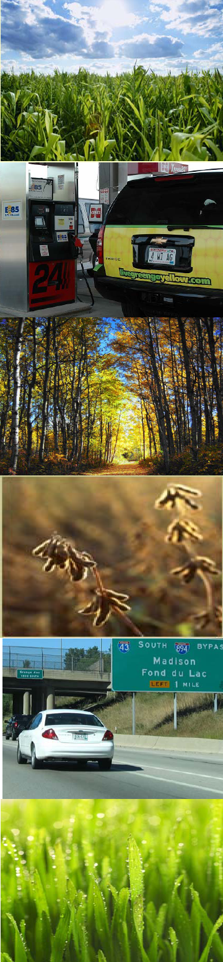
Program Development & Admin
Office of Energy Independence [s. 16.956]
DNR Office of Energy – Streamline permitting for DNR projects
Regulatory/Incentive Programs
  Across agencies : DNR, DATCP, Commerce, DOR, DOT, DPI

Slide 4

Financial Assistance

Slide 5


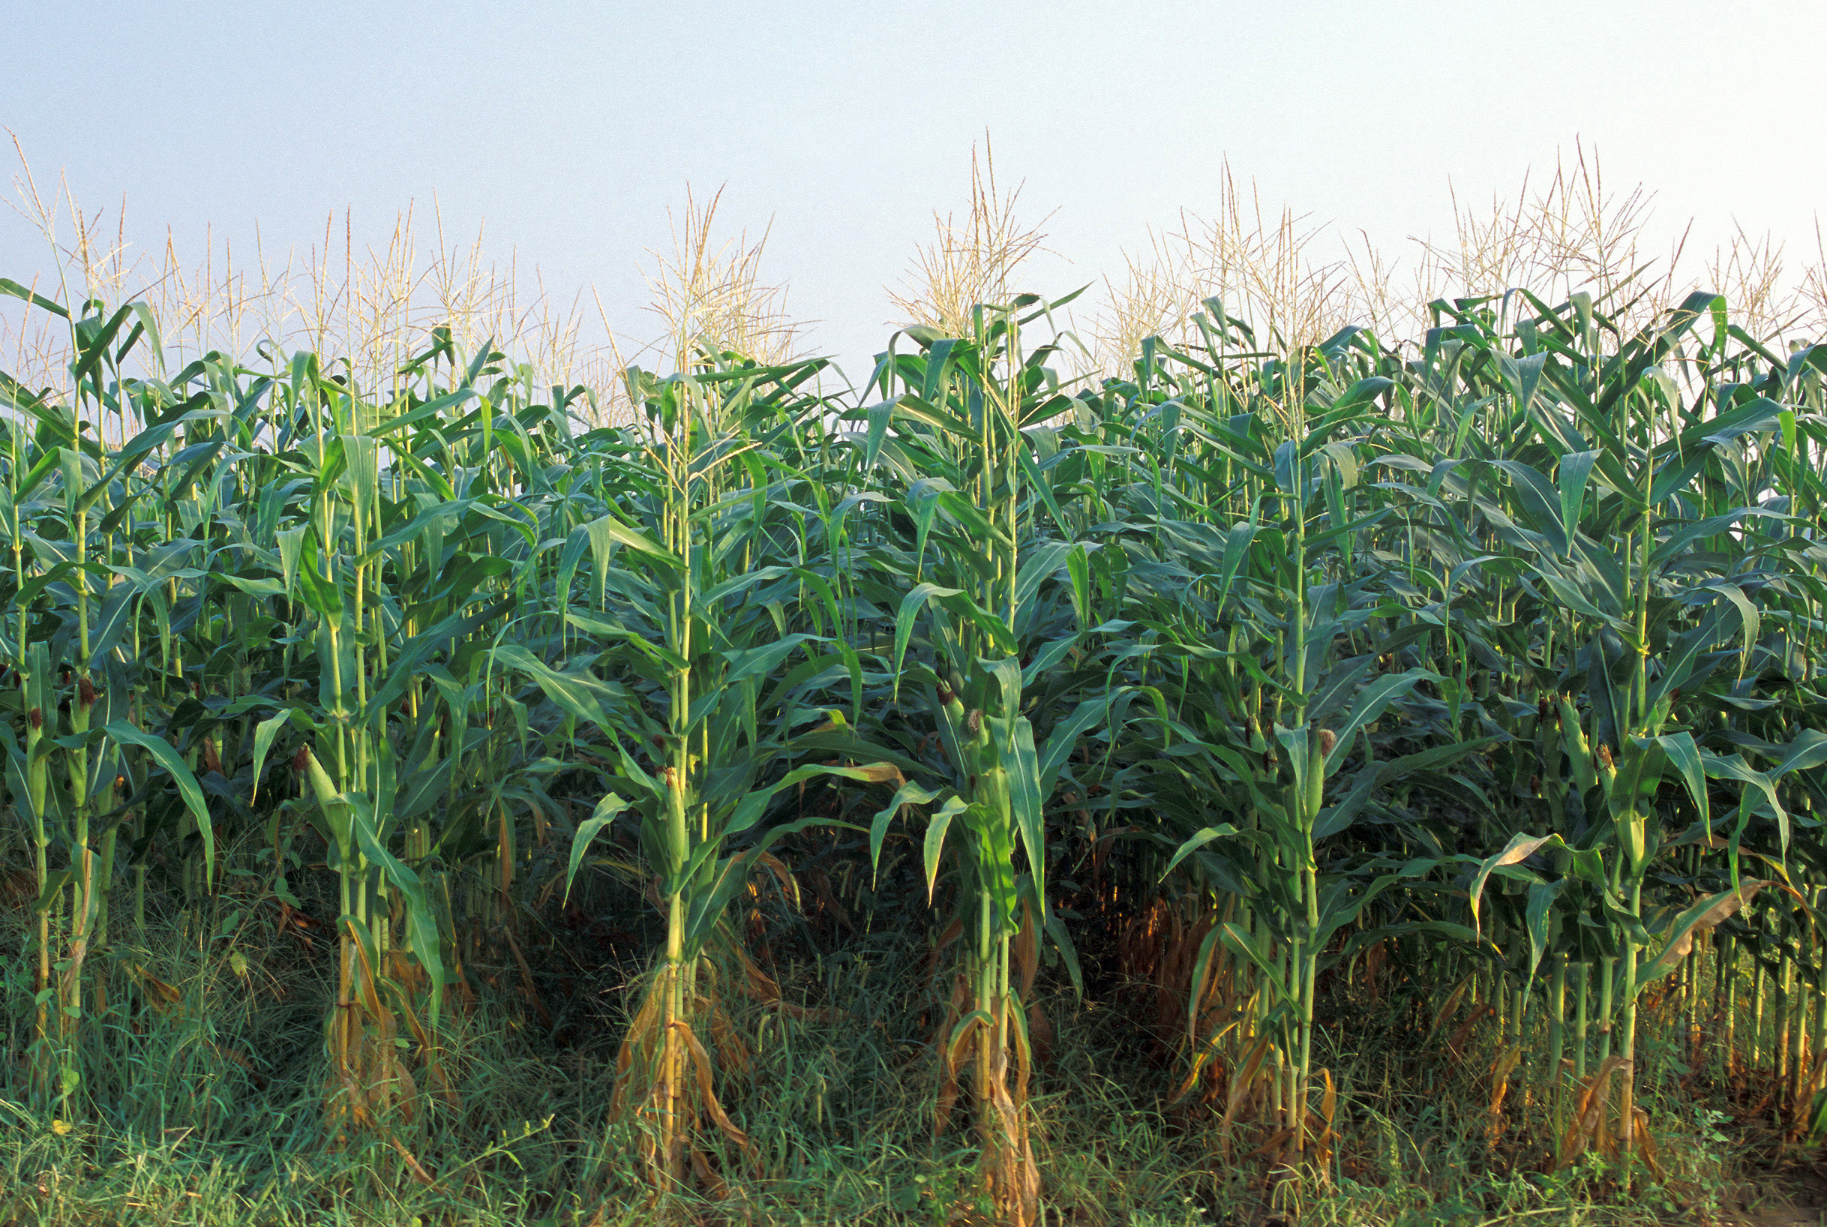

Financial Assistance
Dept. of Ag, Trade & Consumer Protection
  Grants For Ethanol Production Facilities [s. 560.031] (sunset 6/06)
    20¢/gallon up to 15 million gallons
    4 ethanol facilities, $8.6 million distributed
  Agricultural Diversification [s. 93.46 (1), (2), and (3)]
    75% grant, up to $50,000
    Since 2002 -- 20 awards, $600,000
  Biogrant Program (2006)
    7 of 12 awards biofuels, $677,000

Slide 6
Financial Assistance
Dept. of Revenue
  Ethanol and Biodiesel Fuel Pump Income Tax Credit [s. 71.07 (5j)]
    25% of the cost of installation, up to $5,000
    Taxable year 2007 thru 2017
  Biodiesel Fuel Production Income Tax Credit [s. 71.07 (3h)] (pending)
    10¢/gallon, 2.5 million minimum, up to $1 million
    Taxable year 2010 thru 2012

Slide 7
Financial Assistance
Dept. of Commerce
  WI Energy Independence Fund (Renewable Energy Grants and Loans) [s. 560.126]
    50% of project costs
    2008: 22 awards, $7.5 million
  Business Development Resources

Slide 8
Financial Assistance
Dept. of Transportation
  Transportation Facilities Economic Assistance and (TEA) Development; Biofuels Production Facilities [s. 84.185 (8r)]
    50% grants , based on job creation
    5 biofuels facilities, $665,400 awarded
  Freight Railroad Infrastructure Improvement Program [s. 85.08]
    100% loans to connect industry to rail, rail improvements
    4 biofuels facilities, $13.5 million
Notes:
Awards to grain facilities that support the ethanol plants

Slide 9
Financial Assistance
Dept. of Public Instruction
  School Transportation Biodiesel Fuel Cost Assistance [s. 121.575]
    Secure aid to cover the increased cost of using biodiesel fuel in school buses
    Committed to provide match for federal aid
Office of Commissioner of Insurance
  Insurance-Investments; Permitted Classes of Investments [s. 620.22]
    Property/facilities for the development/production of select renewable energy and fuels
    Up to 5% of the portion of the insurer's assets which exceeds $2 billion.
Notes:
Insurance companies have restrictions on the types of investments they invest in and this program renewable energy and fuels can invest biofuels companies, i.e. An ethanol facility. Insurance companies will invest in such entities as venture capitalist which in turn invest in biofuels faciities.

Slide 10

Regulations

Slide 11
Regulations
Motor Fuel Quality Regulations (Commerce)
  Petroleum Products [Ch. Comm 48]
    ASTM D6751- Standard Specification for Biodiesel Fuel Blend Stock (B100)
    ASTM D975 – Standard Specification for Diesel Fuel Oils
    ASTM D4806 - Standard Specification for Denatured Fuel Ethanol for Blending with Gasoline
    BQ-9000 : annotated reference
Oil Inspection [Wis. Stat. Ch. 168] (Commerce)
Notes:
Comm 48.530 - ANNOT. - Assuring compliance with ASTM D 6751 is one of the goals of a BQ-9000 program administered by the National Biodiesel Accreditation Commission. This program includes the Commission's accreditation of producers, and certification of marketers - following a successful formal review and audit of the capacity and commitment of an applicant to produce or market biodiesel fuel that complies with ASTM D 6751. The department will accept this accreditation and certification as adequate assurance of meeting the requirements specified in ASTM D 6751.

Slide 12
Regulations
Water Regulations (DNR)
  Navigable Water [Wis. Stat.Ch. 30]
  Well Construction and Pump Installation [Ch. NR 812]
  Safe Drinking Water [Ch. NR 809.931]
  Wisconsin Pollutant Discharge Elimination System (WPDES) Permit [Wis. Stat. Ch. 283]
  Exemption for Certain Alcohol Fuel Production Systems [s. 283.61]
Notes:
No permit is required under this chapter for the owner of a private alcohol fuel production system to discharge or dispose of any distillate waste product if the waste product is stored in an environmentally sound storage facility and disposed of using an environmentally safe land spreading technique and the discharge or disposal is confined to the property of the owner.

Slide 13
Regulations
Air Regulations (DNR)
  Air Permitting
  Prevention of Significant Deterioration [Ch. NR 405]
  Construction permits [Ch. NR 406]
  Operation permits [Ch. NR 407]
  Registration of Early Emission Reductions [s. 285.78]
  Clean Fuel Fleet Program [s. 285.35]

Slide 14
Regulations
Solid Waste Disposal (DNR)
  Hazardous Waste Identification and Listing [Ch. NR 66]
  Universal Waste Management Standards: [Ch. NR 673]
  Used Oil Management Standards [Ch. NR 679] Exemption for Certain Alcohol Fuel Production Systems [s. 289.44]
Notes:
No permit, license or plan approval is required under this chapter for the owner of a private alcohol fuel production system to establish, construct or operate a system for the treatment, storage or disposal of distillate waste products if the distillate waste product is stored in an environmentally sound storage facility and disposed of using an environmentally safe land spreading technique and the storage, treatment or disposal is confined to the property of the owner.

Slide 15
Regulations
Spill Prevention, Reporting, and Cleanup (DNR)
  Hazardous Substance Discharge Notification and Source [Ch. NR 706]
  Control of Hazardous Pollutants [Ch. NR 445]
Tank Storage Regulations (Commerce)
  Flammable and Combustible Liquids [Ch. Comm 10]
  Flammable and Combustible Liquids Code [NFPA Ch. 30]
  Steel Aboveground Tanks for Flammable and Combustible Liquids [UL 142]

Slide 16
Regulations
Wisconsin Fire Codes (Commerce)
  Fire Prevention [Ch. Comm 14]
  Uniform Fire Codes [NFPA 1]
  Flammable and Combustible Liquids Code [NFPA Ch.30]
Building Code (Commerce)
  Commercial Building Code [Ch. Comm 60 – 65]
Notes:
National fire protection association
Underwriters Laboratory (UL) 142 –

Slide 17
Regulations
Tax Regulations (DOR)
  Alternate Fuels Tax [ss. 78.39 to 78.53]
    22.6¢/gallon LPG & 24.7¢/gallon CNG
  Business Registration [s.73.03(50)]
  Supplier and Export Licenses: Blenders Fuel Report and Registration [s 78.09]
    Ethanol and biodiesel plants are registered as suppliers
    100 biofuels producers registered

Slide 18
Regulations
Local
  County Zoning, Adjustment Board; Powers of Board [s. 59.694 (7) (d)]
    grant special exceptions and variances for renewable energy resource systems (wind, solar, waste to energy)
  Community Right-to-Know and Registration of Hazards

Slide 19
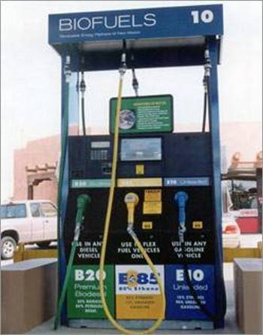
Marketplace Participation

Slide 20
Marketplace Participation
Gasohol, Alternative Fuels, and Hybrid-Electric Vehicles [s. 16.045]
  Requires state employees to operate AFV and use alternative fuels, including biodiesel and ethanol, whenever feasible
  EPAct (Federal) vehicle purchase requirements
Executive Order #141
  Increased biofuels consumption in state fleet

Slide 21
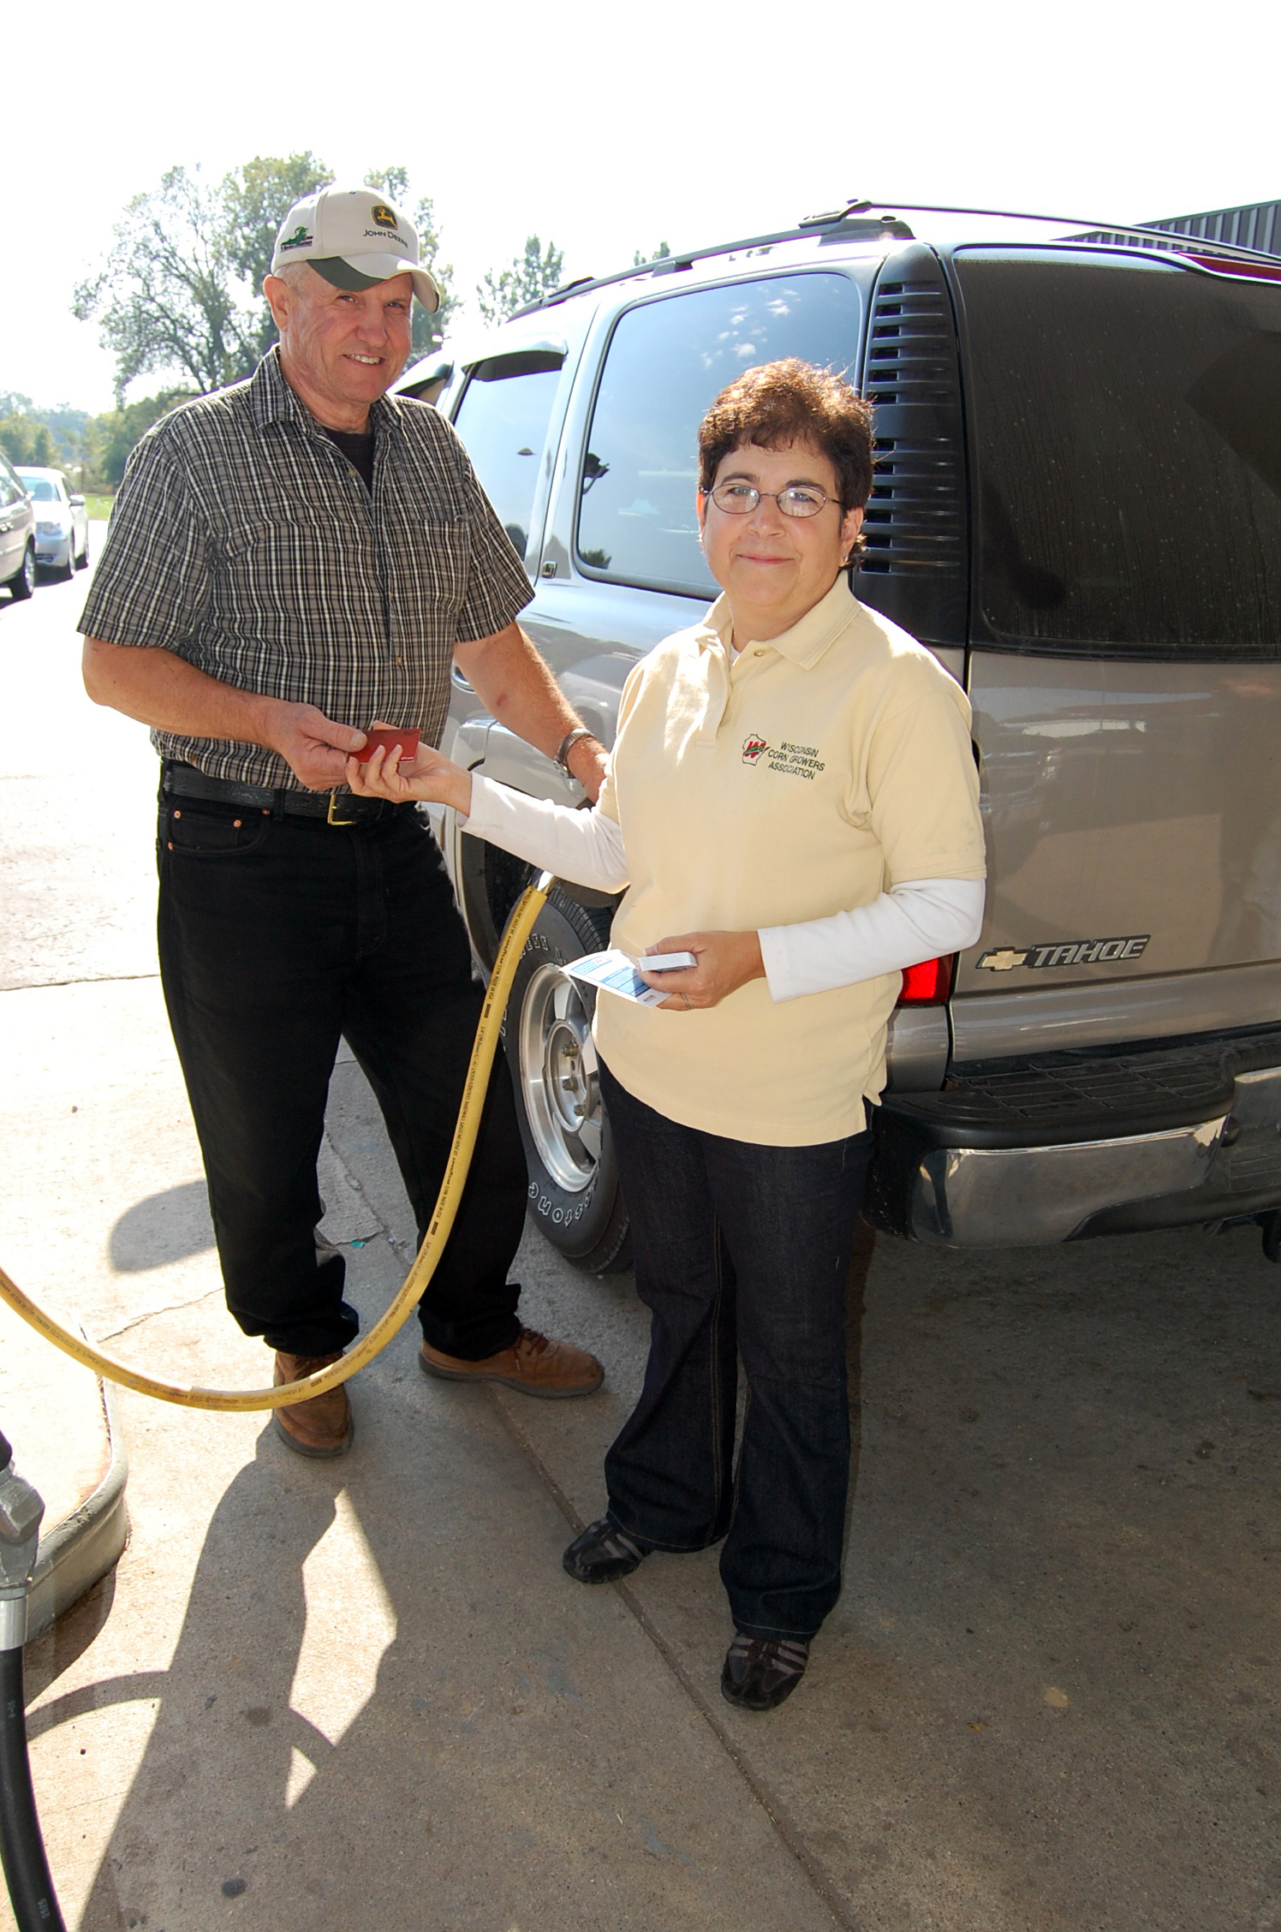
Public Education

Slide 22
Public Education
University Extension Work Functions [s. 59.56 (3)(f)]
  GIS Mapping of Bioenergy Opportunities
  Bio economy team
  Biodiesel Technical Assistance
Agricultural Education and Workforce Development Council [s. 93.33] (with the Council membership under s. 15.137 (2))
  Job retention, educational outreach, policy recommendations for agriculture, food, and natural resources employment and careers.

Slide 23
Public Education
Employee/Public Outreach
  List of Gasohol and Alternative Fuel Refueling Facilities [s. 100.265]
  Executive Order #141

Slide 24
Questions?
Maria Redmond
Wisconsin Office of Energy Independence
17 W. Main St.
Madison, WI 53703
(608) 266-1521
maria.redmond@wisconsin.gov

