Slide 1
Hearing Date
May 7, 2024
State of Wisconsin
FY 2022-23 Single Audit
(report 24-3)

Slide 2
State of Wisconsin Single Audit
The Single Audit is an audit of the federal financial assistance expended by the State of Wisconsin.
We audited 22 federal grant programs selected for review based on the methodology established by the federal government.
We report on the internal controls over compliance, and we provide an opinion on compliance for each federal program selected for review and an opinion on the State’s Schedule of Expenditures of Federal Awards.
State of Wisconsin
Legislative Audit Bureau
May 7, 2024
2
Nonpartisan • independent • accurate

Slide 3
State of Wisconsin Single Audit
The State administered $19.8 billion in federal financial assistance in FY 2022-23.
Seven state agencies administered 95.3 percent of the federal expenditures incurred in FY 2022-23.
State of Wisconsin
Legislative Audit Bureau
May 7, 2024
3
Nonpartisan • independent • accurate

Slide 4
Audit Results
We qualified our opinion on compliance for 6 of the 22 federal programs selected for audit for FY 2022-23.
We made 60 recommendations pertaining to 28 findings.
We questioned $13.0 million in costs that were inappropriately charged to federal funds.
State of Wisconsin
Legislative Audit Bureau
May 7, 2024
4
Nonpartisan • independent • accurate

Slide 5
Emergency Rental Assistance Program
We qualified our opinion on compliance for the Emergency Rental Assistance Program related to the eligibility, allowable costs, and subrecipient monitoring compliance requirements.
We have reported concerns related to the Emergency Rental Assistance Program since its inception in FY 2020-21.
This is the third year we have qualified our opinion on compliance.
State of Wisconsin
Legislative Audit Bureau
May 7, 2024
5
Nonpartisan • independent • accurate

Slide 6
Children’s Health Insurance Program (CHIP)
We qualified our opinion on compliance with the eligibility compliance requirement for CHIP.
DHS provided benefits to ineligible participants.
We questioned $12.7 million in amounts paid for these ineligible participants.
State of Wisconsin
Legislative Audit Bureau
May 7, 2024
6
Nonpartisan • independent • accurate

Slide 7
Subrecipient Monitoring
State agencies may provide funding to a local government or nonprofit organization to administer a federal award on behalf of the state agency.
State agencies retain responsibility for ensuring compliance with federal rules and regulations.
We identified concerns with subrecipient monitoring performed by 4 state agencies related to 7 of the 22 federal programs selected for audit: DOA, DCF, DHS, and DNR.
State of Wisconsin
Legislative Audit Bureau
May 7, 2024
7
Nonpartisan • independent • accurate

Slide 8
Federal Funding Accountability and Transparency Act (FFATA) Reporting
State agencies are responsible for reporting subawards to other entities in the FFATA Subaward Reporting System.
Information from this system is publicly available on USASpending.gov.
We identified concerns with the accuracy and timeliness of FFATA reporting performed by 5 state agencies related to 11 of the 22 federal programs selected for audit: DOA, DHS, DWD, DCF, and DOJ.
State of Wisconsin
Legislative Audit Bureau
May 7, 2024
8
Nonpartisan • independent • accurate

Slide 9
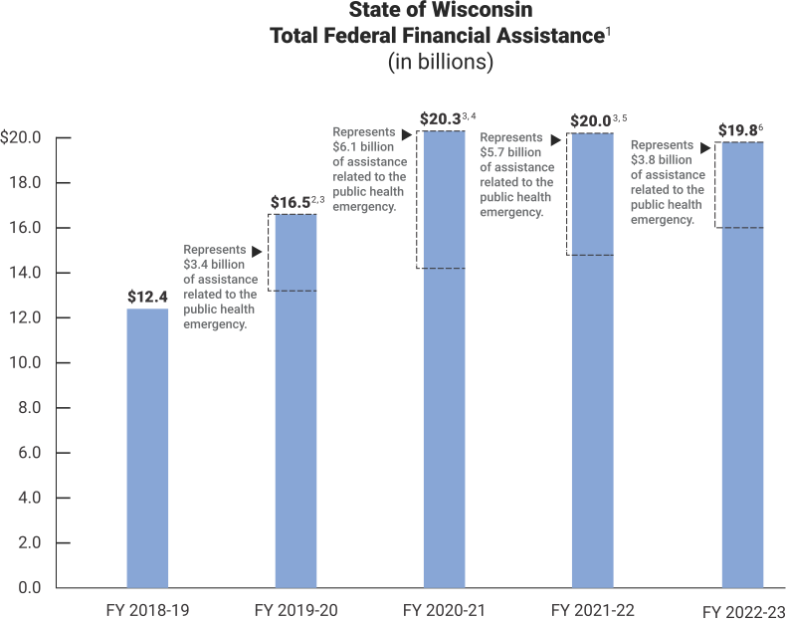
Federal Funding Related to the Public Health Emergency
¹ | Includes cash assistance; noncash assistance, such as food commodities; and outstanding loan balances.
² | Includes $3.4 billion of federal financial assistance related to the public health emergency, and separately identified in the SEFA.
³ | Includes adjustment of prior-year total federal financial assistance due to transfers in FY 2022-23 of prior-year expenditures.
⁴ | Includes $6.1 billion of federal financial assistance related to the public health emergency, and separately identified in the SEFA.
⁵ | Includes $5.7 billion of federal financial assistance related to the public health emergency, and separately identified in the SEFA.
⁶ | Includes $3.8 billion of federal financial assistance related to the public health emergency, and separately identified in the SEFA.

Slide 10
Coronavirus State and Local Fiscal Recovery Funds (CSLFRF) Program
The State reported $747.6 million in expenditures charged to the CSLFRF program in FY 2022-23.
Since inception of the CSLFRF program in FY 2020-21 through March 21, 2024, the State has reported $114.1 million in interest earnings.
State of Wisconsin
Legislative Audit Bureau
May 7, 2024
10
Nonpartisan • independent • accurate

Slide 11
State of Wisconsin Single Audit
The federal government is responsible for working with state agencies to resolve the audit findings and questioned costs.
As part of our next single audit, we will follow up on the status of efforts by state agencies to address findings included in report 24-3.
State of Wisconsin
Legislative Audit Bureau
May 7, 2024
11
Nonpartisan • independent • accurate

Slide 12
Hearing Date
May 7, 2024
Administration of Certain
Supplemental Federal Funds
Department of Health Services
(report 23-6)

Slide 13
Report Recommendations (grants)
DHS should:
specify the types of documents recipients must maintain in order to support grant amounts they requested;
establish written policies for reviewing requested grant amounts;
obtain grant application information and sufficient supporting documentation from the providers awarded the $518,700 we questioned; and
require the providers that cannot provide such information and documentation to repay the funds or reimburse the funds to the federal government.
State of Wisconsin
Legislative Audit Bureau
May 7, 2024
13
Nonpartisan • independent • accurate

Slide 14
Report Recommendations (ventilators)
DHS should:
execute a signed loan agreement with each entity to which it loans a ventilator;
inventory all of its ventilator-related equipment;
track the annual maintenance performed on its ventilators; and
develop a plan for the future use of its ventilators.
State of Wisconsin
Legislative Audit Bureau
May 7, 2024
14
Nonpartisan • independent • accurate

Slide 15
Report Recommendations (OIG)
DHS should:
publicly report summary results of the Office of Inspector General’s (OIG’s) audit and monitoring efforts;
require the OIG to submit in writing a proposed annual internal audit plan and post each of these plans to its website; and
include on its website the reports completed by the internal audit section.
State of Wisconsin
Legislative Audit Bureau
May 7, 2024
15
Nonpartisan • independent • accurate

Slide 16
Hearing Date
May 7, 2024
State of Wisconsin
FY 2022-23 Single Audit
(report 24-3)

