Slide 1
September 10, 2019
University of
Wisconsin System
Report 19-5

Slide 2
UW System Revenue and Expenses
UW System’s revenue totaled $5.3 billion and its expenses totaled $5.1 billion in FY 2017-18.
Tuition and Fees was UW System’s largest revenue source and totaled $1.3 billion, or 24.3 percent of revenue.
Salary and Fringe Benefits was UW System’s largest expense and totaled $3.2 billion, or 63.1 percent of expenses.

Slide 3
Tuition Rates
Resident undergraduate rates have been frozen at the 2012-13 academic year levels since FY 2013-14.
The Board of Regents has approved multiple increases in nonresident and graduate tuitions rates at all UW institutions, except UW-Superior.

Slide 4
Enrollment
From academic year 2008-09 to academic year 2017-18:
resident enrollment at UW System declined by 12,881 students (9.3 percent), and
nonresident enrollment at UW System increased by 10,558 students (48.8 percent).
The decline in resident enrollment was attributed to:
fewer Wisconsin high school graduates;
changes in regional demographics; and
faster college graduation rates.

Slide 5
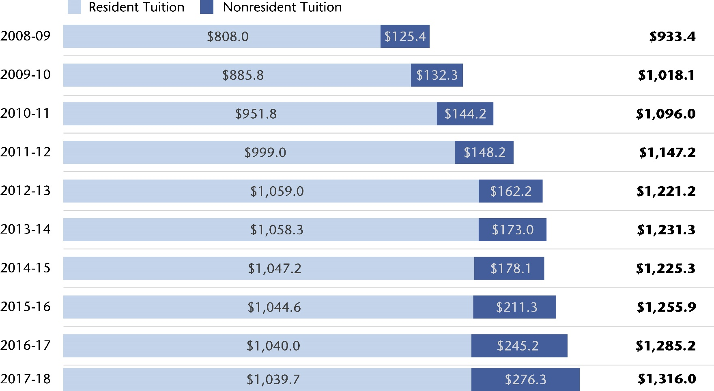
UW System Tuition Revenue By Fiscal Year (in millions)

Slide 6
Program Revenue Balances
As of June 30, 2018, UW System’s total program revenue balance was $1.3 billion on a budgetary basis.
Unrestricted program revenue balances increased by $55.3 million (6.5 percent) as of June 30, 2018, to $906.9 million.
Unrestricted program revenue balances decreased at eight institutions and increased at nine institutions since the first report in FY 2013-14.

Slide 7
UW-Oshkosh Program Revenue Balance
In February 2019, UW-Oshkosh reported to the Board of Regents a program revenue balance of $7.0 million that had been unused for about six years.
UW-Oshkosh reported debt service expenditures as being funded by both this program revenue balance and by its current year revenue.
UW-Oshkosh has increased student housing rates over the past 10 years, despite having the available program revenue balance.

Slide 8
New Personnel Systems
2011 Wisconsin Act 32 required the UW-Madison Chancellor to implement a new personnel system for UW-Madison employees, and the Board of Regents to implement a new personnel system for all other UW System employees.
These personnel systems were required to be separate from the state civil service system and to be implemented on July 1, 2015.
UW System Administration and UW-Madison established policies and required institutions to develop guidelines related to the new personnel systems.

Slide 9
New Personnel Systems
UW institution policies did not consistently comply with UW System Administration policy, and some institutions lacked published guidelines.
UW institutions did not ensure appropriate documentation was maintained to support pay plan or merit-based adjustments.
Policies and procedures related to extraordinary salary ranges were not sufficient or were not followed consistently.

Slide 10
Affiliated Organizations
UW institutions have relationships with various affiliated organizations, including primary fundraising and real estate foundations.
We made several recommendations in report 18-4 to improve the oversight and monitoring or these relationships.
We found UW System took some steps but did not complete implementation of all the recommendations from report 18-4, as of March 2019.

Slide 11
Affiliated Organizations
UW System Administration’s administrative policy on affiliated organizations does not:
require a complete accounting of all costs and benefits or a calculation of the return on investment the UW institution is making in the affiliated organization,
require a cost-benefit report be completed for all affiliated organizations,
address how the cost-benefit report will be evaluated by UW System Administration, and
specify what information, if any, will be formally reported to the Board of Regents.

Slide 12
Recommendations
We recommend UW System Administration:
provide guidance to UW intuitions to ensure accurate reporting in the program revenue balances report and that balances are considered when establishing auxiliary service rates;
ensure UW institutions have developed guidelines that comply with UW System’s policy for granting pay plan increases and merit-based adjustments, and include guidance on the appropriate payroll system codes to be used to record merit-based adjustments;
revise its policy for administering extraordinary salary ranges, require UW institutions to develop guidelines, and evaluate whether the guidelines have been consistently complied with; and
review grievance procedures of all UW institutions and ensure the procedures meet statutory requirements.

Slide 13
Recommendations
We largely repeat recommendations from report 18-4 regarding affiliated organizations.
We also recommend UW System Administration:
revise its administrative policy and cost-benefit report to require all UW institutions provide an accounting of all the costs and benefits to the relationships with each affiliated organization; and
revise the spreadsheet it uses to review certain documents in order to determine compliance with Board or Regent policy.

Slide 14
Recommendations
We also recommend UW-Madison:
ensure its staff are trained on its policy on extraordinary salary ranges and such ranges are approved in compliance with the policy; and
revise its grievance policy to meet statutory requirements.

Slide 15
Legislative Consideration
The Legislature could consider statutory changes to:
require certain UW employees to file annual statements of economic interests with the Wisconsin Ethics Commission, and
define all UW employees who also work for affiliated organizations to be state public officials and require them to adhere to a statutorily prescribed code of ethics.

Slide 16
September 10, 2019
University of
Wisconsin System
Report 19-5

