Slide 1
February 28, 2019
Administration and Oversight of Group Insurance Programs
Report 19-2

Slide 2
ETF’s Administration of Group Insurance Programs
ETF did not:
consistently provide adequate contract administration;
consistently prepare and provide GIB with the results of its written analyses of key programmatic information;
know key programmatic information; or
adequately help GIB oversee program reserves.

Slide 3
Contract Administration
ETF did not determine the extent to which firms achieved contractually specified performance measure goals.
Not all firms were contractually required to submit audits of information technology controls, and ETF did not consistently collect audits or review the audits that were submitted to it.

Slide 4
Written Analysis of Key Information Provided by Firms
ETF took three years to analyze a consultant’s recommendations for improving the Group Health Insurance program and advise GIB on whether to implement them.
At times, ETF provided information to GIB members only after they had arrived at a meeting because ETF was concerned they would share the information with the public.

Slide 5
Key Programmatic Information
We found that ETF:
did not consistently establish intended outcomes of changes to the Group Health Insurance program;
could not explain why the program administrator invests Group Life Insurance program reserves; and
did not establish a written plan to periodically contract for actuarial audits to assess the appropriateness of information provided by program actuaries.

Slide 6
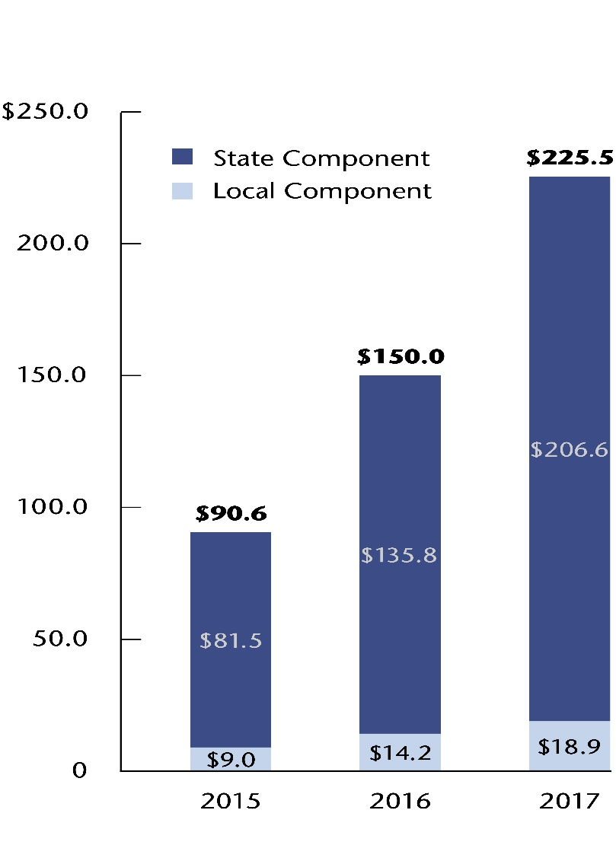
Group Health Insurance Program Reserves

Slide 7
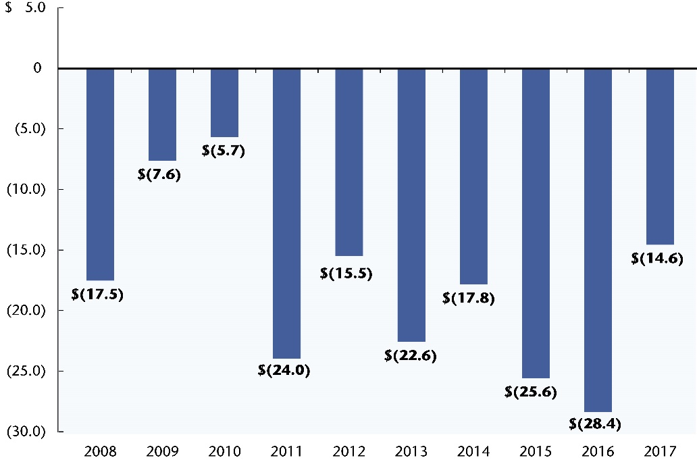
ICI Program Reserves State Component of the Program

Slide 8
Employer Opinions
We surveyed all state agencies and local governments participating in the Group Health Insurance program as of July 2018.
Most state agencies and local governments responding to our survey indicated satisfaction with the program and the assistance ETF provided them.
GIB members were generally satisfied with the timeliness, accuracy, clarity, and completeness of the information ETF provided them.

Slide 9
Improvements to Program Administration
ETF has taken steps to improve its administration of the group insurance programs, including by:
implementing a data warehouse;
ensuring the Group Health Insurance program actuary provides GIB with additional key information; and
setting forth specific financial penalties in contracts with health insurers.

Slide 10
Additional Improvements to Program Administration
ETF should provide GIB with additional information about the performance of program administrators, program actuaries, and auditors.
GIB can use this information to make programmatic decisions.

Slide 11
Recommendations and Issues for Legislative Consideration
We make recommendations for ETF to report to the Joint Legislative Audit Committee by November 22, 2019, on its efforts to improve program administration.
Our report includes three issues for legislative consideration.

